Slide 1
Optional Additional Question

Slide 2
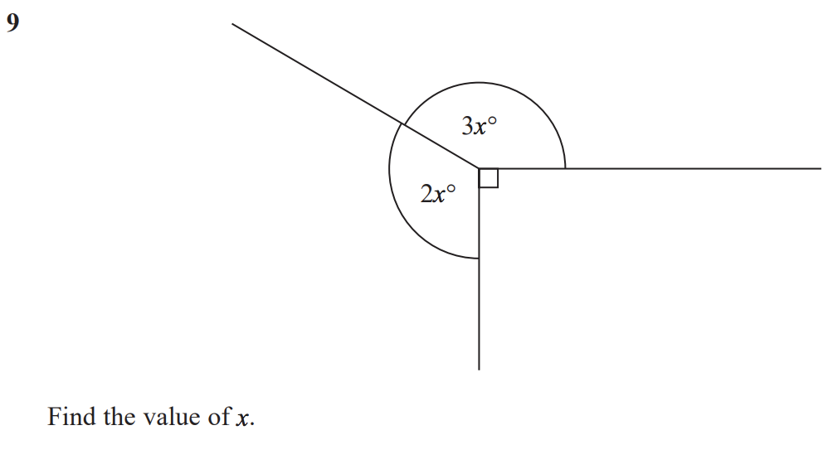
Edexcel, Foundation, Paper 2, June 2017
45.5% got 0 marks
Notes:
What percentage got 0 marks?
15.4% - 1 mark
1.5% - 2 marks
37.6% - 3 marks

Slide 3
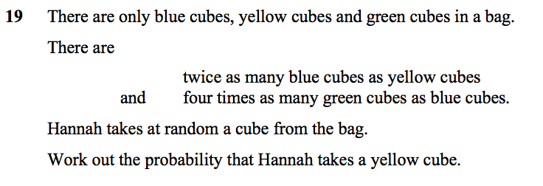
Edexcel, Foundation, Paper 2, November 2017
49.8% got 0 marks
Notes:
1 – 15.7%
2 – 9.7%
3 – 24.8%

Slide 4
Edexcel, Foundation, Paper 3, June 2017
75.1% got 0 marks
Notes:
What percentage got 0 marks?
2.8% - 1 mark
0.7% - 2 marks
0.5% - 3 marks
20.4% - 4 marks

Slide 5
Optional Additional Question 1
Diagram
Answer
Next Question

Slide 6
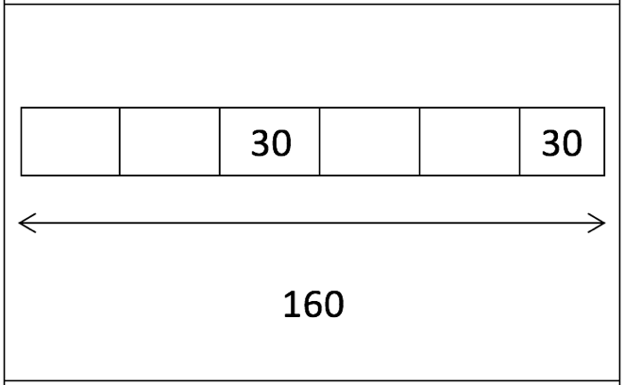
Optional Additional Question 1
Answer
Next Question

Slide 7
Optional Additional Question 1
Length 55cm
Height 25cm
Next Question

Slide 8
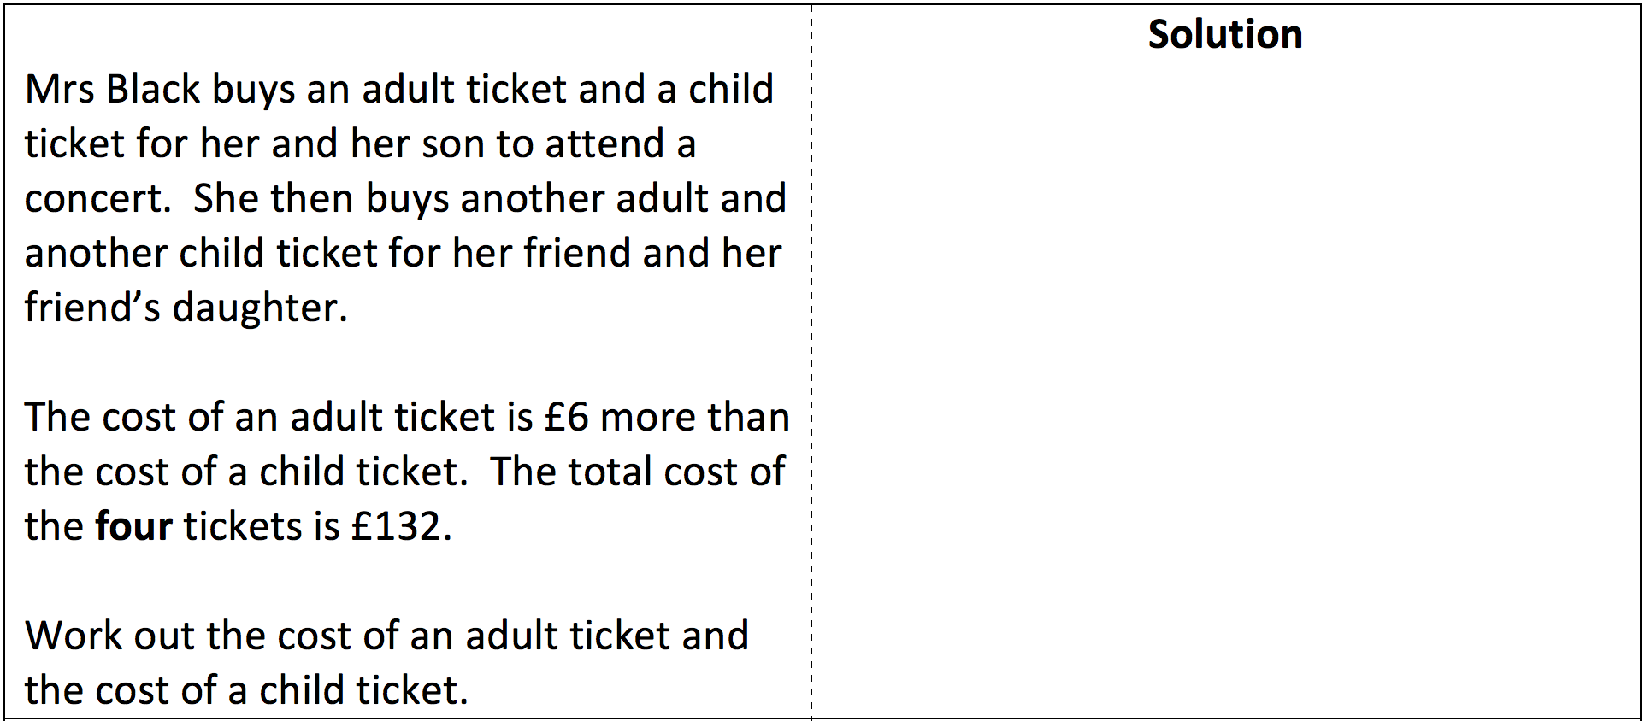
Optional Additional Question 2
Diagram
Answer
Next Question

Slide 9
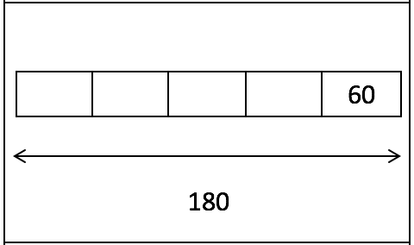
Optional Additional Question 2
Answer
Next Question

Slide 10
Optional Additional Question 2
Adult ticket: £36
Child ticket £30
Next Question

Slide 11
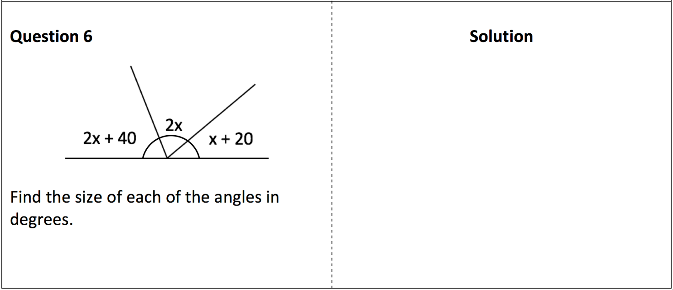
Optional Additional Question 3
Diagram
Answer

Slide 12
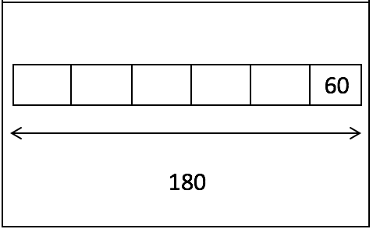
Optional Additional Question 3
Answer

Slide 13
Optional Additional Question 3
48º
88º
44º

