Slide 1
Top Tips!
Maths activities work best when….
…we remember that it’s not just about completing a task – it’s about understanding the mathematics.
…we work together and explain what we are doing.
…we are prepared to say that we don’t understand!

Slide 2
1. Setting the Scene

Slide 3
Fruit and Veg
The World Health Organisation recommends eating 5 portions of fruit or vegetables each day to lower the risk of serious health problems.

Slide 4
Fruit and Veg
7 teachers ate the following number of portions in one day:
0
0
0
1
4
4
5
Mark says: “The average is 0 portions.”
Claire says: “The average is 1 portion.”
Stef says: “The average is 2 portions.”
Who do you agree with and why?
Reason
Reason
Reason
Next

Slide 5
Fruit and Veg
7 teachers ate the following number of portions in one day:
0
0
0
1
4
4
5
Mark says: “The average is 0 portions.”
“This is because 0 is the most common number of portions eaten. We call this the mode.”
Return

Slide 6
Fruit and Veg
7 teachers ate the following number of portions in one day:
0
0
0
1
4
4
5
Claire says: “The average is 1 portion.”
”This is because 1 is in the middle. We call this the median.”
Return

Slide 7
Fruit and Veg
7 teachers ate the following number of portions in one day:
0
2
4
2
2
0
5
1
4
2
0
2
2
2
The total number of portions eaten is 0+0+0+1+4+4+5 = 14
Stef says: “The average is 2 portions.”
“This is found by equally sharing the total number of portions - as if each teacher ate the same amount. This is known as the mean.
The total would still be 2+2+2+2+2+2+2 = 14”
Return

Slide 8
Fruit and Veg
How do we compare to the teachers?
How many portions did you eat yesterday?
Write down a whole number between 0 and 5.
Write your number and initials on the mini-whiteboard.

Slide 9
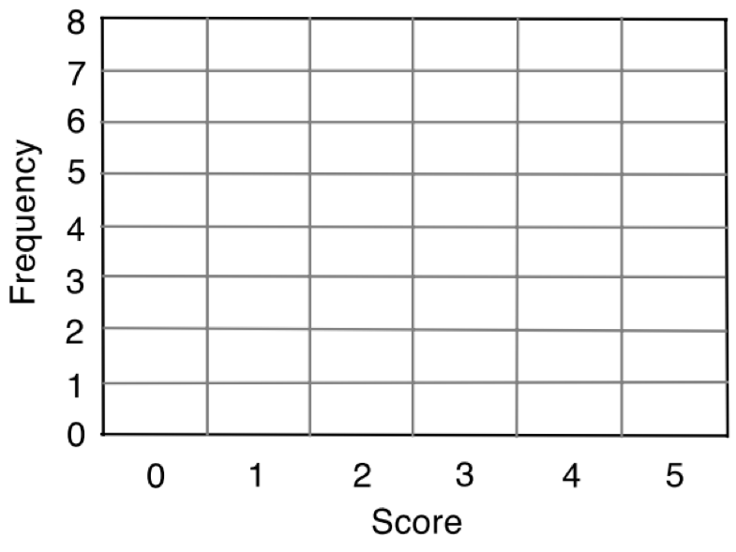
Fruit and Veg
Number of Portions | Frequency
0
1
2
3
4
5
Number of Portions
What is the most common number of portions that people ate?
What is the ‘number of portions’ in the middle?
What would the ‘number of portions’ be if the total number of portions was shared equally?
How many more portions does the person who ate the least need to have to match the person that ate the most?

Slide 10
2. Cards

Slide 11
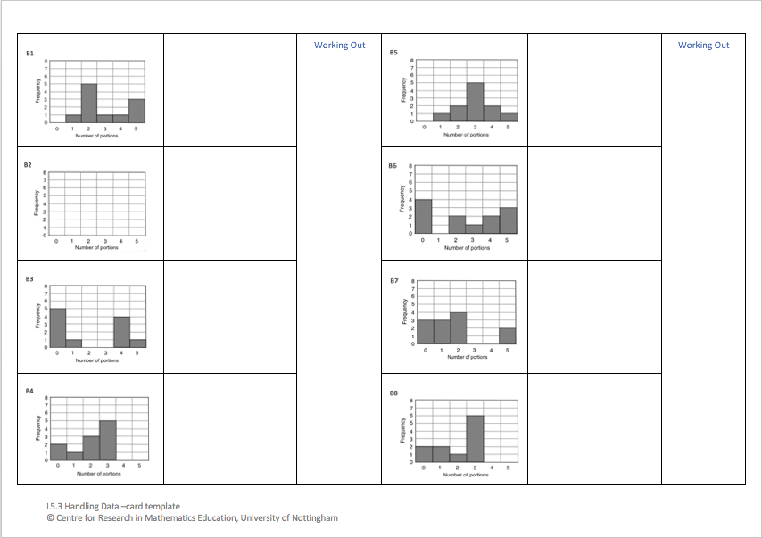
Template
Look at the bar charts.
Which bar chart does our
class bar chart most closely
resemble?
Which bar chart represents a group that is doing the worst at lowering the risk of serious health problems, and why?
Which bar chart represents a group that is doing the best at lowering the risk of serious health problems, and why?

Slide 12
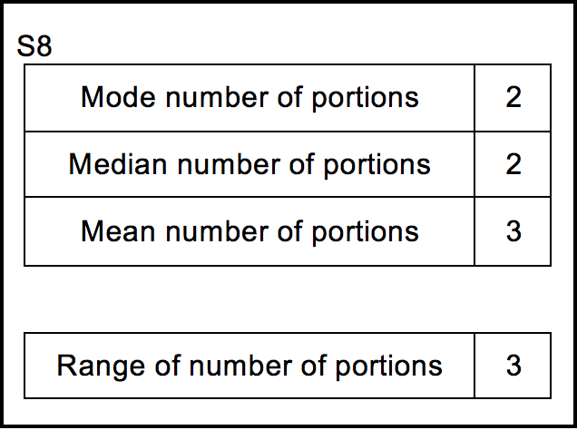
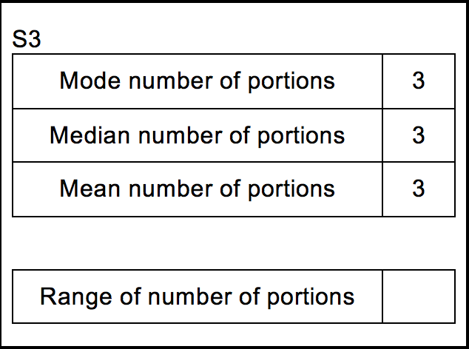
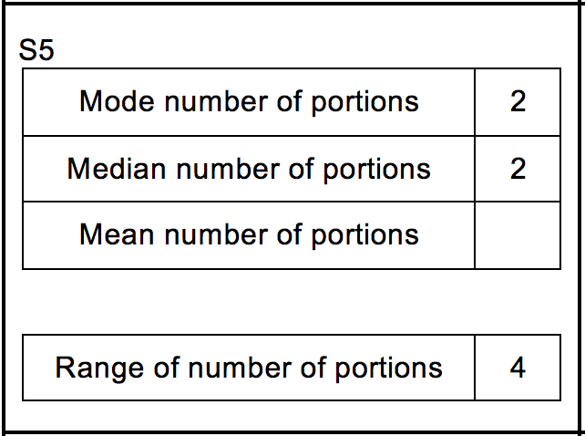
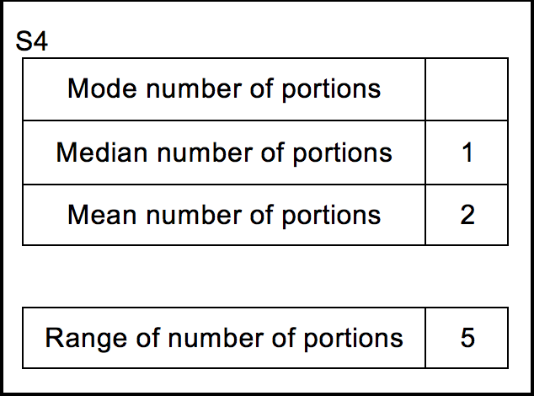
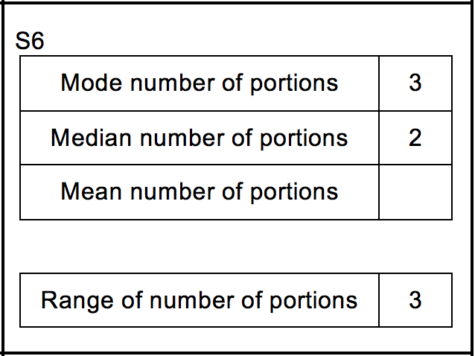
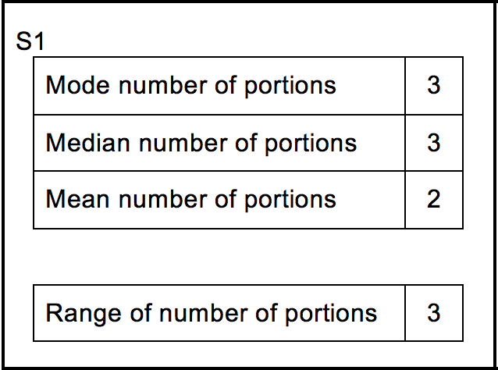
Matching Cards
Take turns to place one of the cards on the template.
Explain your thinking clearly and carefully.
Partners should either agree with the explanation or challenge it if it is unclear.
Some of the statistics tables have gaps in them and one of the bar charts is blank. You will need to complete these cards.
Do the summary statistics help you to decide which group is doing the best and which the worst at lowering the risk of serious health problems?

Slide 13
3. Review

Slide 14
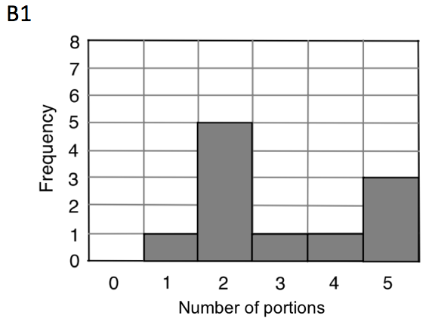
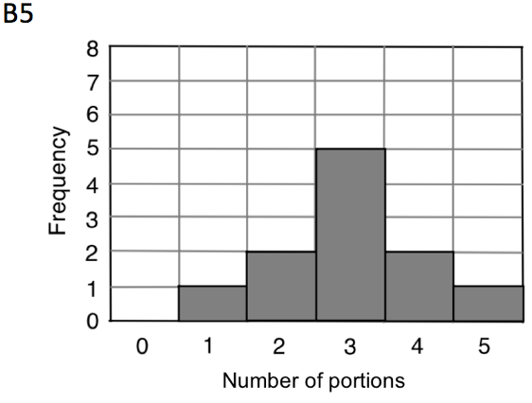
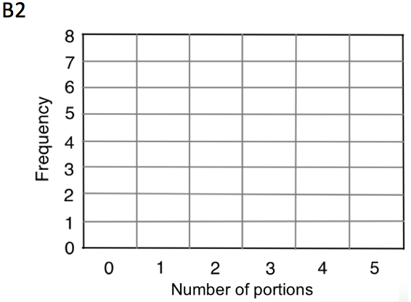
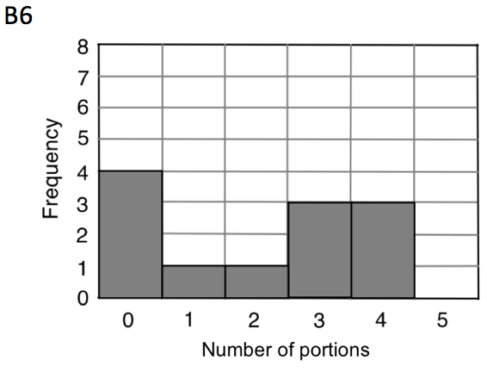
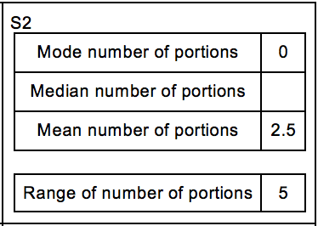
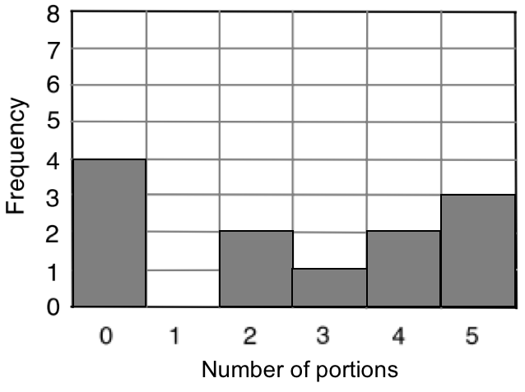
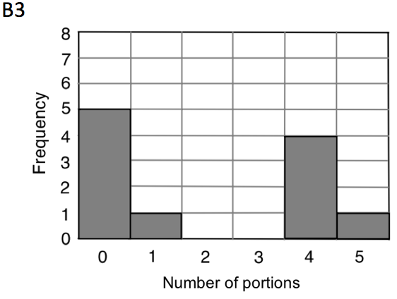
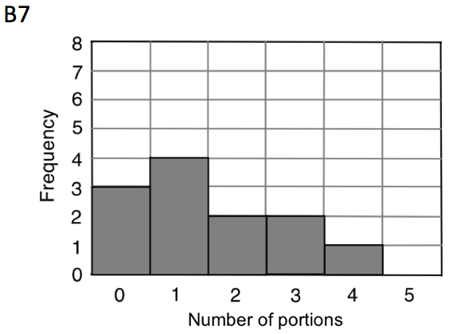
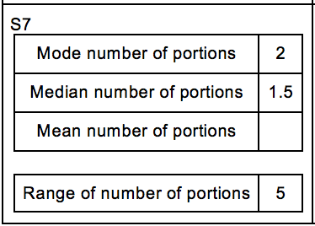
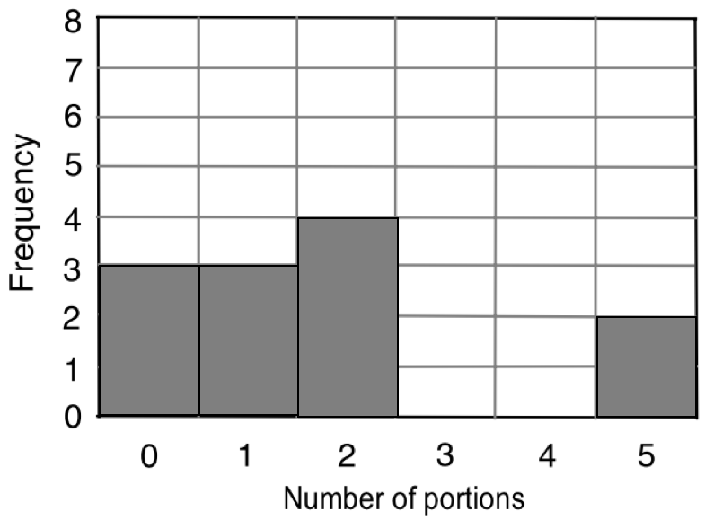
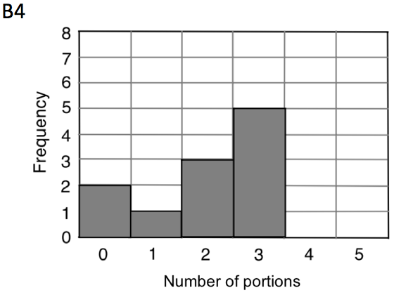
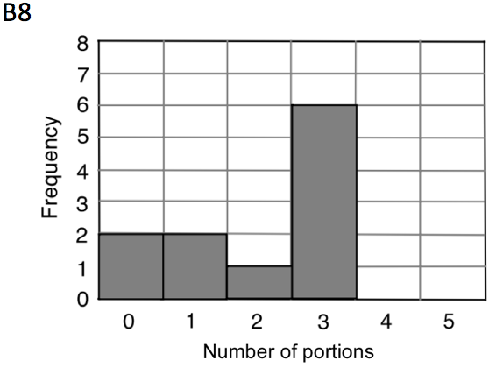
Review

Slide 15
Review
3
4
2.5
0
1.75
2

Slide 16
Possible Solution for Bar Chart B2
2
2
2
2
5
2
5
2
3
5

Slide 17
4. Closure

Slide 18
Closure
Are these statements always true/false or sometimes true/false, and why?
The value of the mode corresponds to an actual event. For example, if the mode is 2 portions then someone actually ate 2 portions.
The value of the mean corresponds to an actual event. For example, if the mean is 2 portions then someone actually ate 2 portions.
The value of the median corresponds to an actual event. For example, if the median is 2 then someone ate 2 portions.

Slide 19
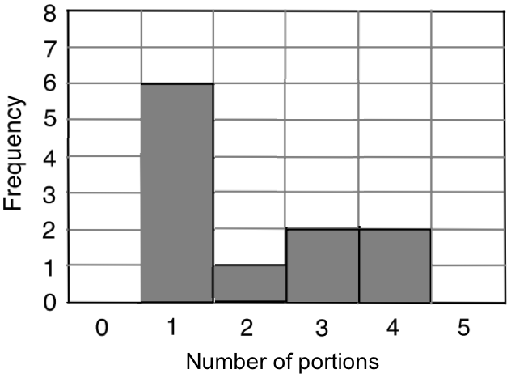
Closure
What would happen to the the bar chart below if everyone represented on it ate 1 more portion each?
Mode number of portions | 1
Median number of portions | 1
Mean number of portions | 2
Range of number of portions | 3
2
2
3
3

Slide 20
Closure
How would the mode, median, mean and range change if everyone represented on the bar chart ate 1 more portion each?
Mode number of portions | 1
Median number of portions | 1
Mean number of portions | 2
Range of number of portions | 3
2
2
3
3

Slide 21
Closure
What would happen if everyone represented on the bar chart below ate 1 less portion each?
Mode number of portions | 1
Median number of portions | 1
Mean number of portions | 2
Range of number of portions | 3
0
0
1
3

Slide 22
5. Extension

Slide 23
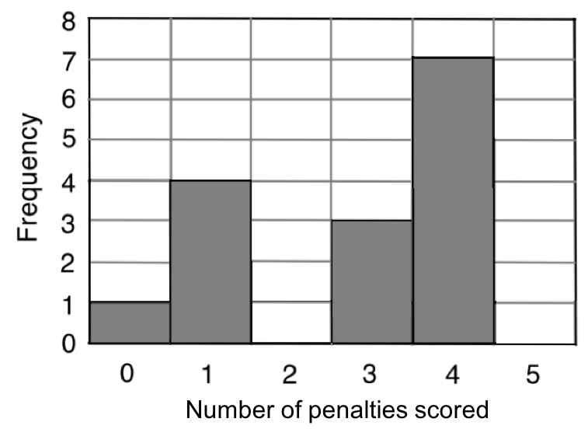
Extension
The bar chart represents the outcome of a penalty shoot-out competition. Each person in the competition was allowed five shots. The graph shows, for example, that four people only scored one penalty with their five shots.
What information can you
provide from this bar chart?

Slide 24
Extension
The bar chart represents the outcome of a penalty shoot-out competition. Each person in the competition was allowed five shots. The graph shows, for example, that four people only scored one penalty with their five shots.
0
1
1
1
1
3
3
3
4
4
4
4
4
4
4

Slide 25
Extension
The bar chart represents the outcome of a penalty shoot-out competition. Each person in the competition was allowed five shots. The graph shows, for example, that four people only scored one penalty with their five shots.
0
1
1
1
1
3
3
3
4
4
4
4
4
4
4

Slide 26
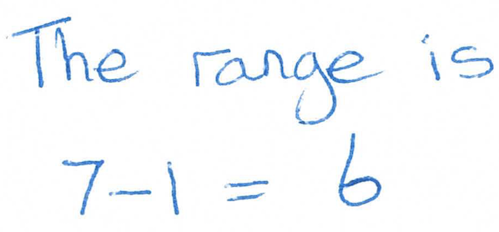
What mistake have they made?
The bar chart represents the outcome of a penalty shoot-out competition. Each person in the competition was allowed five shots. The graph shows, for example, that four people only scored one penalty with their five shots.
What is the range of the number of penalties scored?

Slide 27
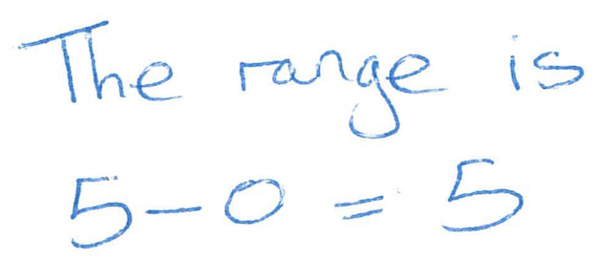
What mistake have they made?
The bar chart represents the outcome of a penalty shoot-out competition. Each person in the competition was allowed five shots. The graph shows, for example, that four people only scored one penalty with their five shots.
What is the range of the number of penalties scored?

Slide 28
What mistake have they made?
The bar chart represents the outcome of a penalty shoot-out competition. Each person in the competition was allowed five shots. The graph shows, for example, that four people only scored one penalty with their five shots.
b) What is the modal value for the number of penalties scored?

Slide 29
What mistake have they made?
The bar chart represents the outcome of a penalty shoot-out competition. Each person in the competition was allowed five shots. The graph shows, for example, that four people only scored one penalty with their five shots.
0
4
9
28
What is the mean number of penalties scored by each person from their five shots?
7
4
4
4
4
1
3
4
Total number of penalties scored = 0 + 4 + 9 + 28
Total number of penalties scored = 41
1
3
4
1
1
3
4
Total number of people = 1 + 4 + 3 + 7
Total number of people = 15
0
1
3
4
Mean number of penalties scored = 41 $÷$ 15
Mean number of penalties scored = 2.73

Slide 30
What mistake have they made?
The bar chart represents the outcome of a penalty shoot-out competition. Each person in the competition was allowed five shots. The graph shows, for example, that four people only scored one penalty with their five shots.
What is the mean number of penalties scored by each person from their five shots?

Slide 31
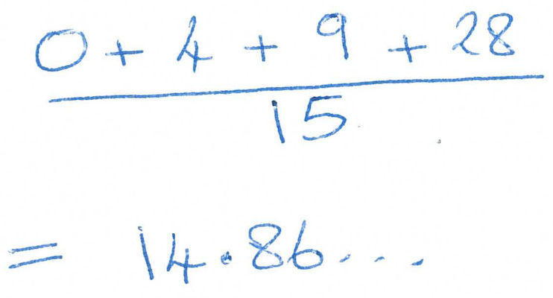
What mistake have they made?
The bar chart represents the outcome of a penalty shoot-out competition. Each person in the competition was allowed five shots. The graph shows, for example, that four people only scored one penalty with their five shots.
What is the mean number of penalties scored by each person from their five shots?

Slide 32
What mistake have they made?
The bar chart represents the outcome of a penalty shoot-out competition. Each person in the competition was allowed five shots. The graph shows, for example, that four people only scored one penalty with their five shots.
Duncan says:
“Half the people scored 4 penalties with their five shots”.
Is Duncan correct? Give a reason for your answer.

