Slide 1
SEDFIT MSTAR
Standard procedure

Slide 2
SEDFIT MSTAR includes the ‘MSTAR’ button on the menu bar
Open SEDFIT MSTAR
Data → Load sedimentation equilibrium data
The data files from Schuck P, Gillis R, Besong D, Almutairi F, Adams G, Rowe A, Harding (2014) Analyst, 139, 79-92 are available for download. This tutorial will use Sim1b (ideal single solute) and NISS1e (very non-ideal single solute) from that paper

Slide 3
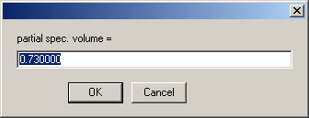
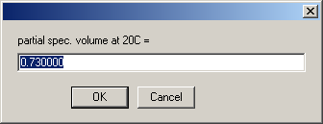
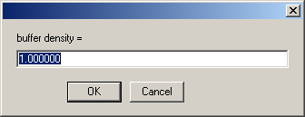
Sim1b:
3. Move red (meniscus) and blue (base) lines to appropriate positions.
The dotted fitting limit lines do not perform any function in this version of SEDFIT so their position does not matter.
Move the green lines to the data in between meniscus and base.
SEDFIT will not allow you to move them too close to the meniscus and base.
Options → Set vbar, rho.
6. Click MSTAR button.
6
5

Slide 4
This is the “MSTAR” page.
Top left: signal vs. r, with green areas shaded for evaluating the missing signal data near the meniscus and extrapolation to base.
Top right: ln(c) vs. r², where c is the signal – baseline (baseline currently set at 0)
Bottom right: dln(c)/dr² vs. signal.
Bottom left: M* vs. r plot, with green area for extrapolation to base.
NB at this stage, the data has not been baseline corrected (including evaluation of the meniscus concentration “Ja”). Before we do anything else, we now explain each of these 4 plots:

Slide 5
The black plot shows the raw data. Limits can be changed in this view like in the normal data plot.
You can manually re-enter the meniscus concentration and override the value from extrapolation.
This green region is the range used to extrapolate the signal to the meniscus. This extrapolation is shown as the red curve segment, with the red cross at the extrapolated value.
Hit the “extrap.” button to undo the manual override. SEDFIT will ask you to select the polynomial order of extrapolation and allow you to change the size of the region.

Slide 6
The green plot is the smoothed raw data. Smoothing can be modified with this button.
The light blue plot is the transformed raw data.
Monodisperse systems show a completely straight line (not shown)
Polydisperse systems curve upwards towards the base (not shown here)
Non-ideal systems curve downwards – a rather extreme example is shown here
The dotted line is the linear regression, from which a ‘ballpark’ weight average molar mass is calculated. Unless the fit perfectly superimposes the data, this number will not be representative.

Slide 7
The graph can also be plotted against radius by toggling this button.
Further smoothing can be changed with this button.
This data is the derivative of the smoothed ln(c) vs. r² plot. Clicking this button will change the derivation method.

Slide 8
The extrapolated value is presented here.
The nature of the M* function means the plot is extrapolated to the base of the cell, accounting for all data preceding. Although real data will appear noisy near the meniscus, this will not matter too much.
The extrapolation is based on the green area. The area can be changed by clicking the “extrap.” button, selecting the polynomial order of extrapolation and changing the region on the c vs. r plot (analogous to the region on the M* plot).

Slide 9
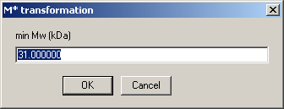
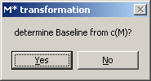
7. Hit the c(M) button so it says “on”:
Set the molecular weight fitting limits. The default is half (lower limit) and double (upper limit) the current estimate.
You will be asked to determine the baseline. Except in exceptional circumstances, you will want to click Yes.
This is a least-squares fit to the raw data performed with a continuous molar mass distribution c(M), according to:
Refer to Schuck et al. 2014 for more details.

Slide 10
The c(M) output gives rmsd, estimated loading concentration (in signal units), weight- and z- average molar mass and standard deviation.
The baseline and Ja values will be estimated from the c(M) fit.
The red fit-line should superimpose onto the black raw data for both the signal vs. r and ln(signal) vs. r² plots.
An estimate for the M* extrapolation based on c(M) will be presented here.
10. Finally press “Esc” on the keyboard to view the c(M) distribution

Slide 11
11. When finished, you can go back to the MSTAR screen.
The red fit line should superimpose the black raw data as much as possible on the c vs. r.
As a general rule, the residuals should not show any patterns. However, in this case the residuals do not go above ±10⁻⁵ fringes. A good fit is ±5x10⁻³ signal for Rayleigh interference.
The c(M) distribution allows you to assess the polydispersity of the system. This is of a much lower resolution than with sedimentation velocity c(s) distributions & components may not always resolve. Non-ideal or noisy data may also not show this distribution very well, but you should still get a good baseline and Ja estimate

Slide 12
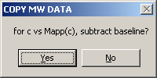
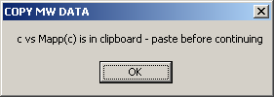
c(M) distribution from the previous slide
The bottom right graph will be copied ‘as-is’, so ensure that the x axis is toggled to either concentration signal or radius, and y axis toggled to preferred derivative method.
For concentration, you will be asked whether to subtract the baseline (Yes).
All graphs are exportable to the clipboard in ASCII format from the “Copy” menu. Just ‘ctrl-v’ in an appropriate spreadsheet/graphing software.
In cases where there is a fit, you will be asked to unload the clipboard of the ‘raw’ data first, then ‘fit’ data.

Slide 13
Other notes
The procedure above was for interference optics. This method will also work for absorbance, but remember to set the green lines to be within the Lambert-Beer law (A<1.4).
If your data goes below 0 fringes, the ln(c) graph will give strange patterns. If it does not change after c(M), transpose your raw data +1, and check that the c(M) ‘notices’ by looking at the calculated baseline.
There are various noise-reduction techniques (overspeeding/presedimenting initial scans/aged cells/higher wavelength). It is suggested that your favoured technique is used before analysing your data with SEDFIT-MSTAR.
For polydisperse systems, keep the rotor speed as low as will allow (reduced molecular weight of 1.5-2.5).
Although polydisperse systems make the ln(c) rise at the base, and non-ideal systems make it lower at the base, a combination of the two would partially cancel each other.
If your system has been identified as very non-ideal, please follow the procedure outlined below.

Slide 14
Summary
Load data
Align meniscus/base/data limits
Set v*rho
Decide system is non-ideal
Initial assessment of data
Non-ideal procedure
c(M)
Export data

Slide 15
SEDFIT MSTAR
Significant non-ideality

Slide 16
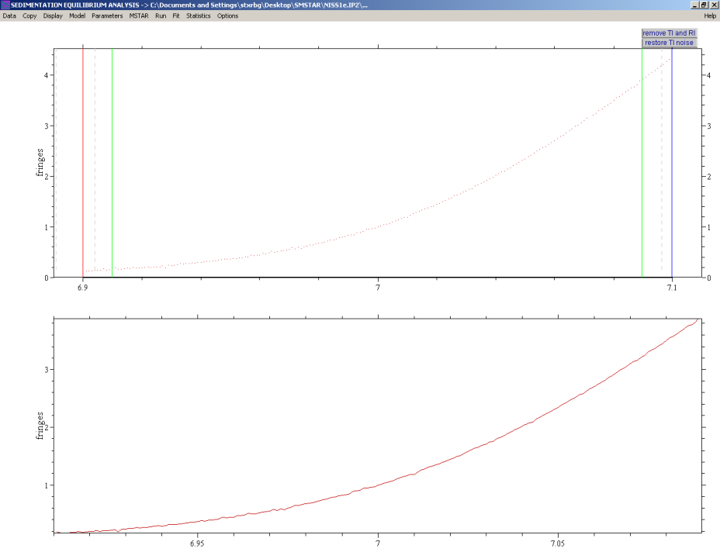
As before, load sedimentation equilibrium data. For this tutorial use NISS1e. This is a simulated single solute with significant non-ideality, also with error.

Slide 17
From the MSTAR screen, there are certain clues of non-ideality:
ln(c) vs. r² bends down towards the base
Mw,app vs c negatively slopes
Turn c(M) on.

Slide 18
Very poor fit on the c vs. r plot.
Little correlation between fit and data on Mw,app vs. c and M* vs. r plots.
Press Esc on keyboard.

Slide 19
Very large residuals with an overall wavey pattern.
Go back to MSTAR and turn c(M) off.

Slide 20
Move the lower green line close to the meniscus as shown.
Turn c(M) back on, and say Yes to determining baseline.

Slide 21
Make a note of the Ja and the baseline.
(in this case: 0.0822, 0.0541)
The rationale behind this is that the non-ideality will be at its lowest near the meniscus as the concentration is lowest.
Turn c(M) back off. The Ja will revert back to extrapolation mode.

Slide 22
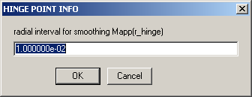
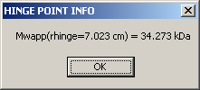
The baseline should stay the same, however manually type in the Ja
(in this case: 0.0822).
Click the extrap. button on the M* plot and select a wider area on the c vs. r plot.
Now click “hinge point info”
Unless you know the loading concentration more precisely, do not manually overide – ‘No’.
‘OK’
NB The Mw,app from the hingepoint is less affected by non-ideality than Mw,app from the M* extrapolation.

Slide 23
Summary
Standard procedure
Decide system is non-ideal
Determine baseline and Ja from highest part of column using c(M)
Manually use MSTAR to extrapolate to base
Export data
Perform hinge point measurement

