Slide 1
Notes:
Welcome to todays event…….
My name is…………..
This session is only for members who joined after 1 April 2015 and have never contributed to the NHS Pension Scheme prior to this date. There are other sessions available for those who have membership prior to this date.

Slide 2



What is the NHS Pension Scheme?
Over 1.7 million actively contributing members
We pay over 1 million pensioners every month
We have approximately 550,000 members with deferred benefits
Notes:
What is the NHS Pension Scheme?
The NHS Pension Scheme is an attractive benefit for those that work extremely hard in the challenging environment of the country’s health service.
It is by far the largest centrally administered public sector pension scheme in Europe.
We currently have over 1.7 million actively contributing members
We pay over 1 million pensioners every month
We have approximately 550,000 members with deferred benefits (this means that the member has left the pension scheme, and isn’t yet claiming their benefits)
The Scheme is open to employees from the NHS and other approved organisations
This Scheme is backed by the Exchequer – which means that your pension comes with a guarantee from the government that you’ll receive it for the rest of your life, no matter how long you live.

Slide 3
Who is eligible to join?
The Scheme is open to any NHS workers aged between 16 and 75 who are:
Directly employed by the NHS
Medical, dental, ophthalmic practitioners or trainees
General medical practice staff
Staff working for certain approved employers
All types of practitioners, locums and non-GP partner
Notes:
Who is eligible to join?
The Scheme is open to any NHS workers aged between 16 and 75 who are:
Directly employed by the NHS including
Medical, dental, ophthalmic practitioners or trainees
General medical practice staff
Staff working for certain approved employers
All types of practitioners, locums and non-GP partner
You can either be working at an NHS employer or an organisation that offers the scheme.
When you join the scheme, it is the responsibility of the employer to provide you with the 2015 scheme guide and you can also access this via the website on the member hub. Which we will show you how to navigate at the end of the presentation.

Slide 4
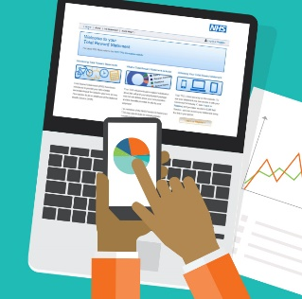
Access to the Scheme
The NHS Pensions Scheme is open to any person whose duties are wholly or mainly administrative, professional, technical or clerical who is employed by a medical school and who -
Must have had eligibility to contribute to the NHS Pensions in 12 months preceding the employment.
Enters employment with a medical school (other than on a change of employer as part of a reorganisation within the National Health Service) while continuing in employment or is within 12 months after leaving a previous employment
Be part of any university that instruction is given to the medical and dental students.
Will be employed as an officer in the employment of an employing authority.

Slide 5
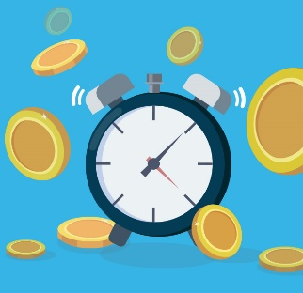
Transfer in
Any pension transferred in will be added to your benefits in the 2015 Pension Scheme.
You must apply to transfer benefits into the Scheme:
within 12 months of becoming eligible to join the Scheme for the first time
before the normal pension age for this Scheme - your state pension age or age 65 if higher
Notes:
If you have another pension, you may be able to apply to transfer it into the NHS Pension Scheme.
Any pension transferred in will be added to your benefits in the 2015 Pension Scheme.
If you are moving from an NHS employer in England and Wales to another, you do not need to apply to transfer, Your NHS Pension Scheme benefits will automatically link.
However, NHS Scotland and HSC Northern Ireland have their own schemes and benefits will not transfer automatically if you move to an NHS employer in England and Wales, so you’ll need to apply for a transfer.
(CLICK)
You must apply to transfer benefits into the Scheme:
within 12 months of becoming eligible to join the Scheme for the first time
before the normal pension age for this Scheme - your state pension age or age 65 if higher
You can view the Transfer in guide and application pack on the member hub, complete the application and provide this to your employer's pension officer.

Slide 6

How does it work?
Whole-time and part-time workers pay a percentage of their gross pensionable salary into their pension each month
This is topped up by your employers' contributions of 20.6%
Member contributions
5.1%-13%
Employer contributions
20.6%
+
You receive tax relief on your contributions
Notes:
The cost of providing the NHS Pension Scheme is shared between members and employers.
(CLICK)
To be a member of the scheme you pay a contribution based on your pensionable earnings; the more you earn, the higher your contribution rate may be.
If you are wondering what pensionable earnings are:
This is the amount of your income that represents your actual earnings for NHS work and is used to calculate the contributions you pay and how much pension you earn each year.
This is usually your salary, wages, fees and any other regular payments.
If your pay goes down in any Scheme year, for example you change to a lower paid job, then the amount of pension you will earn in that year will be less than previous years and your contributions would be lower. More information about what counts as pensionable earnings can be found on our website.
(CLICK)
Your contributions are then topped up by employer contributions, who currently contribute 20.6%
(CLICK)
Prior to 1 October 2022 If you were part time your rate was based on your full-time equivalent pensionable pay, this has now changed, and part time staff now pay pension contributions based on their actual part time pay.
Your contributions would range between 5.1% - 13% depending on your earnings.
(CLICK)
Pension contributions are taken from your pay before tax, so you receive tax relief on any amount you pay.

Slide 7

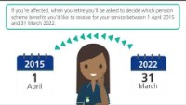
Changes to public sector pension schemes - video
Notes:
We are now going to play you a short video about the changes to the public sector pension schemes. This is also known as the McCloud Judgement.
This only affects members that were in the NHS Pension Scheme on or before 31st March 2012. If you joined after this date you are not affected and this video will not relate to you.
(PLAY VIDEO)
The video we just watched explained what is happening with the McCloud judgement. And just to remind you if you joined the NHS Pension scheme for the first time after the 31st March 2012, this does not affect you.
Anyone that has membership in the scheme between the 1st April 2015 and 31st March 2022 (known as the remedy period) will be given the option to decide which scheme they want their pension to be in for this period. This choice is made at retirement.
If you retire before then, you will retrospectively be asked to make the choice and will be paid any backdated monies owed.

Slide 8


NHS Pension Schemes
Previous Scheme
(1995/2008 sections)
ALL members now contribute to the 2015 Scheme
Notes:
We want to make you aware that there are two separate pension schemes covering NHS workers – the 1995/2008 Scheme and the 2015 Scheme. The 1995/2008 Scheme is now closed to new members and existing members.
(CLICK)
On 1 April 2015 a new NHS Pension Scheme was introduced. New members joining on or after 1 April 2015 automatically join the 2015 Scheme.
You may hear your colleagues talking about their pension in the other schemes, but if you joined the NHS Pension after or on the 1st April 2015, you will be in the 2015 Scheme only.

Slide 9

Benefits in the 2015 Scheme
The 2015 Scheme is a Career Average Revalued Earnings (CARE) scheme
Your pension is 1/54th of your pensionable earnings per Scheme year and is revalued by an amount set by the Treasury (T order) each year +1.5% (revaluation figure)
There is no automatic lump sum at retirement – there is an option to create your own lump sum
Notes:
The 2015 Scheme is a Career Average Revalued Earnings Scheme, known as a CARE scheme.
In this scheme your pension is 1/54th of your pensionable earnings per scheme year. This is then revalued by an amount set by the Treasury (known as a treasury order) each year, plus 1.5%. This is process is known as revaluation.
The amount of contributions you pay does not make up your pension. This is the cost of being in the scheme, it is almost like paying a “membership”. The pension earnt is 1/5th of your pensionable earnings.
If you leave this Scheme before becoming entitled to claim your retirement benefits, annual revaluation stops and is replaced at retirement by the addition of Pensions Increase. Pensions Increase is used to maintain the value of your pension against rises in the cost of living.
The 2015 scheme does not have an automatic lump sum. Members have the option to exchange some of their annual pension in exchange for a lump sum that is normally tax free, this will be shown on your Annual Benefit Statement.
We are now going to show you how your pension pots are built and grow over time.

Slide 10
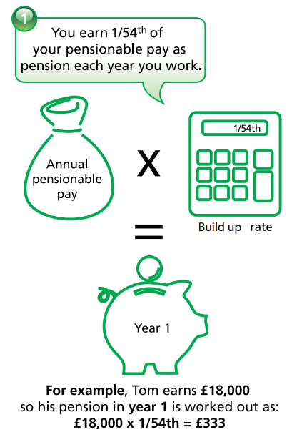
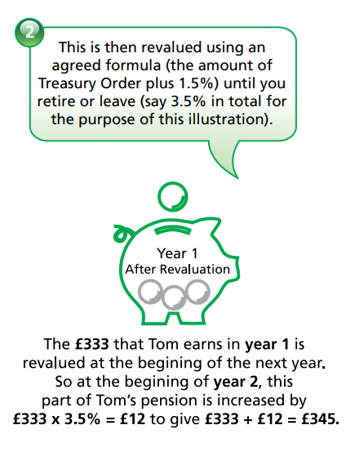

Benefits in the 2015 Scheme
Notes:
In this example, we are going to follow Tom, (CLICK)
to see how his pension grows over his 20 year career within the NHS.
As explained before, your pension earned each year, is 1/54th of your pensionable pay. In year one of employment, Tom earns £18,000, so his pension pot for that year is one 54th of this amount. Therefore his pot is £333.
(CLICK)
This pot is then revalued using the treasury order plus the 1.5%, meaning Toms year one pot would increase to £345 in year two.

Slide 11
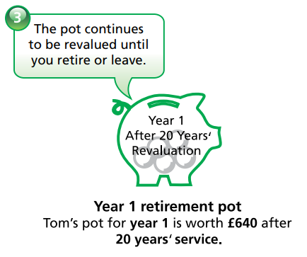
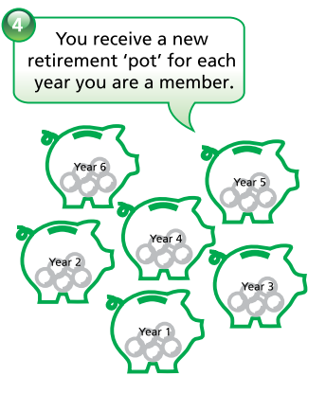
Benefits in the 2015 Scheme
Notes:
Toms year one pot will continue to be revalued every year until Tom decides to leave or retire. So after 20 years service, Toms year one pot is now worth £640.
(CLICK)
You will receive a new retirement pot, one for each year that you work and contribute as an active member. Therefore by the time Tom reaches 20 years service, he will have 20 pension pots, one for each year.
All of Tom’s pots that have been earnt each year go through the same revaluation process. They are all revalued annually and continue to do so until retirement, or if you chose to leave the scheme.

Slide 12
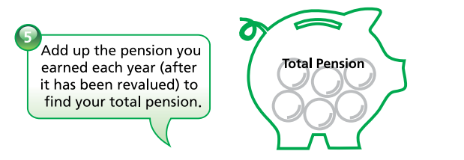
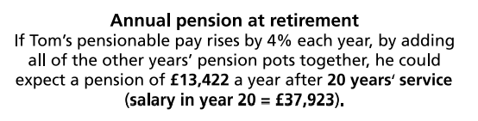
Benefits in the 2015 Scheme
Notes:
For Tom to work out his total pension, he would add up the total of all of his 20 pots. One for each year that he has worked.
For example purposes, if Tom’s pensionable pay increased by 4% each year, and by adding all the pots together that he had earnt, after 20 years service Tom would receive a pension of £13,422.

Slide 13
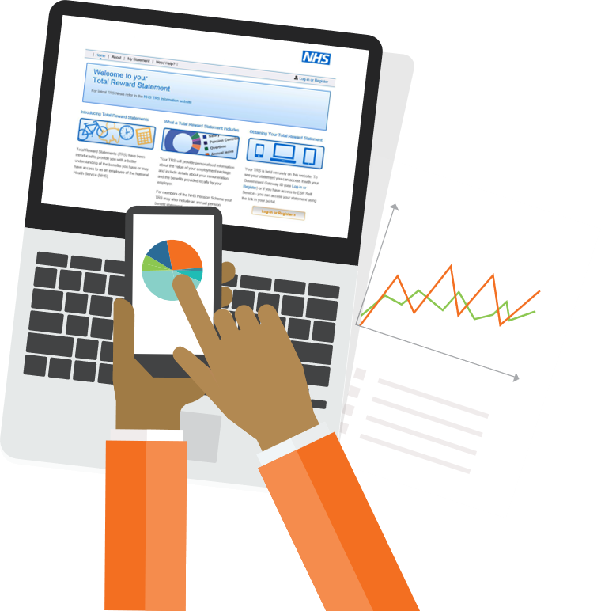

Lump Sum – Commutation
There is no automatic lump sum on retirement in the 2015 scheme.
You do have the option to exchange some of your annual pension for a lump sum, this is called pension commutation
For every £1 a year of your annual pension you exchange you receive a £12 lump sum
Notes:
Increasing your lump sum is also known as pension commutation.
There is no automatic lump sum on retirement in the 2015 scheme, but you can create one and It is your decision to do this. This choice is made at retirement.
To do this you would exchange some of your annual pension for a lump sum.
(CLICK)
For every pound of your annual pension you exchange, you receive a £12 lump sum.
For example, if you exchanged £1000 from your annual pension, you would receive a £12,000 lump sum on retirement.
There is a maximum permitted lump sum that you can take, and this is shown on your annual benefit statement.
The amount of tax-free lump sum you can take is governed by a limit set by HMRC and Tax implications are subject to your individual circumstances.

Slide 14
When can I claim my NHS Pension?
The normal pension age is the age that you can retire from NHS employment and have your pension paid without a reduction.
The normal pension age is State Pension Age (or age 65 if that is later)
Normal Pension age | Minimum Pension Age | Maximum Pension Age
State pension age or age 65 if that is later | Age 55* | Age 75
Notes:
Your normal pension age, is the age that you can retire from your employment, and have your pension paid without a reduction.
(CLICK)
For this scheme, the normal pension age is state pension age or age 65, whichever age is later. Everyone has a state pension retirement age that is individual to them depending on their date of birth. You can check what your state pension age is on the gov.uk website.
(CLICK)
You may choose to retire before your normal pension age, but to claim your benefits this can be no earlier than the minimum pension age which is currently 55 (however this is set to rise to 57 from 06/04/2028)
If you claim your NHS Pension benefits prior to the normal pension age they will be reduced as they are being paid early and will be in payment for a longer period.
(CLICK)
The maximum pension age is 75.

Slide 15
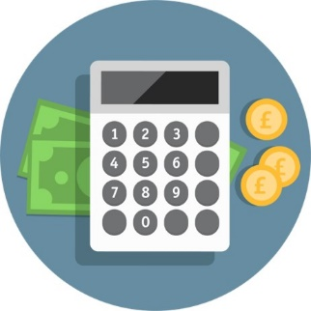
Options to Increase Your Pension
There are a number of ways to increase your benefits:
Additional Pensions (AP)
Early Retirement Reduction Buy Out (ERRBO)
Money Purchase Added Voluntary Contributions (MPAVC)
Stakeholder Pension
Notes:
There are a number ways to increase your NHS Pension benefits
(CLICK x4)
We are going to talk through the main two AP & ERRBO in more detail, and information on the other 2 less popular options can be found on the NHS Pension website.
Additional Pension is where you can choose to buy a set amount of annual pension
You pay for this in either a lump sum payment, or by regular contributions deducted from your pay for an agreed amount.
The cost of buying additional pension is the same whether you work full or part time.
You can buy additional pension to increase your own pension benefits only, or include dependants cover that increases your pension and the benefits payable to your spouse, partner or dependent child. The additional pension does not include an automatic lump sum but can be used to make a lump sum as we mentioned earlier.
There is a calculator on our website which you can use to calculate how much you can buy and it will show you how much this would cost.
(Note, if asked the calculator does not work it is because you cannot currently access on your work place systems).
Early Retirement Reduction Buy Out, also known as an ERRBO, is a feature of the 2015 scheme only, and allows you to reduce your normal retirement age by up to 3 years, but this can be no lower than age 65.
For example, if you have a retirement age of 68, you could buy out 3 years, meaning you could retire at age 65. However, if your retirement age is 66, you could only buy out one year, meaning you could retire at 65.
If you have a state pension age of 66 and 3 months for example, you can buy out the 1 year and 3 months or just the 3 months.
(CLICK)
You will pay additional monthly contributions, and these are paid as a percentage of your monthly wage.
The rate of the additional contributions are depending on your age at the date the agreement is accepted and how much the ERRBO will cost depends on how long the agreement would be in place for.
(CLICK)
An application must be made within 3 months of joining the scheme or would need to be at the beginning of the next scheme year which is April 1st to June 30th.
(CLICK)
The payments are taken once the agreement is in place and will continue until retirement, you cancel the agreement, or you leave the scheme.
The agreement can be suspended on hardship grounds only for up to one year, if contributions are not paid after one year, the contract will be terminated.
Also If you have a break in pensionable service of five years or less, an ERRBO will automatically recommence on the same agreement.
However, if there is a break in pensionable service of more than five years, the ERRBO agreement is terminated.
You can choose to terminate the agreement at any time, however once stopped, you cannot enter a new ERRBO arrangement.

Slide 16

Nominations
You can nominate someone to receive a lump sum on death benefit using the nomination forms.
DB2 - Death Benefit nomination
You can nominate as many individuals as you want, or ONE organisation
If you are not married or in a civil partnership, you may be able to nominate a partner to receive an adult dependant’s pension using a separate form.
PN1 - Partner nomination
NOM1 - Cancel an existing nomination
Notes:
In the event of your death, the NHS Pension Scheme may provide benefits for your family or a person you have nominated.
You can nominate someone to receive a lump sum on death payment using the relevant nomination form.
CLICK
DB2 - Form for the Death Benefit nomination.
You can nominate as many individuals as you want, or ONE organisation. There is no age limit on the nomination, so you could choose to nominate your child or children, and it doesn’t need to be a family member.
If you wish to amend an existing nomination you must submit a new DB2 nomination form, Any existing nomination will be replaced with your new instructions.
CLICK
PN1 - To nominate a partner to receive an adult dependant’s pension after your death
If you have a partner, but are not married or in a civil partnership, you may be able to nominate them to receive an adult dependant’s pension using a separate form.
This is then payable for the rest of their life.
If you are married or in a civil partnership then there is no need to make a nomination for this person.
CLICK
You can also cancel a previous nomination using the NOM1 form.
This will cancel an existing nomination completely, however if you haven’t completed a new DB2 or PN1 then a nomination wont be present on your record.

Slide 17
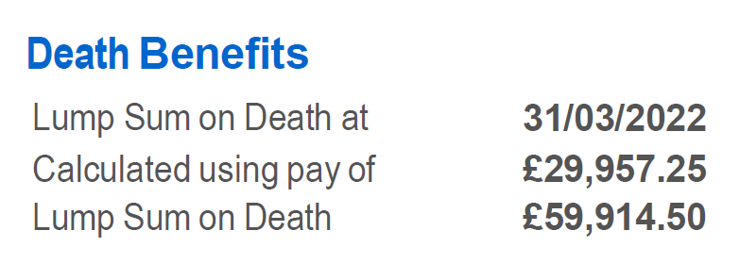
NHS Pension Scheme Life Assurance Lump Sum
Lump sum on death benefit:
When in pensionable employment, usually twice your actual pensionable earnings
Automatically paid to your spouse or registered civil partner – NO nomination required
Nominate your non-legal partner if you want to ensure they receive your benefits
Notes:
Following on from the nominations; The NHS Pension Scheme provides pension and lump sum benefits to your eligible dependants in the event of your death.
You are automatically covered by the Scheme’s life assurance benefits from the day you join, until the day you opt out, leave and also following your retirement.
(CLICK)
The lump sum payable when in pensionable employment is usually twice your actual pensionable earnings, but there are variations depending on what type of member you are.
The example shown on the screen is a member with an annual salary of £29,957.25 so will be entitled to a death in service payment of twice this amount. And remember if you have opted out of the scheme this payment is no longer applicable.
(CLICK)
Your lump sum will automatically be paid to your spouse, registered civil partner or nominated partner.
However, if you wish for this to go to a non-legal partner (married/civil partnership) or someone else, you will need to make a nomination as we’ve just discussed.
If you are not married, not in a civil partnership or do not have any nominations, any lump sum will be paid directly into your estate.

Slide 18

NHS Pension Scheme Life Assurance & Family Benefits
Adult Dependent’s pension:
Payable in the event of an active, deferred, or pensioner scheme member
Can be paid to a legal spouse, a registered civil partner or a qualifying scheme partner
Payable for life
Children’s pension:
Under the age of 23-years-old
Aged 23-years-old or over but unable to earn a living due to a permanent physical or mental condition which they were suffering from at the time of your death
Notes:
An adult dependent’s pension is payable in the event of the death of an active, deferred or pensioner member.
(CLICK)
This again can be paid to a legal spouse, a registered civil partner or nominated partner.
And as per the previous slide you do not need to nominate if you are married or in a civil partnership.
(CLICK)
The adult dependant’s pension is payable for life, even if they remarry or begin living with someone as their spouse or civil partner.
(CLICK)
The children’s pension payable can be paid to anyone caring for the children, or to the children themselves.
The amount of pension payable depends on the number of eligible dependent children and if there is a surviving parent who qualifies for the adult dependant’s pension.
A dependent child is someone who is dependent on you, and is:
(CLICK)
Under the age of 23
(CLICK)
OR aged 23 over but they are unable to earn a living due to a permanent physical or mental condition which they were suffering from at the time of your death.
A dependent child may include a natural or adopted child, stepchild, child of your partner, grandchild, nephew or niece and eligibility conditions apply which will be checked at the point of application.
The amount received for all death benefits will depend on your individual circumstances at the time of your death.
Within the 2015 scheme guide you will find a table which shows what benefits are payable depending on your membership status.

Slide 19
Transfer out
If you want to transfer to another UK scheme, read and complete the transfer out guide and application pack.
Your employer should fill in a cash equivalent transfer value form if:
you’re an active member
you left in the past year
This is then for you to return with your transfer application pack.
Notes:
If you opt out or leave the Scheme and don’t not want to take a refund or have exceeded 2 years membership, we may be able to transfer your pension benefits to another approved provider.
If you want to transfer to another UK scheme, read and complete the transfer out guide and application pack
CLICK
Your employer should fill in a cash equivalent transfer value form if:
you’re an active member
you left in the past year
This is then for you to return with your transfer application pack.
NHS Pensions will then produce a cash equivalent transfer value for you to provide to the receiving scheme.

Slide 20

What does the NHS Pension Scheme provide?
Maternity, Paternity, Parental and Adoption pay
Ill-health benefits (subject to qualifying criteria)
Flexibility of when you take your benefits
Premature retirement
Retirement benefits
Cost of living increase
Notes:
Your pension membership provides lots of other benefits we haven’t discussed in detail today including:
(CLICK)
A member can continue to be pensionable throughout any period of absence for maternity, paternity, parental or adoption. This is referred to as ‘special leave’. Your employer must provide you with the necessary information about pension arrangements before you start any special leave for maternity, paternity, parental or adoption leave.
(CLICK)
Ill health benefits – You may be entitled to an Ill health retirement pension if you become too ill to work. This is subject to qualifying criteria.
(CLICK)
Flexibility so that If you don't want to work until your normal pension age or choose to work before or beyond this age, the NHS Pension Scheme is flexible to allow you to do this. But bear in mind that if you retire before the normal retirement age your benefits will be reduced.
(CLICK)
Premature retirement options are available if you are made redundant and are over minimum pension age, to claim your pension under redundancy grounds.
(CLICK)
Retirement benefits – we’ve explained how these are calculated and you can find more information and examples in our Scheme member guides on our website
(CLICK)
Cost of living increase - Once your pension benefits are payable, your pension will be subject to an increase each year.

Slide 21

Benefits of the Scheme Video
Notes:
There’s many benefits to the Scheme, We’ve got a short video to play.
The video covers a lot of topics, and we are now going to cover these in more detail.

Slide 22
NHS Pension Scheme flexibilities
In December 2022, the Department of Health and Social Care (DHSC) proposed changes to the NHS Pension Scheme to give members more flexibility around retirement.
Some of the changes took effect on 1 April 2023 and some took effect on 1 October 2023.
  The changes support staff to flexibly retire and continue to build up benefits whilst working.
  They also enable those who have already retired to build up new benefits in the 2015 Scheme.
  If you’re affected by annual allowance charges, the changes could help you to manage your pension tax position.
Notes:
Some background to start off with…..
Last year the Department of Health & Social Care announced some proposed changes to the NHS Pension Scheme, to increase members options regarding flexible retirement.
The proposals were accepted, and the first change happened on 1 April 2023. This allowed members who had claimed their 1995 scheme pension benefits to rejoin the 2015 section of the scheme following their retirement, however those with maximum membership and no longer contributing to the Scheme were not allowed to re-join from 1 April 2023. For these members they can re-join from 1 October 2023 and do not have to claim their pension before doing so.
Previously the option to rejoin the 2015 NHS Pensions Scheme once you had claimed your pension benefits was only available to members who retired with 2008 and or 2015 scheme pension benefits.
The second change was to allow more flexibility around partial retirement (or drawdown as it is also known) from 1 October 2023, members with 1995 scheme benefits can also apply for partial retirement, subject to the criteria being met. This presentation will explain this updated process in more detail, including the application process.
And finally, changes were made to Annual Allowance and Lifetime Allowance thresholds. Further details on these changes can be on our website here: Annual allowance | NHSBSA

Slide 23
Changes from 1 April 2023 – retire and rejoin
You can take your full 1995 Section pension, then return to work and re-join the 2015 NHS Pension Scheme to earn further benefits.
If you take age related retirement or early retirement and return to work, your pension payments won’t be reduced or stopped (known as ‘abatement’).
If you decide to re-join the NHS, you can work as many hours as you choose straightaway.
If you have reached maximum service of 45 years in the 1995 Section or 2008 Section of the Scheme, you can return and rejoin the Scheme in the 2015 Scheme from 1 October 2023 as long as you’re under the age of 75.
For more information, please visit our website
Notes:
You can now take your full 1995 section pension benefits, return to work and rejoin the 2015 NHS Pension Scheme however you must have at least a 24 hour break required If you are fully retiring.
I don’t think this applies to anyone working for the BSA but if you’re a Special Class or Mental Health Officer member and take your pension at age 55, but return to work before you reach age 60, the requirement for your post-retirement pay plus pension to be less than your pre-retirement earnings will be suspended until 31 March 2025.
You can read more about abatement and the circumstances where it may still apply at nhsbsa.nhs.uk/nhs-pension-retirement-flexibilities
previously, members of the 1995 Section were limited to working 16 hours a week in the first month after retirement to avoid their pension payments being affected. As long as you have had a break of 24 hours from your previous job, you can move to a new employment contract and start building 2015 benefits immediately.
If you have reached maximum service of 45 years in the 1995 Section or 2008 Section of the Scheme, you can return and rejoin the Scheme in the 2015 Scheme from 1 October 2023 as long as you’re under the age of 75.

Slide 24
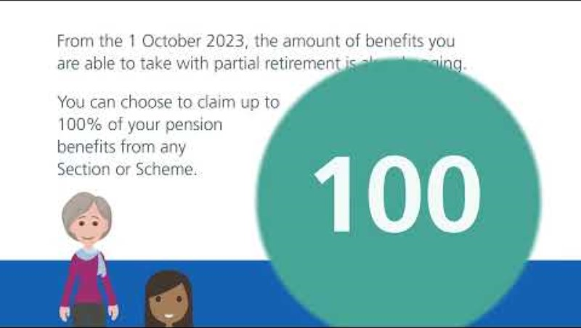

Slide 25
Recap of your steps for applying for partial retirement
1 | Talk to your HR team about new working arrangements that mean reducing your pensionable pay by at least 10% for the 12 months after taking partial retirement.
2 | Use the Partial Retirement Calculator to decide what percentage of pension to take. If you’re affected by McCloud and can’t wait until then, use the McCloud Percentage Tool.
3 | Ask your employer for the AW8 Retirement Benefits Claim Form and start your retirement application.
4 | Complete the AW8 Partial Retirement Supplement Form – attach it to your completed AW8 and send it to your employer to finalise their sections and forward your application to us for processing.
5 | Start your new partial retirement working arrangement, take some of the pension benefits you’ve already built up and continue to add to your pension in the 2015 Scheme.
Notes:
Recap the steps,
We must keep advising that it is your responsibility, as the member, to monitor that reduction in pay of 10% or you could end up on a position where abatement applies, and you may have to repay any pension paid to you. Remember you must get the agreement from your employment that allows you to achieve that 10% reduction before completing any application forms.

Slide 26
Partial Retirement – The McCloud ruling
Your pensionable service for the McCloud remedy period - 1 April 2015 to 31 March 2022 – was put back into the 1995/2008 Section of the Scheme on 1 October 2023.
If this affects you and you take partial retirement, you’ll be contacted in the 12 months after you’ve partially retired and asked to choose between keeping these benefits in the 1995/2008 Section or taking equivalent 2015 Scheme benefits for the remedy period instead.
Your McCloud choice could affect your tax position or final salary link. If you later choose to take 2015 Scheme benefits for the remedy period, you may have overpayments to pay back.
You can read more about McCloud and if you’re affected on our website www.nhsbsa.nhs.uk/changes-public-service-pensions
Notes:
When it comes to making this choice, the part of the Scheme that’s better for you could be different depending on how long you continue to work after you’ve taken partial retirement.
An interim calculator tool called the McCloud Percentage tool has been developed, to help members who are affected by McCloud but want to look into partial retirement. We will look into this more on the next slide.

Slide 27
Partial Retirement – The McCloud ruling continued
If you are affected by McCloud, the McCloud Percentage Tool is available on our website
It allows you to see what percentage of pension you could take to avoid having overpayments to repay, when you make your McCloud choice later on.
To use it you’ll need to know the membership that’s been used to calculate your pension benefits. This is called your pensionable service or reckonable service depending on the Section of the Scheme.
You can find this on your Annual Benefit Statement (ABS) or Total Reward Statement (TRS) or ask your employer.
Notes:
If you are affected by McCloud, the McCloud Percentage Tool is available.
It allows you to see what percentage of pension you could take to avoid having overpayments to repay, when you make your McCloud choice later on.
To use it you’ll need to know the membership that’s been used to calculate your pension benefits. This is called your pensionable service or reckonable service depending on the Section of the Scheme. And this can be found on your Total Reward or Annual Benefit statement.
Annual Benefit Statements (ABS) and Total Reward Statements (TRS) are updated each year in August, usually to the end of the most recent financial year. For example, the statements that were made available in August this year should be updated to March 2023
If you were a fully protected member for McCloud, you can use the percentage from this tool and your ABS or TRS statement to estimate the percentage you can take to avoid having and overpayment. If you were not a fully protected member and moved to the 2015 Scheme before 1 April 2022, use the Partial Retirement Member Estimate form which is on the getting an estimate of your pension webpage on our website and we’ll produce an estimate for you.
Member partial retirement estimate request form (nhsbsa.nhs.uk)

Slide 28
How can I track what my pension is worth?
Each year we update your pension record using information from your employer
We provide you with either a Total Reward Statement or an Annual Benefit Statement
You can access your statement via ESR or via My NHS Pension
Find out more at:
www.nhsbsa.nhs.uk/total-reward-statements
or email nhsbsa.mynhspension@nhsbsa.nhs.uk
Notes:
It’s really important to keep track of your pension and it’s never too early to start planning for retirement.
Each year your pensions record is updated to the 31 March from information sent to us by your employer, we then use this information to provide active and deferred members with a statement.
Depending on your circumstances, you’ll receive either a Total Reward Statement or an Annual Benefit Statement.
You will be able to view your statement through the online Electronic Staff Records (ESR) which is a payroll system used by certain employers.
If you do not have access to ESR you should have received an invitation to register for My NHS Pension.
Once registered you will be able to view your annual benefits statement.
If you have not received an invitation you can contact us on nhsbsa.mynhspension@nhsbsa.nhs.uk
One of my colleagues will add this email address into the Q&A and the email address is shown on the slide.
We have a total reward and annual benefit statement online session available for members.
If you would like further information on your annual benefit statements and how to access this, then this presentation is recommended for you.

Slide 30
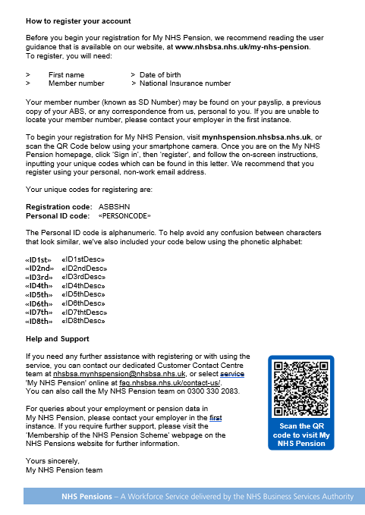
Registration process – example letter
Notes:
All members who are currently actively contributing (including Active pensioners) to the NHS Pension Scheme in your organisation, will be contacted via their postal address that we hold on our systems.
If they are a deferred member they will need to contact us directly at nhsbsa.mynhspension@nhsbsa.nhs.uk to receive their registration codes.

Slide 31
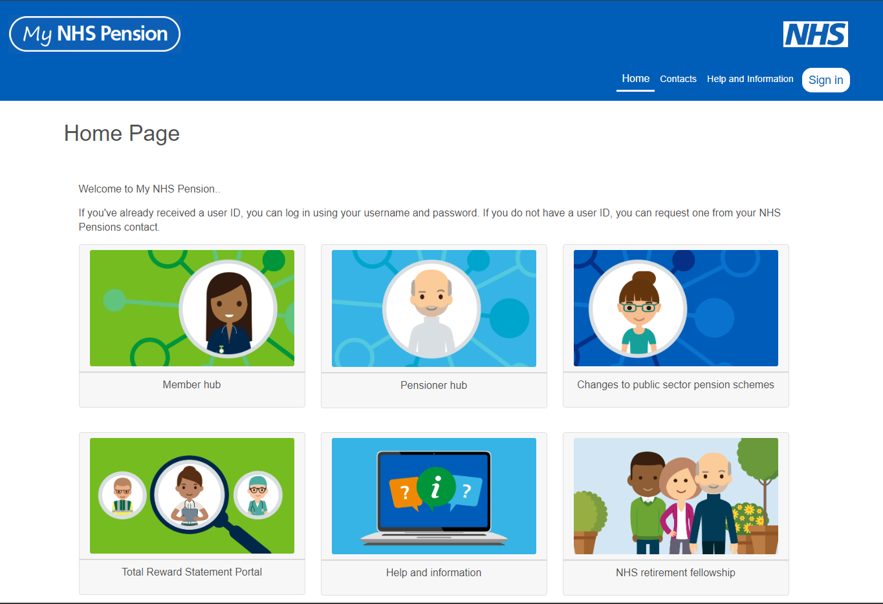
Step 1 - How to register

Slide 32
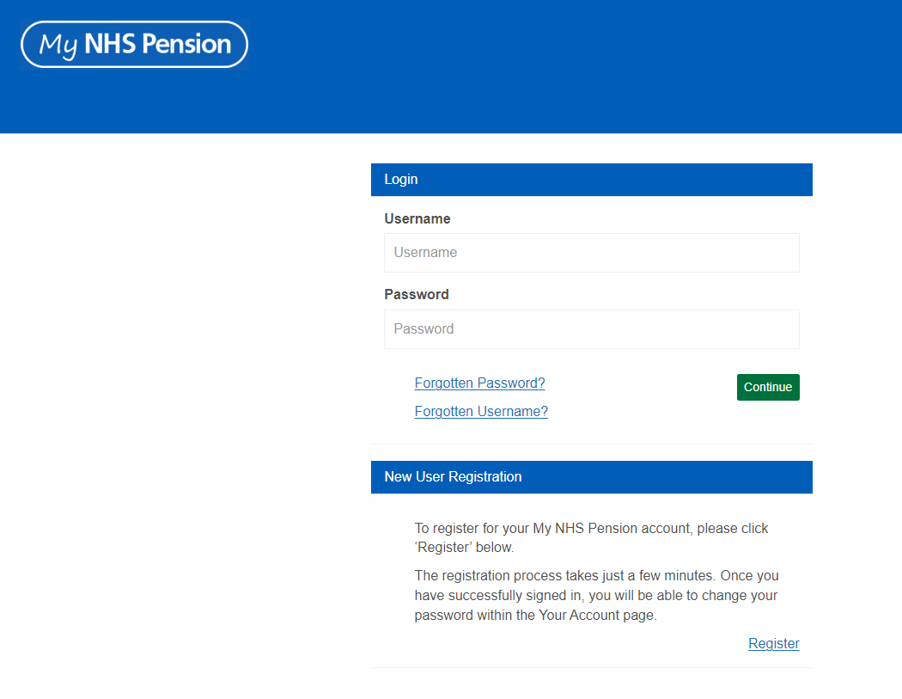
Step 2 - New user registration

Slide 33
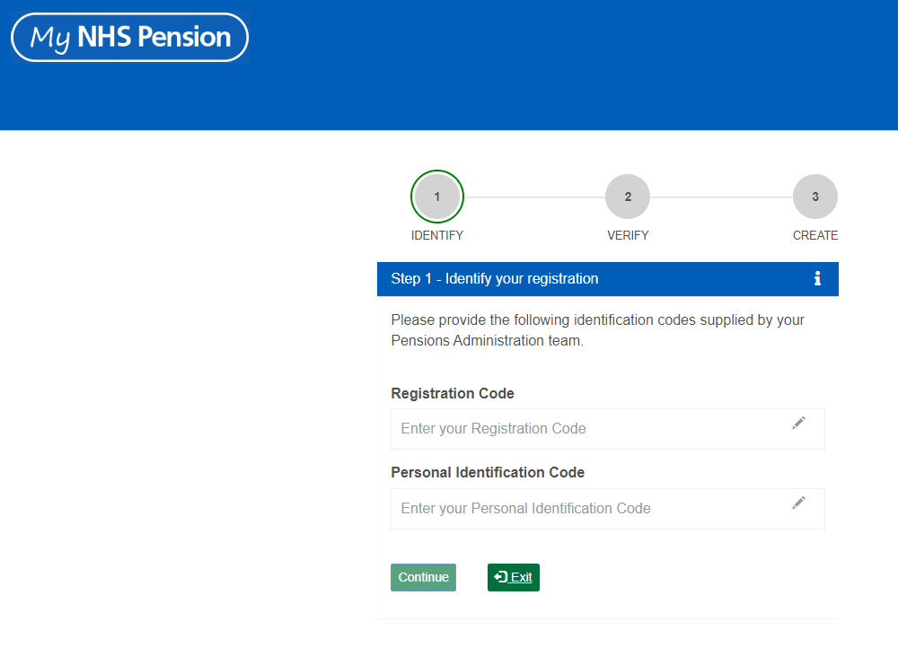
Step 3 – Unique codes

Slide 34
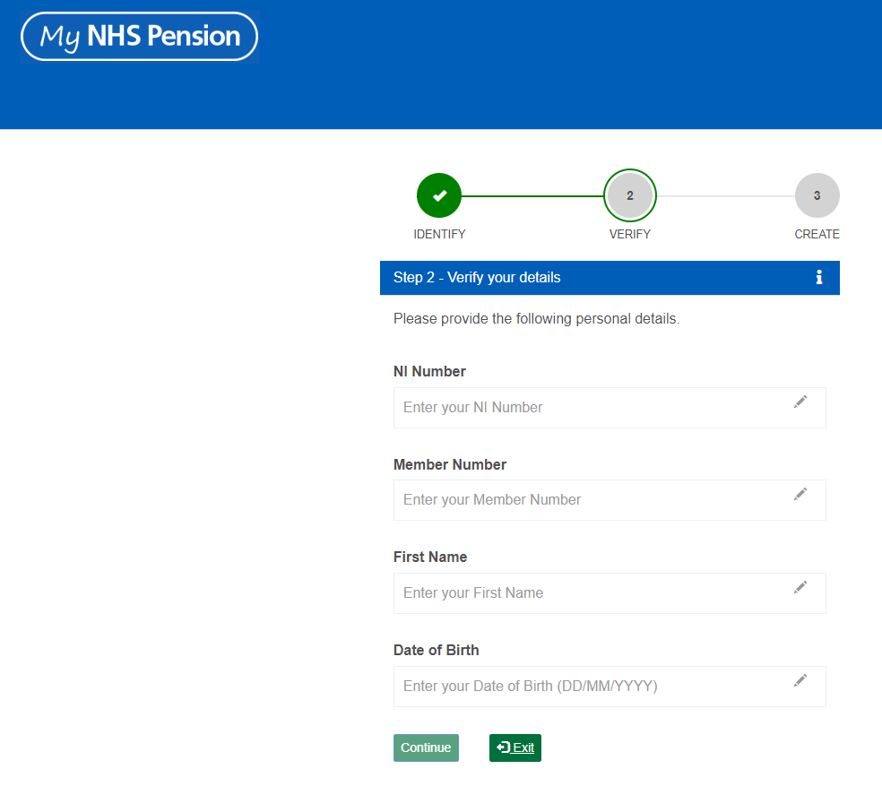
Step 4 – Known facts

Slide 35
Step 5, 6, and 7 – Creating account for My NHS Pension
Create a username and password
Provide an email address
Create security questions

Slide 36
First login
Once registered, you will be asked to log in for the first time.
Once you have input your username and password, you will be asked to set up a two-factor authentication.
You can choose to authenticate using:
An authentication app
SMS
You will be provided with recovery codes to support them to self-serve if they are locked out of the system.
You will also be prompted to verify your email address, which can be used to reset your username or password if needed. You will need to check your spam/junk folders for the verification email. If you have not received it, please contact the My NHS Pension Support team.
Notes:
Recovery codes – we recommend that members download these and store them safely to support them in self serving on account issues.

Slide 37
My NHS Pension functions
Payslips
Benefits dashboard
P60s
Current retirement benefits
My NHS Pension functionality
Your details
Help and Information
Update address
Scheme information
Nominations
Contacts
Earnings history
Service employment
Main menu More NHS information pages Your account Pensioner members
Notes:
Pensioners have access to be able to download P60’s and payslips they receive from the pension scheme. (Any active pensioner will have view of their benefits they are in receipt of only at this time) they will need to access their current service information via their current routes.)

Slide 38
Support
Member support
In the first instance you should view the My NHS Pension webpage on the NHSBSA website.
If you are having trouble with registration or accessing My NHS Pension, you can contact pensions directly at mynhspension@nhsbsa.nhs.uk
If the data in My NHS Pension is incorrect, you can contact pensionsmember@nhsbsa.nhs.uk or if it impacts your current employment, please contact your employer.
Notes:
NHS Pensions cannot action any member queries via third parties in relation to registering for the My NHS Pension Portal

Slide 39
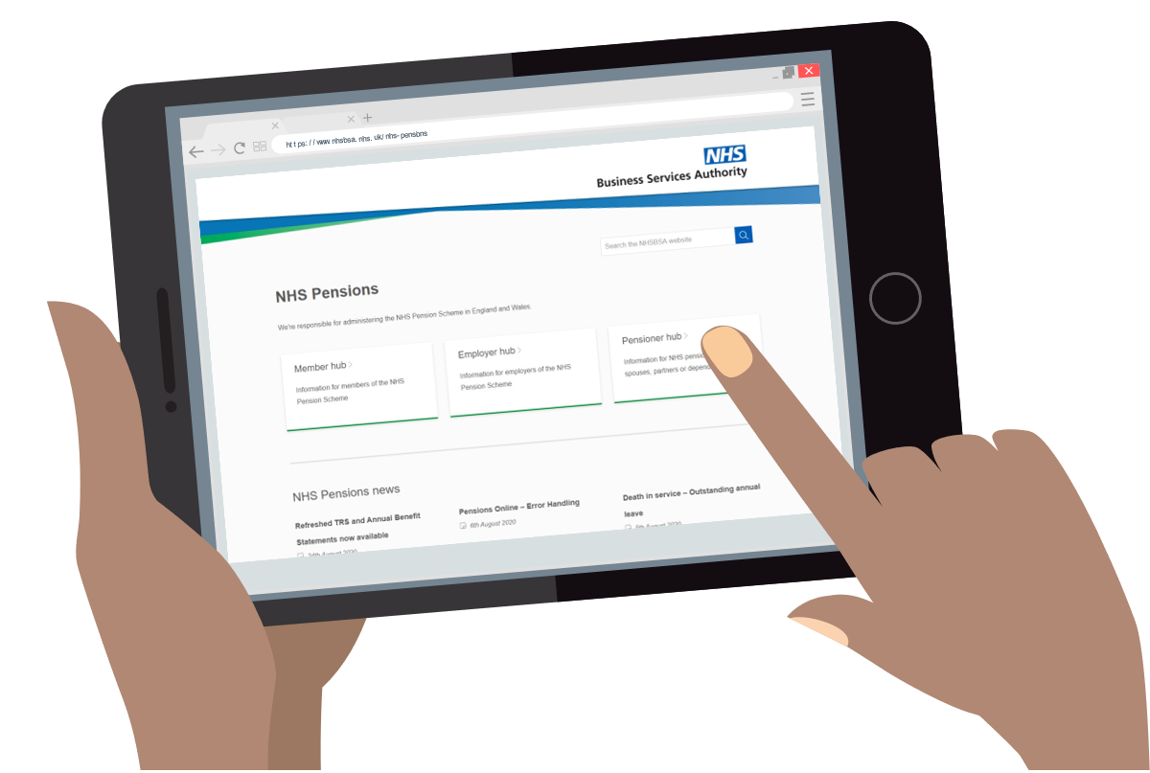
Find out more
Find more information on our Member Hub: www.nhsbsa.nhs.uk/nhs-pensions
Contact Centre: 0300 330 1346
nhsbsa.pensionsmember@nhsbsa.nhs.uk
Visit our Ask Us pages to find answers to common FAQs
Notes:
Via the member hub you will also find all our upcoming member events that may be of interest to you.
We hold events that focus on a member's annual benefit statement and a retirement option session.
These are delivered via Microsoft teams, you can click on the session that you want to attend and register your place.

Slide 40

Questions

