Slide 1
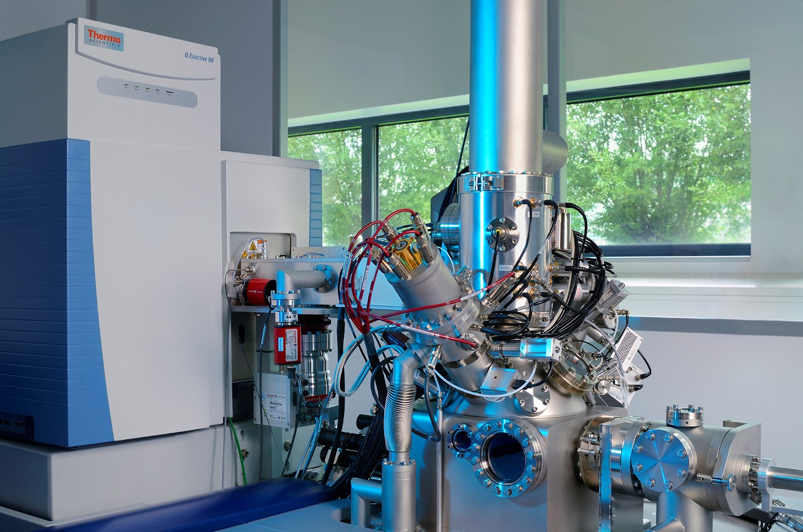
“3D OrbiSIMS” Launch Event
14th January 2019
13:00 - 17:00
Chemistry Building X1 / Foyer
Label Free Chemical Imaging of Materials, Cells and Tissues
13:00: Lunch
13:30: Prof Ian Gilmore (National Physical Laboratory)
‘The 3D OrbiSIMS - Next Generation Technology for Molecular Imaging in High-Definition’
14:00: Prof Ricky Wildman (Engineering, UoN)
‘Understanding the Chemical Composition of 3D printed Multimaterial Objects’
14:10: Prof Felicity Rose (Pharmacy, UoN)
‘Potential Applications of the “3D OrbiSIMS” in Regenerative Medicine’
14:20: Prof Paul Williams (Life Sciences, UoN)
‘Molecular Imaging of Bacterial Biofilms and Microbiomes’
14:30: Break
14:45: Prof Andrei Khlobystov (Chemistry, nmRC Director, UoN)
‘Nanoscale Imaging and Analysis at the University of Nottingham’
15:00: Dr Lucy Collinson (The Francis Crick Institute)
‘Challenges in Correlating Biological Structures to Elemental Information’
15:30: Dr Ewald Niehuis (IONTOF)
‘Industrial Applications of the Hybrid SIMS’
16:00: Lab Tours
Join us for the launch of the new “3D OrbiSIMS”. A hybrid time-of-flight / OrbitrapTM secondary ion mass spectrometer.
A gateway to the unprecedented mass spectral molecular imaging and analysis of a diverse range of materials.
For more information and / or to register for free visit:
https://tinyurl.com/3DOrbiSIMS
Image Courtesy of IONTOF GmbH.

