Slide 1
Flipped Classroom
Russell Stannard
www.teachertrainingvideos.com

Slide 2
Flipped Classroom
Nothing new.
It is a form of blended learning.
Move teaching stuff to home.
Free up class time for focus on tasks, coursework, projects in the class ( in groups/pairs/individuals).
Students watch videos at home ( do quizzes, simple activities to check understanding).

Slide 3
Teaching/Learning
Home
Podcasts
Class
Tasks
Problem solving
Videos
Reading
Quizzes to check learning
Group based
Presentations
Screen casts
Other activities
Pair work
Class discussions

Slide 4
Why use it?
It fits very well with the Higher Education lecture mode.
May develop student autonomy.
Reflects more 21st century learning.
Fosters more group work, collaborative learning.
Frees up more class time.
Can be introduced slowly.

Slide 5
Learning theory
Homework
Behaviourist
Automated
However could be collaborative..
In class
Constructivist
Group based
Task/Project based

Slide 6
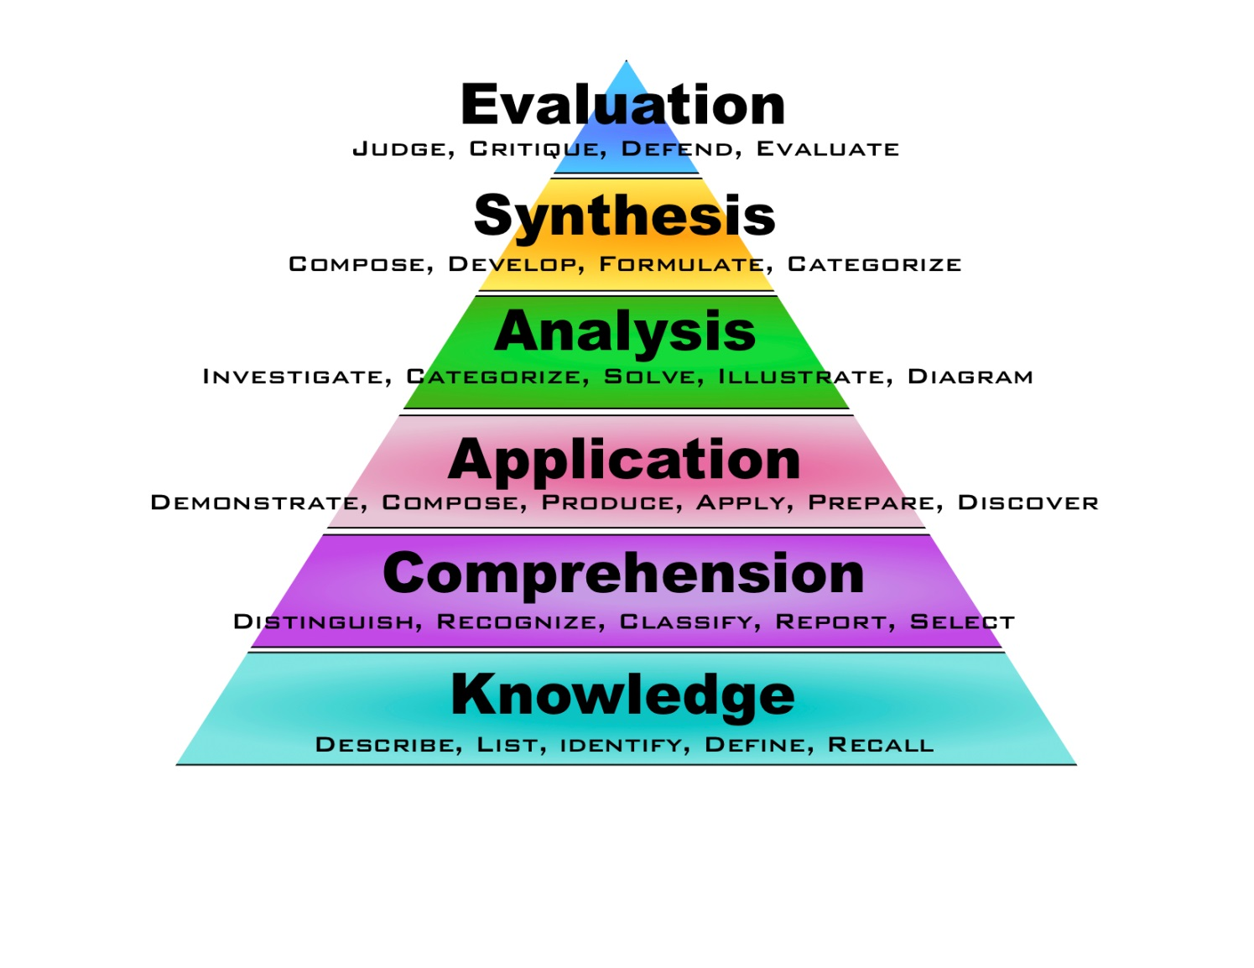
Blooms

Slide 7
MSc Multimedia
Example one-University of Westminster

Slide 8
2006
In 2006 before term Flipped Classroom existed.
Was working on multimedia level courses at the University of Westminster.
Why not make screen capture videos so the students can learn the tools at home.
In class we can do the coursework and do group discussions about the coursework.
Link to the multimediatrainingvideos.com site

Slide 9
Partial flip
Increased tutorial time
Reduced lecture time

Slide 10
Food for thought
I never announced anything.
I was the only teacher to do it.
We reduced lecture time and increased tutorial time.
Created a very good feeling on the course.
Helped the weaker students.
Challenges of those that didn’t do the homework.
Some of the tutors struggled with the tutorial time.
Content very organised. Easy to access.
Bit by bit. From a few classes, to one module to 50% of the course.

Slide 11
Feedback
Work at own pace.
Play back.
Quicker.
Great for exam time/coursework.
Need to have time in class to ask questions.
Better use of class time.
Wouldn’t want to do it all the time.
With difficult concepts not so good.
Like ‘live’ element of lectures.

Slide 12
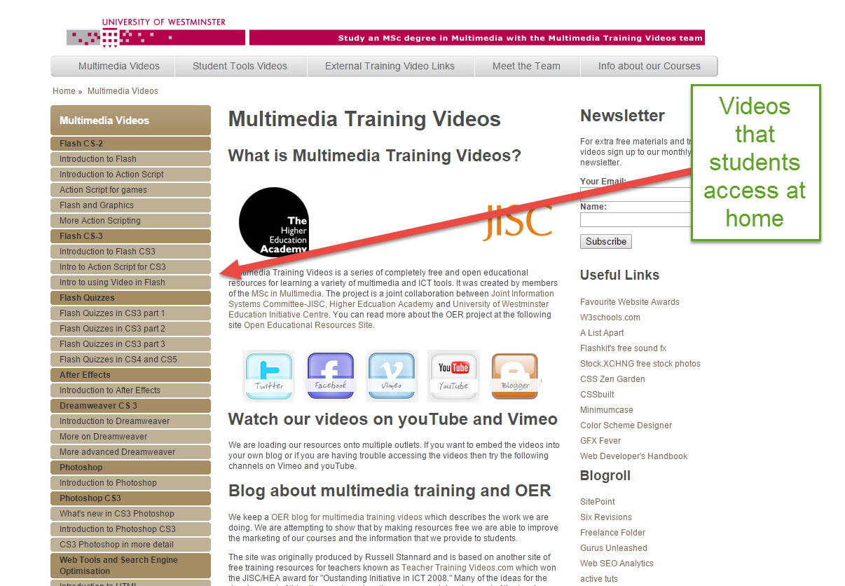
Idea

Slide 13
Marketing

Slide 14
Teaching english

Slide 15
Flipping English Classes
Grammar
Pronunciation
Writing skills
Exam skills
Study skills
More group work
More pair work
More problem solving
More task based learning

Slide 16
Example
Watch video about oral exam for FC at home
Do quiz at home to check learning
In class re-enact the exam in groups
2 students do exam, one student acts as examiner
In class work in groups and think of typical questions in the exam

Slide 17
Some examples
10 ways I have used screen capture

Slide 18
Learning Content
Find it
Make it
Content

Slide 19
At home
Video
Screen casts
Articles
Podcasts
Blogs

Slide 20
Screen capture
JING
Screen corder
Screen cast-o-matic
How does screen capture work? Watch this video
Camtasia
SnagIt ($30)

Slide 21
Feedback
Same technology can be used to give feedback to students.
Original work in 2006 which generated enormous publicity. I even appeared on TV!
Idea has developed massively with research taking place in the UK, Norway, Canada, Japan, Italy, USA etc.
Example one
Example two
Example three

Slide 22
Conclusions
Could have a place in some of our teaching and learning but need to think about….
What lessons you do it in.
What students do with the videos/content.
What activities you do in the class.
How you organise the content ( Moodle)

Slide 23
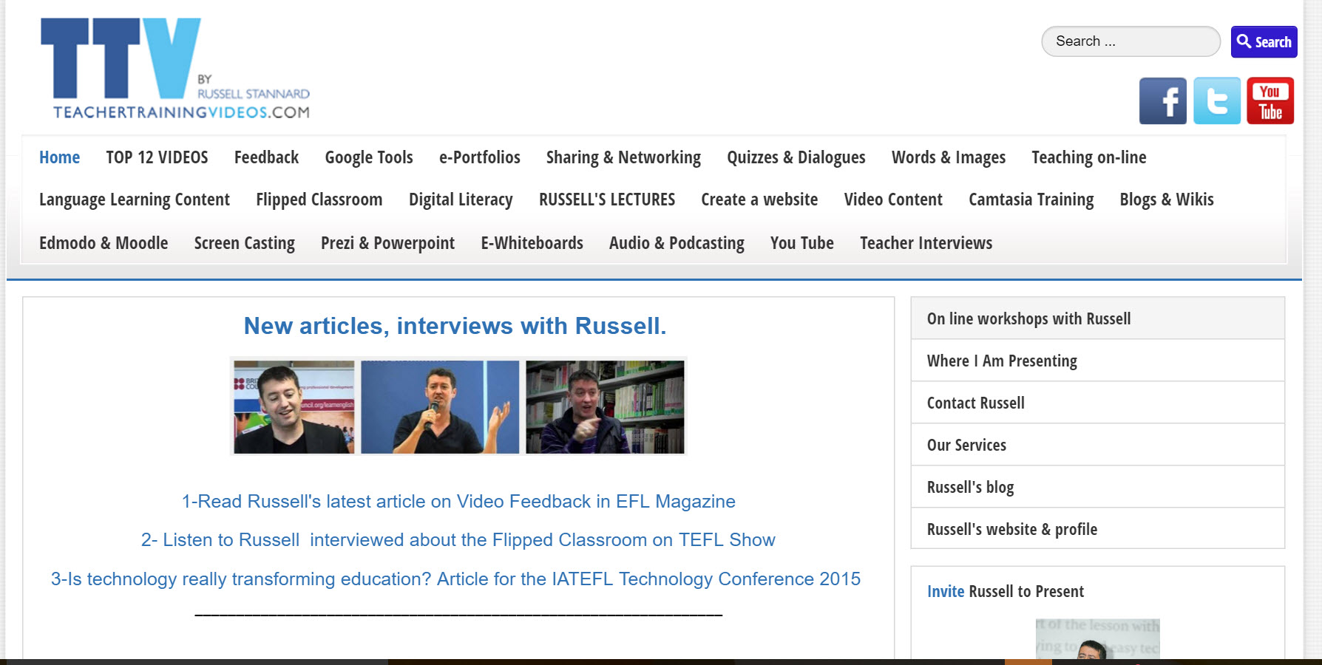

Slide 24
References
Learn the technologies
The tool I like the most is SnagIT- Watch this video ($30)
A great tool to start with JING ( FREE)
Further reading
Summary of recent research
Flipped Classroom and engagement
Interview with Edward Moran
My feedback idea
Recent article on my feedback idea
Examples
Multimedia Example

Slide 25
Russell Stannard
Please follow me on my website and sign up to my newsletter.
www.teachertrainingvideos.com

