Slide 1
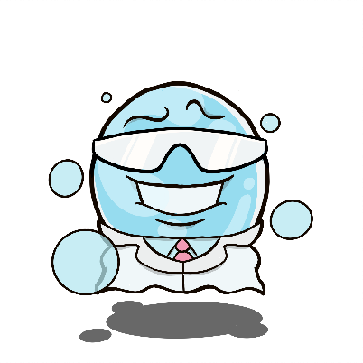
Communicable diseases – the Great Greeting experiment
Aims:
After this lesson you will have a better understanding of how bacteria can spread between people and objects and the importance of vigilant hygiene in a healthcare setting. You will cover:
How bacteria infections can spread from person to person
How our behaviour can help reduce the spread of bacteria and how this can reduce the use of antibiotics

Slide 2
Pathogens
Pathogens are microbes that cause disease.
There are four main types of Pathogens
Virus
Bacteria
Fungi
Protists
Note: these aren’t always pathogens and can be helpful to humans!

Slide 3
Bacteria
Prokaryotes - single celled organism without a membrane bound nucleus
They obtain nutrients from their environment to live – this can be from the human body
They can reproduce inside and outside of the human body
Cause infections such as: Meningitis, Pneumonia and Tuberculosis

Slide 4
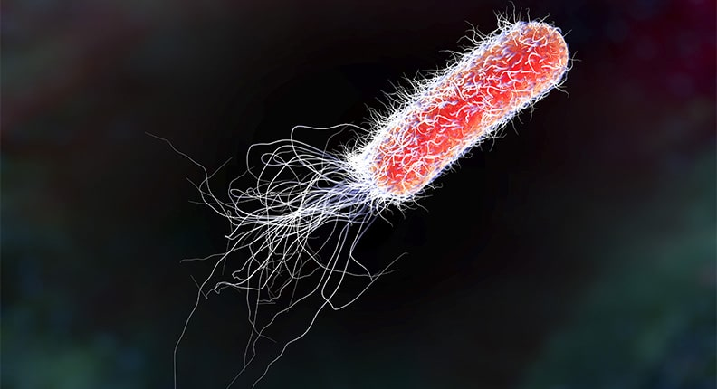
Structure
Bacteria type: e.coli
Chromosonal DNA | Bacteria DNA is not contained within a nucleus, it is found loose in cytoplasm
Plasmid DNA | Can move from one bacterium to another giving variation
Flagella | Bacteria can have one or more flagella. These can rotate or move in a whip-like motion to move bacteria
Cell Wall | Provides structure and protection

Slide 5
Virus
Are smaller than bacteria
Can easily spread between humans
They are parasitic – meaning they need a host organism to survive and reproduce
They reproduce inside a host cell, using their machinery, then burst out of the cell
Viruses are responsible for the Flu, Chicken Pox and Measles

Slide 6
Virus structure
They come in different shapes, depending on the type of virus.
All have a protein coat that contains genetic material which is either DNA or RNA but never both.
Hepatitis C Virus
DNA or RNA
Protein Coat

Slide 7
How are pathogens transmitted?
Direct touch eg. Shaking someone’s hand
Indirect touch via an intermediate object eg. A door handle
Water droplets eg. Sneezes, coughs, speech

Slide 8
Activity – The great greeting experiment
To demonstrate how pathogens are spread through direct and indirect touch.
Discussion:
Which greeting transferred most ‘pathogen’?
Which greeting was the best to reduce transfer of pathogens?
Did you observe transfer through the intermediate object?
Was it easy to remove the ‘pathogen’ from your hand using the wipes?

Slide 9
How can pathogen transmission be prevented?
Good personal hygiene eg. Washing hands regularly
Good food hygiene eg. Cooking foods thoroughly to kill all bacteria
Good hygiene at home eg. Disinfecting surfaces
Vaccination – teaching the body how to defend itself when exposed to particularly pathogens
Clean water – sterilising water to kill pathogens eg. cholera

Slide 10
Activity 2
MRSA outbreak
There has been an outbreak of Methicillin Resistant Staphylococcus aureus (MRSA) in a hospital. Can you think of 10 actions to try and prevent/control the spread of the infection. Please work in pairs/groups.
MRSA is a bacterial infection that is difficult to treat and is known as a ‘Superbug’. MRSA lives harmlessly on the skin of about 1 in 30 people, however, if it gets inside the body it can become very dangerous.

