Slide 1
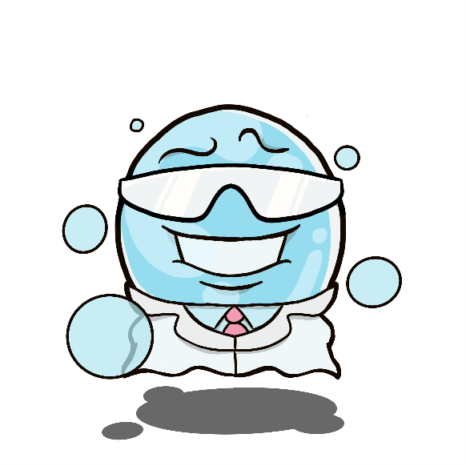
Stick and Slide
Aims:
To have a better understanding of:
1) What is a biofilm
2) Why it is more difficult to treat an infection once bacteria have formed a biofilm compared to single-cell bacteria

Slide 2
Reminder – What is a bacteria?
Bacteria is a single celled organism.
Can cause disease ‘a type of pathogen’ or can be useful, like bacteria found in the intestines that help digestion.
Bacteria can spread easily between animals and people through food, touch, water and air.
Bacteria infection can be treated using antibiotics that can kill the bacteria

Slide 3
Bacteria on Surfaces
Can bacteria survive on a surface?
Bacteria can survive on a surface for weeks. In the right environment bacteria will multiply and grow on the surface forming a ‘colony of bacteria’.
In what environment is it important to prevent bacteria surviving on surfaces? Why?
Healthcare environment
Why - Prevent spread of infection between patients
and to vulnerable people
What types of surfaces are important to keep free of bacteria?
Medical devices

Slide 4
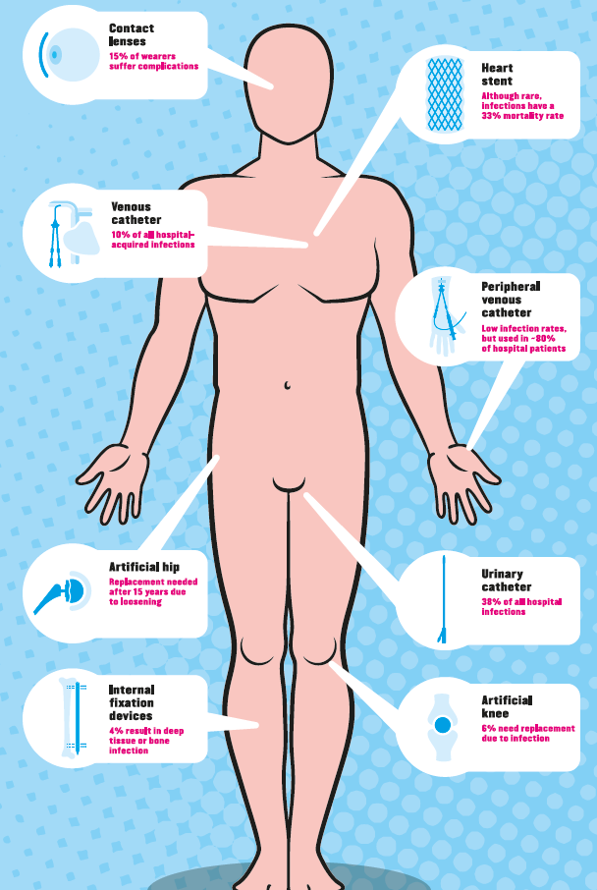
Medical devices – any instrument used in a medical setting
How could bacteria be introduced?
Direct hand transfer from a medical professional
Indirect hand transfer from another surface
Water droplets ie. Cough, sneeze or speech
What is the leading cause of infections in a healthcare environment?
Urinary Catheters are no.1 cause of Hospital acquired infections and cost the NHS £1billion / year
Notes:
Medical device is any instrument used in a medical setting – could be an implant, needle, tubing – all surfaces that could carry bacteria (explain that they are all sterilised but are handled by people) Ask how they think bacteria could be introduced?
Which do they think would causes the highest number of infections? (maybe give a choice and a hands up vote ie. Catheter vs hip replacement) E
One surface in a hospital that is know to cause the most infections is the surface of a catheter – ‘show students catheter to pass round’ a catheter is inserted in the uretha to draine urine from the bladder in cases of incontinence/ retention caused by a range of conditions. Ask students how they think bacteria could be introduced.

Slide 5
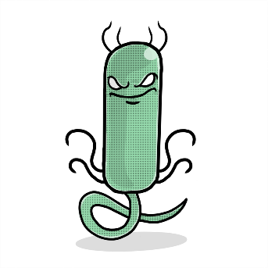
What can happen when bacteria grow on surfaces?
Adhesion to a surface
Formation of a monolayer and production of extra-cellular matrix
Micro-colony formation
Mature biofilm ‘slime city’
Easier to kill with antibiotics
More difficult to kill with antibiotics
Notes:
Bacteria can attach to a surface as a single bacteria
Overtime they’ll reproduce and can form a monolayer – the cells can secrete proteins etc. that form a matrix around the cells
Overtime as the cells continue to reproduce and secrete this matrix the colony grows and the ‘slime’ grows
Until it reaches a mature biofilm – also known as a slime city where the bacteria are encased with the matrix.
Which scenario is easier to treat? The left or the right?
So what would be great is if we could try and stop the bacteria forming slime cities. Which brings us onto this research -

Slide 6
How do antibiotics work?
It depends on the type of antibiotic, they can work in a number of different ways that either leads to their death or prevents reproduction eg.
  Attack the cell wall of the bacteria, specifically they prevent bacteria producing a molecule peptidoglycan that provides the strength the cell wall needs to survive in the human body
  Prevent successful DNA replication in bacteria
  Inhibit protein synthesis – lead to cell death

Slide 7
Activity
To determine if the presence of a ‘biofilm’ on a surface effects the ability of ‘antibiotics’ to kill/remove the ‘bacteria’.

Slide 8
Discussion
Which surface was easier to clean, with or without the biofilm?
What methods could we try to prevent biofilms forming on the surface?
How could biofilms be a problem in a healthcare environment such as a hospital?

Slide 9
Summary
Bacteria can survive on surfaces
Bacteria can survive on medical devices and cause infections in healthcare settings
Bacteria can form biofilms ‘slime cities’ which make them harder to treat with antibiotics

