Slide 1
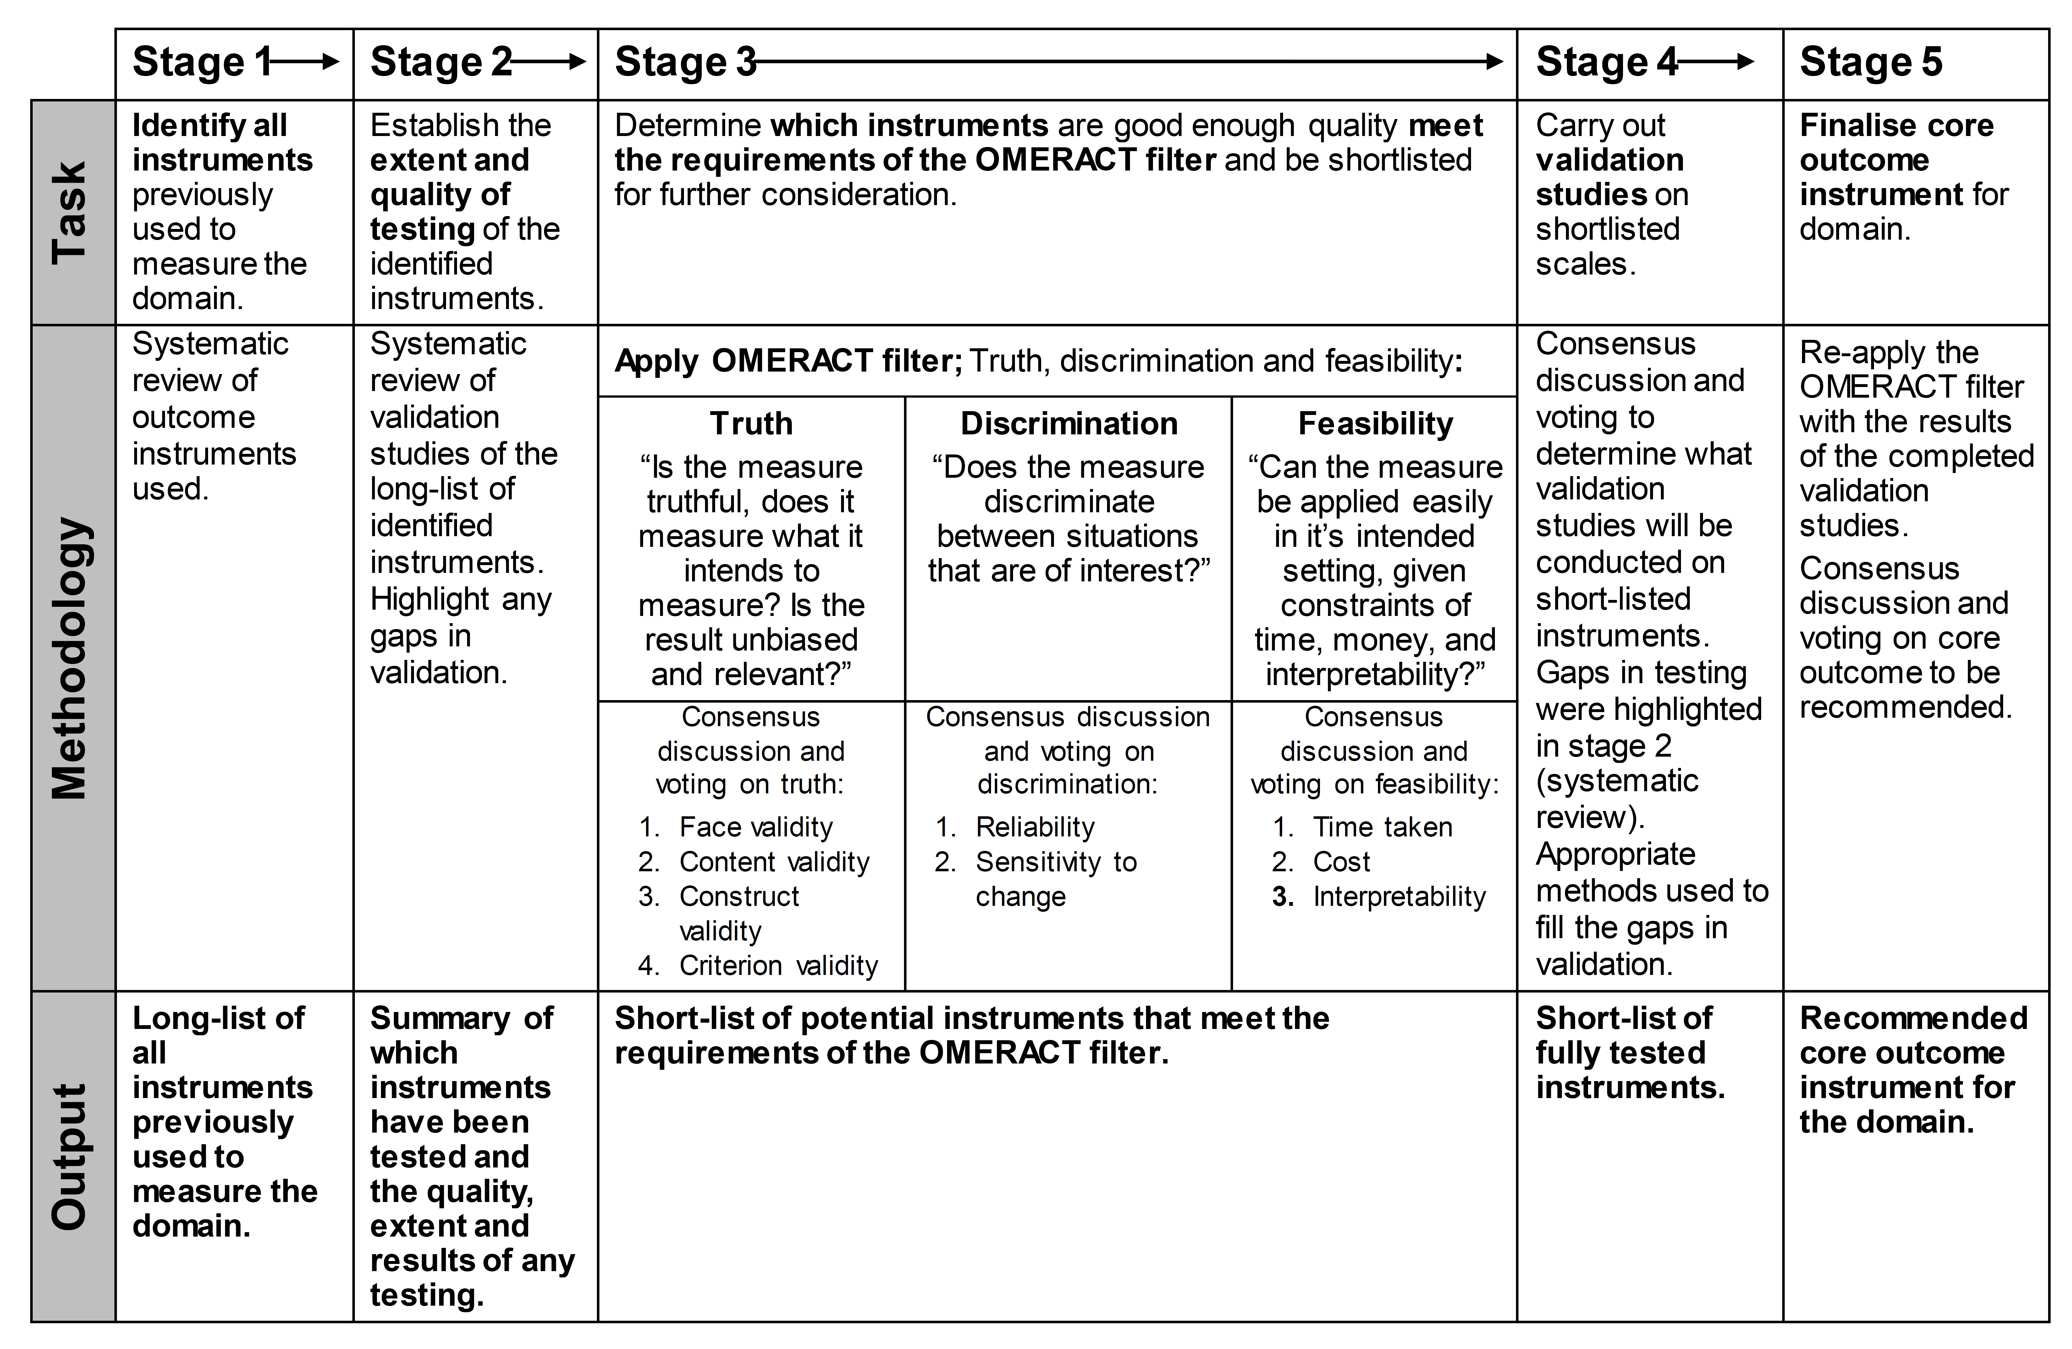
Step 1: Define scope and applicability
Population (condition)
Intervention
Setting (e.g. trial, registry, clinical practice)
Geographical / regional scope *
Stakeholders
Step 2: Develop Core Set of Outcome Domains
Consensus study involving representatives of relevant stakeholders.
Step 3: Develop Core Set of Outcome Measurements
Identification and recommendation of adequate measurement instrument(s) for each core outcome domain by a 5 stage process
Step 4: Disseminate, prepare guidance material, review, and possibly revise Core Set of Outcome Measurements

