Slide 1
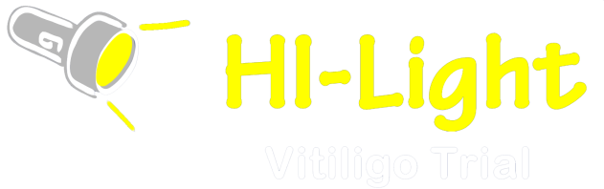
MED TESTING
Training Resource
MED TESTING
Training Resource
By Dr Jonathan Batchelor
With thanks to Melody MacGregor, Sally-Ann Bell,
Vanessa Unsworth and Natasha Rogers

Slide 2
Introduction
Prior to commencing treatment with narrowband UVB, a Minimal Erythema Dose test, also known as an MED test, is performed to identify a patient’s individual sensitivity to narrowband UVB.
This purpose of this training resource is to demonstrate how to perform an MED test. The MED test ensures that the patient receives a starting dose of narrowband UVB suitable for their individual skin.
In the HI-Light trial all participants will start at the same starting dose, and the MED test is mainly performed to rule out photosensitivity, but we will also be recording the MED test result in the medical notes.
The MED test involves a small hand held machine, which exposes the skin to ten fixed incremental doses of narrowband UVB.
Readings are taken 24 hours later when the effect of the narrowband UVB has reached its peak. The MED is the lowest dose needed to produce a clearly demarcated area of redness, or erythema, on the skin.
The instructions in this training resource relate to use of the Dermalight 80 MED tester, which is being issued to sites for use in the HI-Light trial. Please refer to the ‘Dermalight® 80 MED-Tester operating instruction manual’ for more information.
Some sites may choose to carry out MED testing using their own equipment, so some steps of the procedure will be slightly different.
If this is the case, please take advice from the local phototherapy nurses and medical physics department.
These instructions assume that the MED tester has been calibrated prior to use.
This should be done by your local medical physics department.

Slide 3
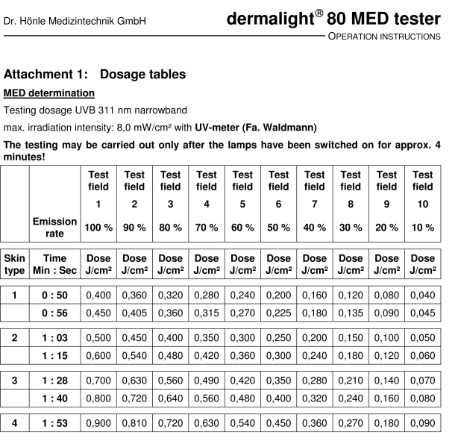
Med Testing
Determine the skin type of the patient - ask the patient about how their skin responds to sun
exposure and refer to the table in the Dermalight 80 MED tester manual (summarised below).
Having determined the skin type of the patient, use the other tables at the back of the manual to determine the exposure time to be used for the MED test. If the patient is skin type 4, 5 or 6, please use the exposure time given for type 4 skin.
In the manual there are three tables, based on the MED tester having three slightly different outputs. Having calibrated the MED tester, the medical physics department will be able to tell you to which of these tables to use.
Step 1
Skin type 1 Always burns, does not tan (Celtic type)
Skin type 2 Burns easily, tans poorly (fair European type)
Skin type 3 Sometimes burns; tans gradually after repeated
sun exposure (dark-skinned European type)
Skin type 4 Rarely burns; tans easily (Mediterranean type)
Skin type 5 Very Rarely burns, tans darkly easily
Skin type 6 Never burns, always tans darkly
For each skin type, two exposure times (in seconds) are given
please use the shorter of these two times.

Slide 4
Step 2
Step 3
Step 4
Examine the patient’s skin and select a suitable site on which to perform the MED test.
The best site is the lower back or buttocks, as these are not commonly exposed to the sun.
The test area should be normal skin, not affected by vitiligo or any other skin rash.
If necessary, the inner upper arm can be used but this is not recommended.
The patient must wear protective goggles or glasses, as should the person performing the test.
Anyone else in the room during the MED test must also wear protective goggles or glasses.
The person performing the test should also wear protective cotton gloves.
Switch on the MED machine and allow it to warm up for at least
4 minutes prior to MED testing.
Once switched on, it should be laid face down on a table and covered with the device’s case or with a fabric cover such as a pillowcase.

Slide 5
Step 5
Step 6
Step 7
Adjust the exposure time, as determined in step 1, using the (-) or (+) buttons.
Once the MED tester has warmed up, hold it lightly but firmly on the selected area of skin and press the MODE (or START/STOP) button to start the timer.
The end of the exposure time is indicated by a beep and the MED tester is switched off automatically.
Before removing the MED tester from the skin, mark the skin with a skin marker at both ends of the tester. This will enable the person reading the test result on the following day to know which area of skin was exposed to the UVB.
Ask the patient to keep the area
as dry as possible for 24 hours so that the markings are kept as clear as possible.

Slide 6
Step 8
Step 9
Step 10
Complete the medical notes with date and time the procedure was performed and sign the entry.
The patient returns 24 hours later for the result to be read.
The MED is identified using the table in the manual.
It is the dose given to the area showing a square of erythema that is just visible.
Complete the medical notes with date, time of reading, the MED result and signature.
Step 11
When the test is completed the MED tester should not be re-used for 3 to 5 minutes.
This resource was developed as part of the HI-Light Vitiligo Trial, which is funded by the National Institute for Health Research Health Technology Assessment programme (project number 12/24/02). The views and opinions expressed herein are those of the authors and do not necessarily reflect those of the NIHR, NHS or the Department of Health.

