Slide 1
So, I want to publish in AMLE... what do I need to know?
William M. Foster
University of Alberta
Editor
Academy of Management Learning and Education
September 25, 2019
Presented at:
The British Academy Writing Workshop for Sub-Saharan Africa

Slide 2
Academy of Management Learning and Education
Theory-driven journal!!!
Our goal is to build and/or test theory about Management Learning. Management Education & B-Schools.
We also hope, to contribute to Management, Organization & Education research more broadly.
4 in ABS rankings.
A* in ABDC rankings.
2019 IF-3.274; 5-year-4.902

Slide 3
Academy of Management Learning and Education
Interested in all forms of research: conceptual, empirical (qualitative and quantitative) and critical.
We engage in topics that pertain to management education, management learning and/or business schools.
Not a teaching or pedagogical journal. We do not publish papers that discuss classroom exercises or teaching methods.

Slide 4
Sections of the Journal
Research and Reviews:
Conceptual papers, empirical research, literature reviews that lead to generating new theoretical questions.
Who Built Maslow’s Pyramid? A History of the Creation of Management Studies’ Most Famous Symbol and Its Implications for Management Education. Todd Bridgman, Stephen Cummings, John A Ballard (Vol. 18, 1, 2019).

Slide 5
Sections of the Journal
Essays & Dialogues:
Provocations and challenges on major topics.
Also theory-driven.
Co-Associate Editors (Russ Vince & Paul Hibbert).
Call to action is required!
From the AMLE Editorial Team: Disciplined Provocation: Writing Essays for AMLE (Vol. 17:4, 2018)

Slide 6
Sections of the Journal
Exemplary Contributions: Invited, peer-reviewed
Leaders in a field are asked to weigh in on important issues.
Can Early-Career Scholars Conduct Impactful Research? Playing “Small Ball” Versus “Swinging for the Fences”-Philip M. Podsakoff, Nathan P. Podsakoff, Paresh Mishra, and Carly Escue (17(4), 2018)

Slide 7
Sections of the Journal
Book and Resource Reviews
Not peer-reviewed
Contact AE Megan Gerhardt gerharmm@miamioh.edu about contributions.
Reviews resources of all kinds—simulations, trade books, video collections, etc.
New: Comparative book reviews.

Slide 8
Recent Questions and Emerging Ideas
How does management learning occur in sites outside of universities?
Why do students embrace (and reject) certain types of management research?
How have students’ views of gender discrimination in the workplace changed?
How do accreditation and ratings impact business school and their constituents?
How is faculty research in China affecting the development of a research culture in Chinese universities?
Why have MOOCs not have the effect many thought they would?
How do corporate universities impact management education?
How is business ethics taught? Is there a better way?
Why do management students choose to become entrepreneurs?

Slide 9
Future Special Issues
New Histories of Business Schools and How They May Inspire New Futures
Guest Editors:
Patricia Genoe McLaren
JC Spender
Stephen Cummings
Ellen O’Connor
Todd Bridgman
Gabrielle Durepos
Christina Lubinski
Call for Submissions: January 1, 2020
Deadline for Submissions: March 31, 2020 Scheduled for Publication: June 2021

Slide 10
Future Special Issues
Learning and Education Strategies for Scholarly Impact:
Influencing Regulation, Policy and Society through Research
Guest Editors
Usha C. V. Haley
Sir Cary L. Cooper
Andrew J. Hoffman
Tyrone S. Pitsis
Danna Greenberg
Paul Hibbert
Initial submissions May 31, 2021
Scheduled for Publication: September 2022

Slide 11
On the go!
Rhythms of Academic Life: Frost and Taylor 20 Years on.
Guest Editors:
Jon Billsberry, Deakin University
Michael Cohen, Deakin University
Tine Köhler, University of Melbourne
Micheal Stratton, University of North Carolina Asheville
Susan Taylor, University of Maryland at College Park
Confronting the Crisis of Confidence in Management Studies: Why Senior Scholars Need to Stop Setting a Bad Example-Bill Harley
Isolation in Globalizing Academic Fields: A Collaborative Autoethnography of Early Career Researchers- Belkhir et al.
Scheduled for Publication: June 2019

Slide 12
Outline
Editorial view of 5 common limitations in academic papers.
Discussion of common publishing myths.
Possible suggestions.

Slide 13
Top 5 limitations of academic papers
Kitchen sink approach to theorizing
Include far too many ideas in the paper
Fear that some theory will be forgotten.
Indicates a lack of focus & clear understanding of research question.
Characterized by:
Meandering argument
Paper too long.

Slide 14
Top 5 limitations of academic papers
Unclear contribution
Not clear which conversation the paper is joining.
Not clear how the paper is contributing to the conversation.
Characterized by:
No clear research question
Mere application of theory to new empirical context.

Slide 15
Top 5 limitations of academic papers
Lack of construct clarity
The constructs of the paper are not defined or ill-defined.
The boundary conditions of the paper are not outlined.
Characterized by:
Overlapping ideas and theories.

Slide 16
Top 5 limitations of academic papers
Poor literature review
Does not outline the key gap in the literature or a problematization of a empirical observation.
Poor citation practices.
E.g., lack of key citations, dated citations, limited number of citations
Characterized by:
Unfocussed presentation of literature.

Slide 17
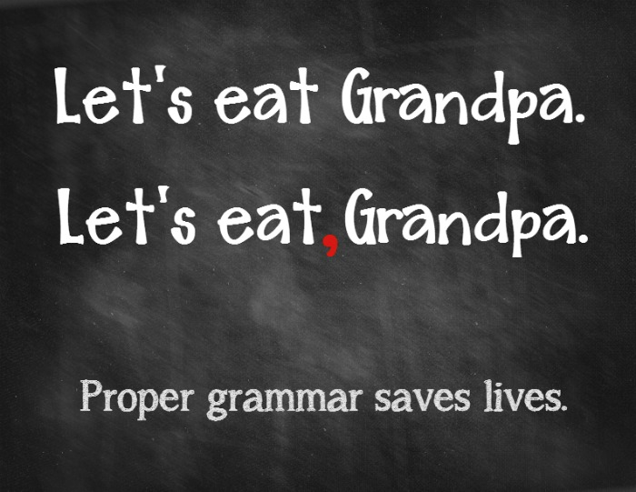

Slide 18
Top 5 limitations of academic papers
Unpolished work
Sloppy and poorly written paper.
Does not “look” like an academic paper.
Characterized by:
Poor grammar.
Spelling mistakes.
Poor formatting.

Slide 19
Top Publishing Myths
Q.A.D. vs. Top Journal
Takes as long to write a good paper as it does a poor paper.
Shoot high!
The reviewers will fix it.
The reviewer’s job is to provide constructive.
Don’t expect the reviewers to know how to fix the paper.
The reviewers didn’t understand my brilliance
Your job is to make them understand.
Clarify!

Slide 20
Suggestions
Ask for a friendly review.
But not from someone friendly!
Get an honest appraisal of you work.
Present a numerous venues.
Look at/for exemplars.
In target journal
In top journals

Slide 21
Suggestions
KISS.
Write simply and clearly
Grandma test.
Abstract
Important and overlooked aspects of authorship
Keep abstract short and snappy.
Get to the point.
Should not recreate your introduction

Slide 22
Suggestions
Paper Keywords.
Pay attention to your keywords.
Important way for Editors & AE’s to select reviewers.
Letters to the editor
Tell the Editor if you have a conflict.
This is the place to ask for a specific AE or reviewer
Remember…everyone gets rejected.
Their paper

Slide 23
Questions?

