Slide 1
The Soundtrack to My Life
John Osborne & Farai Pfende
Notes:
Presenter notes
NB – No introductions at this point
Play snippets of music from different genres and eras for delegates to listen to for 2-3mins.
Current playlist used includes snippets of the following tracks:
[add list here]

Slide 2
What Does Music Mean to You?
Think about a piece of music that is important to you
Notes:
Presenter notes 5mins
NB – No introductions at this point
Ask delegates to:
Think about a piece of music [song] that is important to them, and write it down on the piece of paper provided.
Explain that it can be important for any reason and they do not have to share any difficult memories or emotions, and encourage the group to be sensitive and respectful of others feelings.
Share it with the person sitting next to them [exchange songs] and discuss
What memories does it revive?
What reconnections are made?
Ask one or two couples to feedback to the group.

Slide 3
What Music Can Do
Transports us to a particular time or place
Stimulates all of our senses
Releases strong emotions
Calm, soothe and comfort us
Reconnects us with our memories
Notes:
Presenter notes 3mins
Explain:
Transports us to a particular time or place – takes us to the place, age or time we associate with that piece of music. [For example, a wedding day/the birth of your first child/sitting in your mother’s kitchen as a child/your freshers’ week at the start of university etc…]
Stimulates all of our senses – you are taken there with all your senses. [seeing the bride for the first time/the anxiety and thrill of new parenthood/ the smell of mum’s cooking/or the awful hangover that accompanied a great night out]
Releases strong emotions – music that is important to you gives you the same feeling you had at the time of an event. You could find yourself smiling/laughing/dancing/crying just as if you were in that particular time and place
Calm, soothe and comfort us – being presented with familiar and important often brings a feeling of comfort, like meeting a long lost friend, or finding a treasure you thought you’d lost
Reconnects us with our memories - Music connects us to our memories. Most significantly, we know that these musical links are retained even when memory and speech are impaired by dementia.

Slide 4
Core Soundtrack Principles
People do not lose the ability to communicate, we lose the ability to understand them.
You cannot work with people with dementia without knowing their life history.

Slide 5
What is the Soundtrack?
Soundtrack is a person centred tool
It is used to draw together a unique compilation of music significant to a person
It is designed to travel with people through their dementia journey.
Notes:
Presenter notes 2mins
Read slide

Slide 6
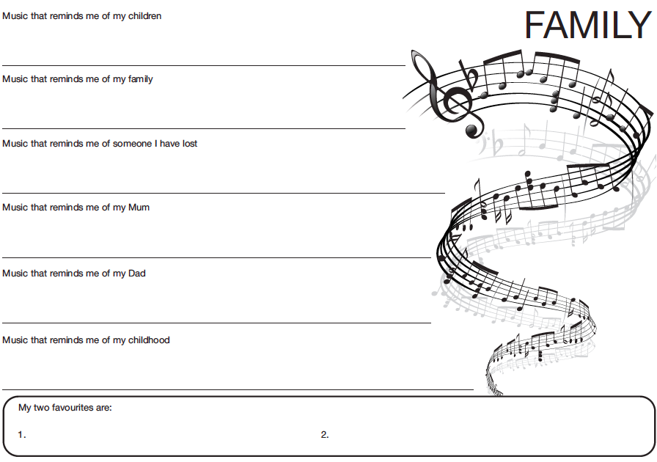
Notes:
Presenter notes 7mins [and into break if delegates wish to continue]
Divide delegates into groups of 3.
Hand out sample pages of the Soundtrack tool. Facilitate the completion of the questions and discussion within the groups.

Slide 7
Person
Centred
Values
CARER
Make time to talk and listen
Explain about dementia
Explain person centred care
Involve them with other professionals
Give charities and website information
Introduce them to other carers
Include them in training
Involve activities and life history work
Include them when working with the person
Involved them in care planning
Notes:
Presenter notes 2mins
Explain:
Soundtrack is about the individual being at the centre and having support which is based on person centred values.
[Soundtrack is about getting to know who a person truly is and recording their personal narrative/life story through the music that reconnects them to their memories and feelings. The soundtrack tool is equally accessible to anyone not just music lovers, because consciously or unconsciously music has always been a part of our lives. The tool is used with respect of the rights and choices that each individual makes, bearing in mind that as single piece of music may mean different things to different people. Soundtrack involves care workers, their line managers, commissioners, family and others who care and support the person working in partnership with the person with dementia.]
Partners listen, enable the person and gather the information that will ensure that they really get to know who the person is and what their outcomes are. Only then can we be supporting people to live with dignity and to have a good quality of life.

Slide 8
Benefits to the Person and their Family
Affirms the person’s sense of identity and attachment
Stimulates positive interaction
Promotes inclusion and meaningful occupation
Reconnect people to their past
Reassures and provides comfort
Notes:
Presenter notes 1min
Read slide
Explain that these benefits relate to Tom Kitwood’s flower – He stated that every person/human being has six psychological needs
LOVE
ATTACHMENT
OCCUPATION
COMFORT
IDENTITY
INCLUSION

Slide 9

Notes:
Presenter notes 5mins
Show video clip

Slide 10
Benefits for Staff
Broadens skills and knowledge
Promotes a proactive way of working
Encourages creativity and enjoyment of work
Helps them to see the whole person
Notes:
Presenter notes 1min
Read slide

Slide 11
Notes:
Presenter notes 5mins
Show video clip

Slide 12
Research Aim:
Improving Quality of Life
Soundtrack is a powerful way to reconnect with people
Stimulates and transports to another time and place
Recognises uniqueness of every individual
Strengthens life history and reminiscence work
Empowers and validates identity
Promotes physical and psychological wellbeing
Notes:
Presenter notes 2mins
Explain that there is a research project going on to evaluate the use of soundtrack. Our overall aim is to improve the quality of life of people affected by dementia [that is the person, their family and staff]. Our initial results are showing that Soundtrack:
[Read the slide]

Slide 13
To Find Out More:
Website:
www.joco.gb.net
Phone:
0115 9145879
Email:
john.osborne@joco.gb.net
farai.pfende@joco.gb.net
kate.williams@joco.gb.net
Social Media:
Find us on Facebook or Twitter @JoCoInfo
Notes:
Presenter notes 4mins
Ask delegates for feedback or questions

