Slide 1
Feedback from
The Soundtrack to My Life
John Osborne

Slide 2
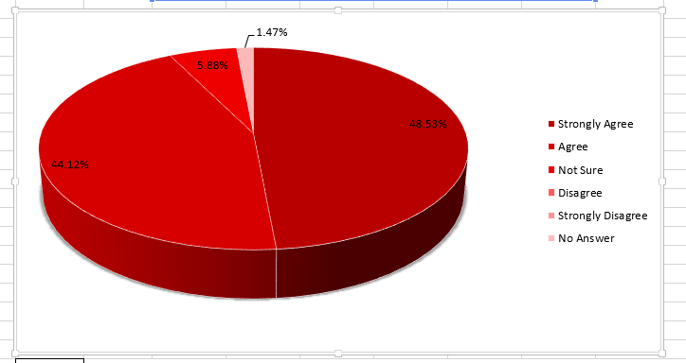
Feedback from JackDawe Staff
The training I attended will improve my work performance:
92.65% of staff
Strongly Agreed or Agreed
with the statement

Slide 3
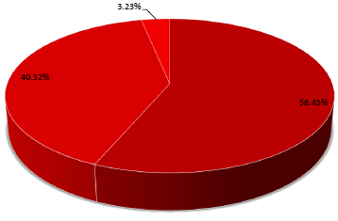
Feedback from JackDawe Staff
The enjoyed the training I attended:
96.77% of staff
Strongly Agreed or Agreed
with the statement

Slide 4
Lessons Learned
Staff working in dementia care:
Do need training
Do believe training enhances their practice
Training providers have a responsibility to support not only understanding but implementation

Slide 5
Going Forward
STML training now includes:
A clearer learning pathway for staff
Action plans to support learning and implementation
Action plans to ensure that individual care staff can engage & develop relationships with individuals and families

Slide 6
Vote of Thanks
The Jackdawe team of care staff and managers
Kate Fisher
Anthony Kelly and Elaine Argyle
Institution of Mental Health
Individuals and families using Jackdawe services

Slide 7
Training Event
The 3 session Soundtrack Training is being made available by Nottingham County Council at a cost of £30 per person. Sessions will be held at Rufford on the following dates:
13th June
9th July
3rd September
Information will be circulated by Kevin Tennant and will be available to book via Eventbrite

Slide 8
To find out more
Website:
www.joco.gb.net
Phone:
0115 9145879
Email:
john.osborne@joco.gb.net
farai.pfende@joco.gb.net
kate.williams@joco.gb.net
Social Media:
Find us on Facebook or Twitter @JoCoInfo

