Slide 1
CASA – Connecting Assistive Solutions to Aspirations
Conference for Home Care Staff
University of Nottingham 30-4-2014
Mike Craven, Maria Laura De Filippis, Tom Dening, Jen Martin
NIHR MindTech Healthcare Technology Co-operative
mindtech.org.uk

Slide 2
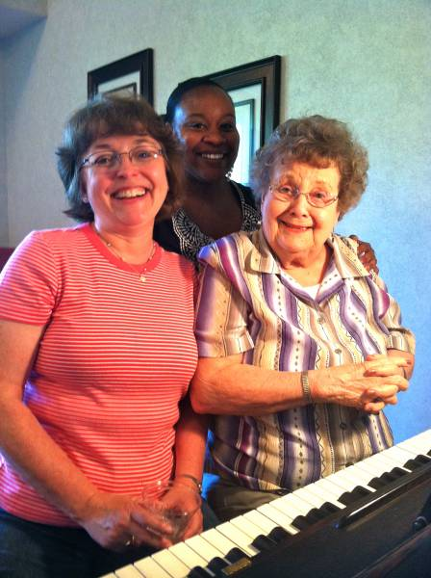
CASA – contents of talk
Context
Dementia
TSB long-term care ‘sandpit’
Overview of the CASA project
Technologies
Needs and Aspirations
Methods for capturing these
Evaluation tools
Carer interviews planned
Questions & discussion

Slide 3
What is dementia?
a clinical syndrome (combination of features)
due to brain disease, most often Alzheimer’s disease
various cognitive deficits (memory, thinking, language, praxis, spatial awareness etc)
sufficient to interfere with everyday life
usually progressive
does not of itself cause impaired consciousness

Slide 4
How common is dementia?
age-related condition (not caused by age)
about 700 000 people in UK with dementia
prevalence & incidence both rise sharply from 65-85/90 years old
> 65 prevalence approx 3%; >85 = 20%
can occur earlier in life (working age dementia) – about 17 000 in UK

Slide 5
How dementia interferes with daily life
memory – forget appointments, lose things
language
expressive – findings words, names
receptive – harder to understand what’s said
praxis – difficulty with daily tasks e.g. dressing
thinking & judgement, e.g. planning
alertness & motivation – can lead to apathy
altered mood and behaviour

Slide 6
Dementia and technology
what is specific to dementia?
continuum between good design & technology for older people in general and those with dementia
indeed, with what is good for people in society?
But…
not everyone with dementia is the same!
pathway from MCI to severe dementia, so needs may be different at different stages
working age dementia, younger cohort of people with different histories of tech usage and often living with younger families too

Slide 7
What technology may offer
Particular areas that may encompass unmet needs where technology may help:
encouraging daytime activity
company
continence
personal care
biofeedback including mood state

Slide 8
Assistive Technology issues
huge industry already (£150m ??) - lots of devices on market
web based resources e.g. www.atdementia.org.uk
little or no evaluation - better assessment of available evidence
tends to be product led, not needs led – this ought to change
how to ensure uptake of appropriate technology
equity of access?
attention to funding solutions
e.g. subscription, equity release etc

Slide 10
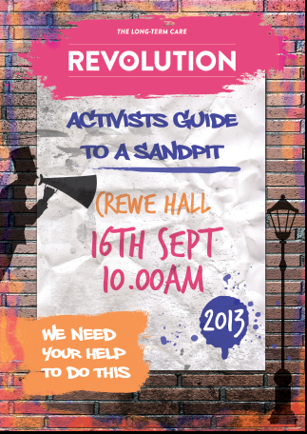
Into the Sandpit…

Slide 11
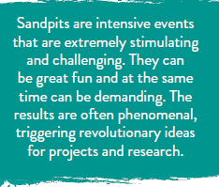
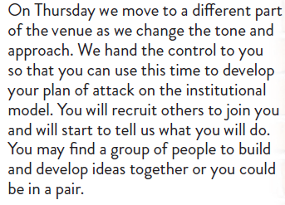
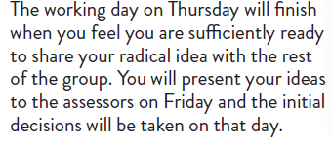

Slide 12
Overview of CASA
9 month project supported by government grant (TSB)
Aims
Create independent living packages for 2 groups
older people with dementia
younger people with learning disability
Link to a person’s aspirations – what they like doing or want to achieve in life
Conduct test of example packages
Develop business model for packages

Slide 13
Overview continued (Partners)
Partners
Leone Services Ltd. finance/business models
Sensixa Ltd. sensor technologies
University of Nottingham clinical specialists, tech. eval.
Alzheimer’s Society focus groups
University of West England user experience, robotics, data
Swiss Cottage School ‘smart home’ testbed

Slide 14
Overview cont. (Workpackages)
WP1 – Aspirational Co-Design of Enabling Technologies Packages
Develop co-design process away from ‘needs assessment’ model
Person-led approach to drive the selection of assistive technologies
Develop and test branding concepts that makes the purchase of these products and services desirable e.g. ‘cook easy pack’
WP2 – Delivering Smarter Proactive Technology
Integrate smart sensing technologies into everyday devices
Provide updates triggers by tracking physiological & cognitive changes
WP3 – Equitable Financing Strategies
New financial models and business cases
Explore data monetisation
WP4 – CASA Design Pilot Studies

Slide 15
CASA – contents of talk
Context
Dementia
TSB long term care sandpit
Overview of the CASA project
Technologies
Needs and Aspirations
Methods for capturing these
Evaluation tools
Carer interviews planned
Questions & discussion

Slide 16
Types of Technology
Alarms & pull cords (1st generation telecare)
Memory aids
Telecare (2nd generation)
Communications (3rd generation telecare)

Slide 17
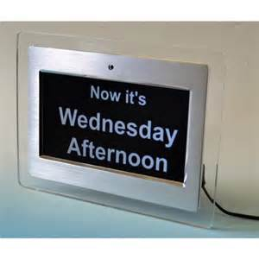
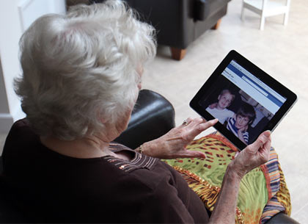
Memory technologies
Reminder messages
Clocks and calendars
Medication aids
Locator devices (for ‘lost’ objects)
Aids for reminiscence and leisure

Slide 18
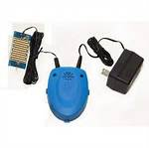
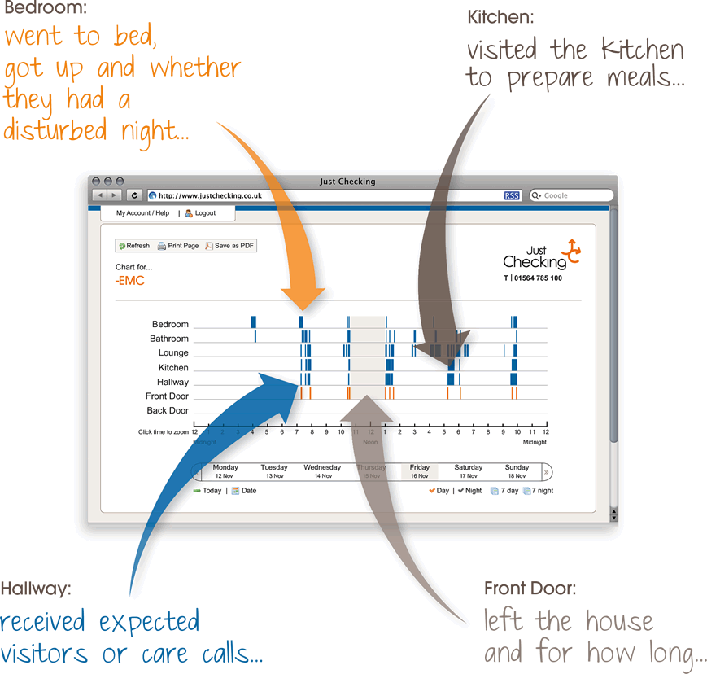
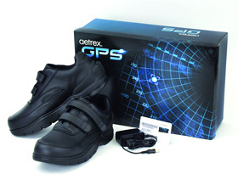
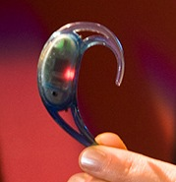
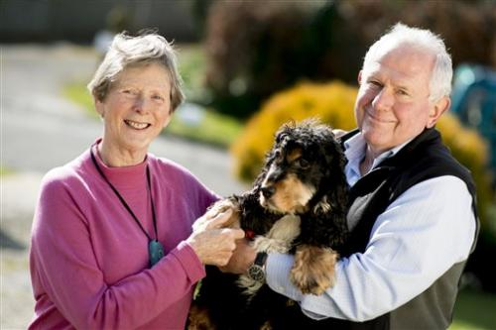
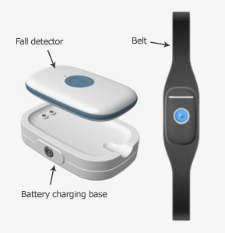
Telecare technologies
‘Smart home’ sensors
Floods
Extreme temperature
Gas
Location
Absence from bed/chair
Getting up in the night
Leaving the home
Falls
Physiological sensors

Slide 19
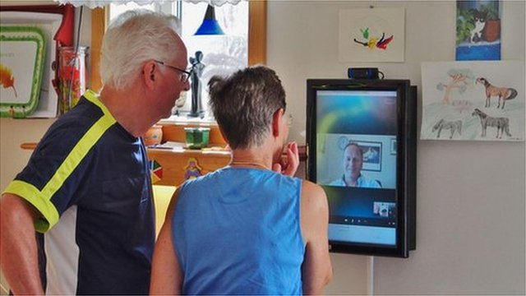
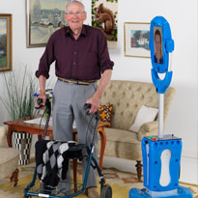
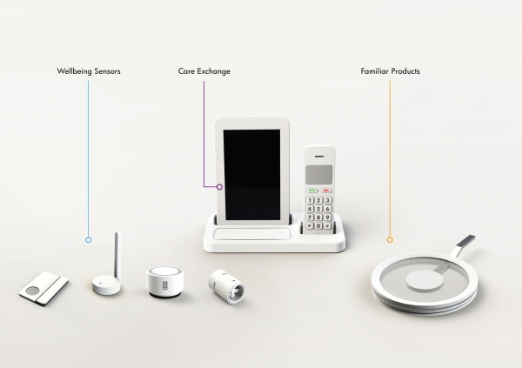
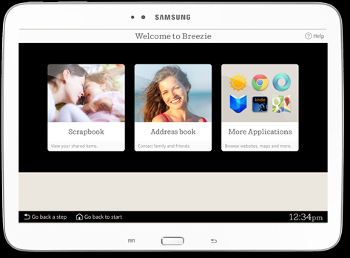
Communication technologies
Video links
‘Robots’
Phone/tablet Apps
Home hubs

Slide 20
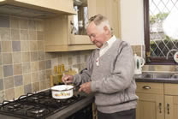
Possible model of informed design for CASA
Needs / motivations /meta-motivations
1: Participation, social relationship etc.
2: I want to cook more for myself and my guests
3a:With technology ‘X’ I can cook…
Assistive Technologies (AT) exist which may address aspiration?
Expectations about AT
If AT exists and is
accessible
If AT does not exist or is
not accessible
or if AT does
not match
aspirations
3b: I could cook comfortably
using a technology ‘with
features X, Y and Z’
YES
NO
Try out
different
ATs
Actual solution
User Experience
New solutions/
More accessible solution
Features
Integrations
Expected user experience
4a …in a (un)satisfactory way
Good Match?
NO
Partial /No
Match
4b … I want to order food
… I want to find recipes that I can cook independently etc.
Satisfaction
YES
Aspiration realised
Information for designers

Slide 21
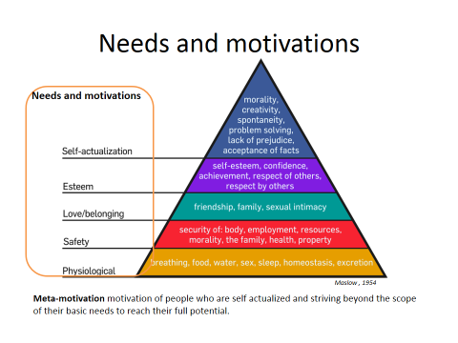
Needs and Aspirations
What do older people with dementia aspire to achieve?
Beyond basic needs
Reach full potential
Well-being: Social & Psychological as well as Physical … ‘Biopsychosocial’
Focussing on autonomy – choice and desires

Slide 22
Methods for capturing aspirations
Ask carers about older people in their care
Use focus groups
5 main questions
We want to start with few questions about which technologies help people with memory problems in everyday life.
We would like to ask you a few questions about your relationship and experience with Assistive Technologies and devices?
On the basis of your experience, when a user has to take a decision or make a choice, how do (or could) ATs support them?
On the basis of your experience, when a user has to communicate a decision or choice, how do (or could) ATs support them?
On the basis of your experience, when users have to aim to be autonomous and independent, how do (or could) ATs support them?

Slide 23
Evaluation tools
Various measures: QUEST, PIADS, LIFE-H, DEMQOL etc.
Determine their suitability for CASA …

Slide 24
Carer interviews
Schedule (Nottingham)
Ethics application & Alzheimer’s Society Partnership form completed
Two focus groups of 4-5 carers completed
Plus
Lincoln Social Care: Assisted Technologies familiarisation session

Slide 25
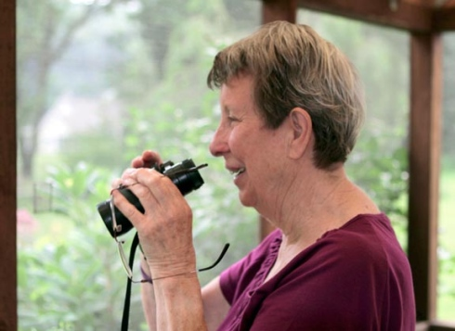
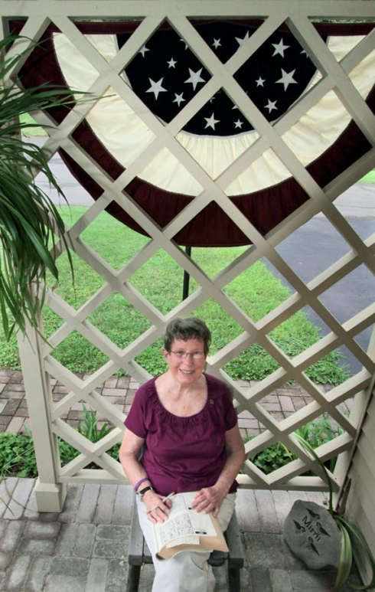
Questions?
Margaret "Mimi" Steffen walked about her immaculately kept ranch home in Honesdale armed with binoculars and ready to do one of the things she loves most: bird watching.
"I do my puzzles, stay socially active, and I'm writing my book," she said. "At this point, I won't get too upset if I can't remember some names of people or some of my birds."
http://thetimes-tribune.com/lifestyles/proactive-attitude-helps-one-woman-fend-off-alzheimer-s-effects-1.1027169

