Slide 1



Integration and your future
[some from Tony Wilde, but also, where should we go]
Grant from NIHR SSCR
Trent Dementia Research Network

Slide 2
Aims of IRIS [Intensive Recovery Intervention Service]
Prevent Hospital admission
Prevent entry into short term care
Prevent entry into long term care
Facilitate early discharge
Plus – enable a much better standard of home living

Slide 3
Partnership working
An accurate referral !
Discharge planned from day one
True joint working
Setting up good working relationships
Consistency of approach
The ‘real stuff’ that matters

Slide 4
WHY?
Aging populations (in the next 20 years the elderly population will go up by 40%)
First time ever there are more >65 than <18
Hospital beds (70% over age 65)
Cost of an NHS bed ~ £250 – 300 a day
Cost to the public purse - £4M a week!
Dementia time-bomb
Home is best ….

Slide 5
PM’s Dementia Challenge
“One in three people over 65 will develop dementia
In England in 2012, 670,000 people had dementia – (roughly) the combined populations of Bristol and Leicester. This number will double in the next 30 years...
Among the over-55s, dementia is feared more than any other illness…
(Roughly) £19 billion a year cost to our economy is huge…estimated… higher than the costs of cancer, heart disease or stroke…[&].. a moral imperative to improve dementia care”
Over the past 5 years (up to 2013):
Total research funding for dementia has doubled
At the G8 Dementia Summit in December 2013…[renewed]… commitment to the dementia challenge and announced its intention to double research funding for dementia again by 2025

Slide 6
FUNDING FOR HOME CARE!
Andrea Sutcliffe, CQC [Times, 28.04.14], ‘penalise…this type of visit (15 minutes)…inspect councils where poor provision of care.’
Grant from NIHR SSCR
Trent Dementia Research Network

Slide 7
Living well with dementia
at home & home care
support to do this
Grant from NIHR SSCR
Trent Dementia Research Network

Slide 8
East Midlands Academic Health Science Network (EMAHSN)
One of 15 new [AHSN’s] set up…to transform health and patient care through innovation… a new and unique partnership..key focus on adopting and spreading innovation and best practice. EMAHSN will develop solutions to healthcare problems and ensure existing solutions are spread more quickly..a population of 4.8 million… in the counties of [Notts., Derbys., Lincs., Leics., Northants. and Rutland]…focus on.., for example the care of frail older people...

Slide 9
We are approaching them to FUND this FORUM going forward – but how do you want it?
Grant from NIHR SSCR
Trent Dementia Research Network

Slide 10
East Midlands wide?
Health/social care commissioners stakeholders?
With the CQC?
How can you/we demonstrate service improvement?
Root in Service Template
Grant from NIHR SSCR
Trent Dementia Research Network

Slide 11

Nottingham University, Section of Old Age Psychiatry
Now “We need you!!” [again!]
You will help us all by telling us how to take things forward (not just today) to improve integration, partnership & service delivery

Slide 12
Nottingham University, Section of Old Age Psychiatry
Service Template for home care with dementia: ‘Ten Commandments’- must be considered
1. Commissioning (service suitable for people with dementia and carers)
2. Integration, co-ordination and care management
3. Person and relationship centred care
4. Continuity of care
5. Support for carers
6. Care planning
7. Training
8. Support for staff
9. Flexible and responsive services
10. Organisational factors (Policies, procedures, processes, systems and culture)

Slide 13
Nottingham University, Section of Old Age Psychiatry
Service Template for home care with dementia: ‘Ten Commandments’- must be considered
1. Commissioning (service suitable for people with dementia and carers)
2. Integration, co-ordination and care management
3. Person and relationship centred care
4. Continuity of care
5. Support for carers
6. Care planning
7. Training
8. Support for staff
9. Flexible and responsive services
10. Organisational factors (Policies, procedures, processes, systems and culture)

Slide 14

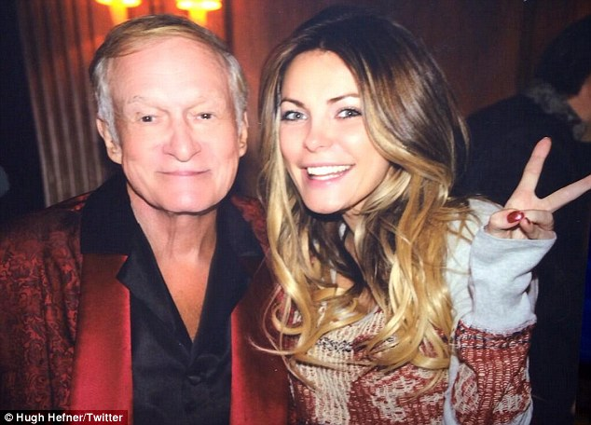
10 January 2014 : It's...different: Hugh Hefner didn't look too thrilled with his wife Crystal's balayage ombré hair makeover in a Twitter picture posted Thursday
'Thanks for all the positive comments on my new hair,' the previously platinum blonde wrote on Instagram Monday.
'It's a big change for me, and I knew you guys would give me your honest opinion. Now to convince Hef.'
When the on/off couple celebrated their first wedding anniversary on New Year's Eve, Crystal was still blonde as ever.

Slide 15
Services supporting people with dementia and their carers at home –a Service Template for proper services
Service template - says what should be considered for proper services
Grant from NIHR SSCR
Trent Dementia Research Network

Slide 16
10 January 2014 : It's...different: Hugh Hefner didn't look too thrilled with his wife Crystal's balayage ombré hair makeover in a Twitter picture posted Thursday
'Thanks for all the positive comments on my new hair,' the previously platinum blonde wrote on Instagram Monday.
'It's a big change for me, and I knew you guys would give me your honest opinion. Now to convince Hef.'
When the on/off couple celebrated their first wedding anniversary on New Year's Eve, Crystal was still blonde as ever.

