Slide 1










Study in Taiwan
Education Division
Taipei Representative Office in the UK
Ministry of Education
Republic of China (Taiwan)

Slide 2








Living in Taiwan
01
  Tradition meets Modernity
  Taiwan has a vibrant, multicultural environment. Cosmopolitan urban centres, stunning nature reserves, traditional indigenous culture, and food delicacies.
Study in
Taiwan
  Safe society and convenient living environment
  Ranked 1st in Health Care according to the CEOWORLD Health Care Index 2025. Happiest country in Asia in 2025. Consistently ranked among the top 5 countries for safety and friendliness for five consecutive years (2019–2023).
  Traditional Mandarin characters & culture
  Taiwan continues to use traditional Mandarin character forms.
  Learners can more fully appreciate Mandarin language and Taiwanese culture across the centuries.

Slide 3


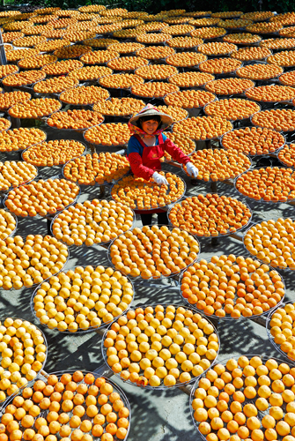

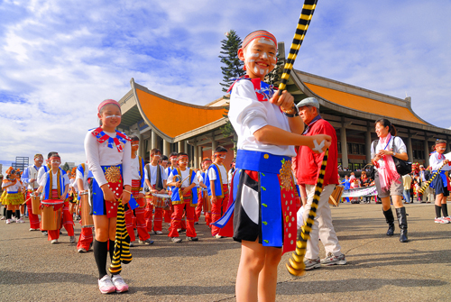




Slide 4
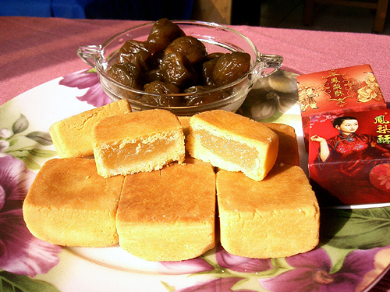
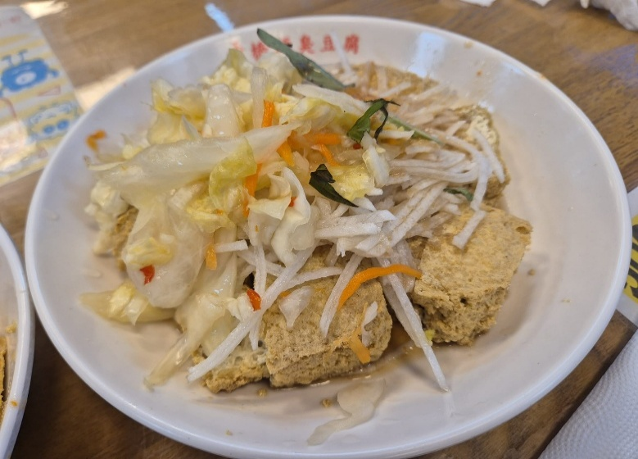

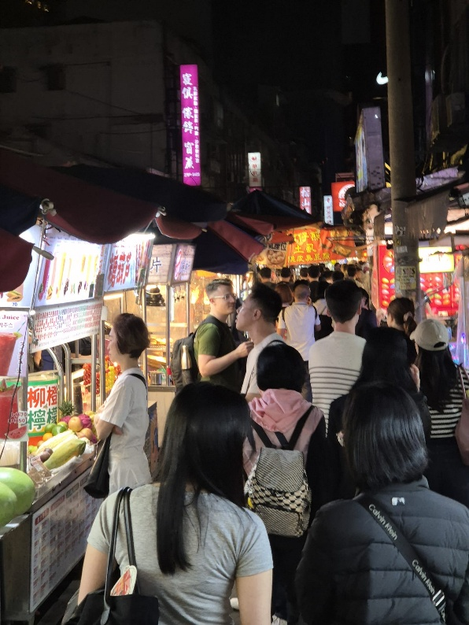
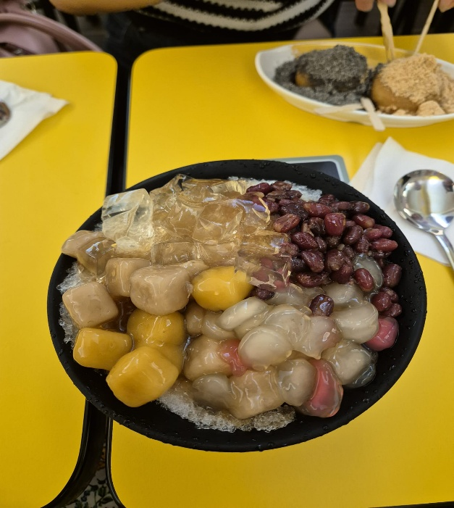

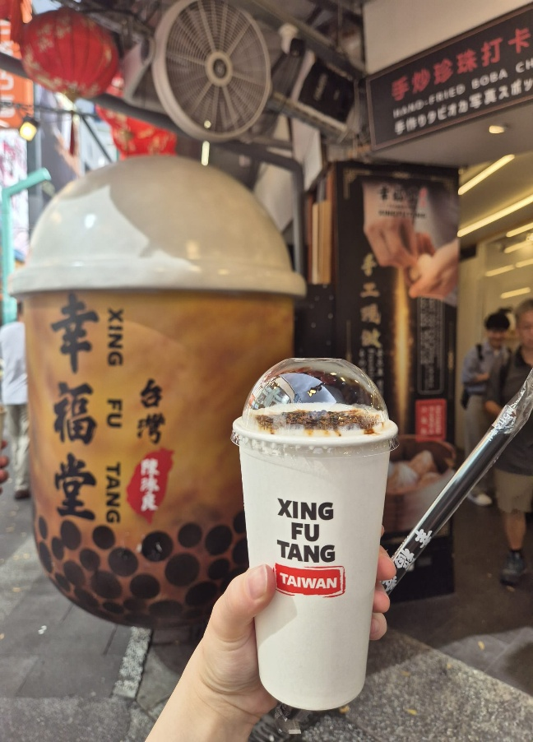
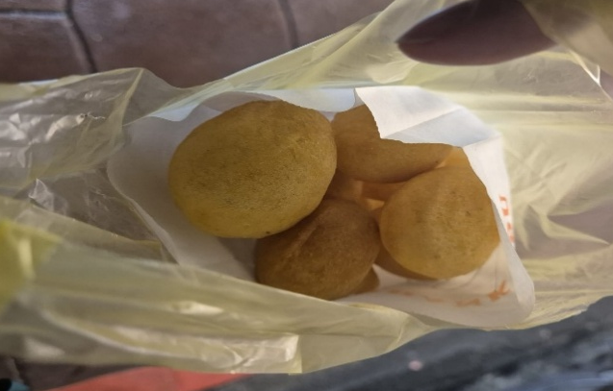

Slide 5




Scholarship Programmes
TAIWAN SCHOLARSHIP
For degree study in Taiwan
HUAYU ENRICHMENT SCHOLARSHIP
For Mandarin Chinese language study
in Taiwan

Slide 6





01
Taiwan Scholarship

Slide 7

01
Eligibility
UK Passport-holder
High-school diploma
(A-level or equivalent)
Post-secondary degree(s);
Excellent academic record

Slide 8
01
Disqualification
Taiwanese, Chinese, Hong Kong, and Macau citizens.
Already studying at a university/college in Taiwan (unless about to graduate and pursuing further study).
Already studied in Taiwan for degree of the same level.
Exchange or dual/joint degree students.
Received the Taiwan Scholarship for five years in total already or will exceed the five-year limit.
Had previous Taiwan Scholarship or Huayu Enrichment Scholarship from the MOE revoked.
Will receive other scholarship/subsidy from the Taiwan government or education institutions in Taiwan.

Slide 9


Taiwan Scholarship
01
  Monthly Stipends
Undergraduate: TWD $15,000 / month ≈ £365, 4 years
Master: TWD $20,000/month ≈ £500, 2 years
PhD: TWD $20,000/month ≈ £500, 4 years
  Waiver of Tuition Fee
  University Tuition Fee in TW
  Public: about TWD $40,000 / semester
  Private: about TWD $75,000 / semester
up to TWD 40,000 per semester

Slide 10


Application Process
Deadlines vary
By 31st March
Late April/
Early May
By 31st May
By June
Apply for admission
to a university
Applications submitted on the Taiwan Scholarship and HES Program Website
Letters of reference submitted to Ms Virginia at virginia@mofa.gov.tw
Interview
Result
announced
Provide
Admission Letter
Contact
Virginia 姜恬昕
Education Division, Taipei Representative Office
Email : virginia@mofa.gov.tw
Website: https://www.roc-taiwan.org/uk_en/cat/22.html
Notes:
華測會每年皆於國內外辦理多場測驗，以因應世界各地華語學習之熱潮，迄107年底考點已分布於海外30國，考生人數達53,168人次，累積考生人數已逾30萬人次。在海外施測部分，本部依「海外施測計畫」補助我國駐外單位相關試務經費；另有海外教育機構以代理模式協助辦理施測事宜，代理單位依報考人數繳交相應權利金。
我國華語文能力測驗繼107年1月獲匈牙利教育辦公室語言測試認證中心採認後，又於同年3月獲越南教育培訓部正式公告採認證書，並將其納入該國高考語文科目中文項目免試之證明，加拿大溫哥華卑詩省教育廳也採認華語文能力測驗為外語學分之標準。
另外，華語文能力測驗業建立與美國外語教學委員會（American Council on the Teaching of Foreign Languages, ACTFL）及歐洲共同語言參考架構（Common European Framework of Reference for Languages, CEFR）可相對應之分級架構，與國外指標接軌。
為因應產業界及學界需求，華測會亦開發「快篩測驗系統」，由使用單位購買帳號，採雲端測驗，具有隨到隨考，即測即評特性，半小時就能精確評估受測者之華語文聽力或閱讀能力等級，可協助企業快速掌握員工華語能力、幫助學校進行新生華語能力分班作業等。

Slide 11
Applying for Admission
01
  (1) Apply for Chinese-Taught Programmes
  Pass the “Test of Chinese as a Foreign Language” (TOCFL)
  Band B or above.
Hold in mid-March
In London
  (2) Apply for All-English Programmes :
  Check the programme is included in the 'English-taught Programme Reference List’
  Request the university to issue an official document confirming the course is taught fully in English

Slide 12
TOCFL
01
  Standardised Chinese language proficiency tests developed by Taiwan
Level |  | Indicative Course Hours In non-Chinese-speaking areas | Vocabulary Base | CEFR
Band Novice |  | 60-240 hours | 300
Band A | Level 1 | 240-480 hours | 500 | A1
 | Level 2 | 480-720 hours | 1000 | A2
Band B | Level 3 | 720-960 hours | 2500 | B1
 | Level 4 | 960-1920 hours | 5000 | B2
Band C | Level 5 | 1920-3840 hours | 8000 | C1
 | Level 6 | More than 3840 hours | 8000 | C2

Slide 13
01
Huayu Enrichment Scholarship
(HES)

Slide 14
01
Eligibility
UK Passport-holder
High-school diploma (A-level or equivalent)
Above the age of 18 years old
Excellent academic record

Slide 15
01
Disqualification
Taiwanese, Chinese, Hong-Kong, Macau nationals .
Currently studying Mandarin in Taiwan.
Have studied a degree programme in Taiwan.
Already received an HES or a Taiwan Scholarship in the past.
Exchange student to Taiwan.
Currently receiving financial benefits from the Taiwan government or another educational institution.

Slide 16

HES
  Monthly Stipends
28,000 NTD ≈ £680
  Duration
Short-term course: 3, 6, 9 months
Between Sept. 2026 and August 2027

Slide 17
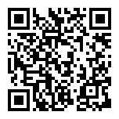
Application Process
Deadlines vary
By 31st March
End of May
June
Apply for admission to a language centre
Applications submitted to BACS
Result
announced
Provide
Admission Letter
Website:
The British Association for Chinese Studies, BACS
Notes:
華測會每年皆於國內外辦理多場測驗，以因應世界各地華語學習之熱潮，迄107年底考點已分布於海外30國，考生人數達53,168人次，累積考生人數已逾30萬人次。在海外施測部分，本部依「海外施測計畫」補助我國駐外單位相關試務經費；另有海外教育機構以代理模式協助辦理施測事宜，代理單位依報考人數繳交相應權利金。
我國華語文能力測驗繼107年1月獲匈牙利教育辦公室語言測試認證中心採認後，又於同年3月獲越南教育培訓部正式公告採認證書，並將其納入該國高考語文科目中文項目免試之證明，加拿大溫哥華卑詩省教育廳也採認華語文能力測驗為外語學分之標準。
另外，華語文能力測驗業建立與美國外語教學委員會（American Council on the Teaching of Foreign Languages, ACTFL）及歐洲共同語言參考架構（Common European Framework of Reference for Languages, CEFR）可相對應之分級架構，與國外指標接軌。
為因應產業界及學界需求，華測會亦開發「快篩測驗系統」，由使用單位購買帳號，採雲端測驗，具有隨到隨考，即測即評特性，半小時就能精確評估受測者之華語文聽力或閱讀能力等級，可協助企業快速掌握員工華語能力、幫助學校進行新生華語能力分班作業等。

Slide 18
01
Other Opportunities

Slide 19
Fellowships
  For Foreign PhD student or
  Postdoctoral Research Fellow
To undertake short-term research in Taiwan
Duration: from 2 to 6 months
PhD Student: $25,000 NTD/month
Postdoctoral: $40,000 NTD/month
+
Economy Class Round-Trip Airfare
  Application Process
Find a host university in Taiwan
Submit application by 30th Sept.

Slide 20
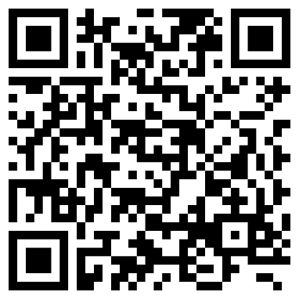

TFETP – TAIWAN FOREIGN ENGLISH TEACHER PROGRAM
  English Teacher
English Native Speaker + Bachelor’s or above from an accredited University + teaching qualification
Stipends:
- Holders of a bachelor’s degree: NT$ 65,230~85,380.
- Holders of a master’s degree: NT$ 72,760~94,980.
- Holders of a doctoral degree: NT$ 75,950~100,010.
English Teacher Assistant
English Native Speaker + Bachelor’s from an accredited University
Monthly salary of NT$48,000

Slide 21
  MOFA Opportunities
  Taiwan – Europe Connectivity Scholarship
Open to European passport holders studying at European Universities
University to University Cooperation
  YMS Scheme
Working holiday visa for 18-30 y.o
Work or study in Taiwan for 1 year

Slide 22

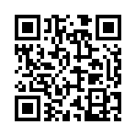
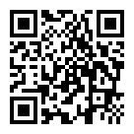



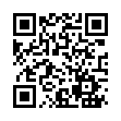
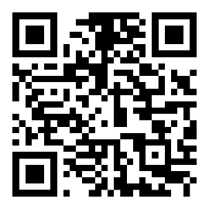

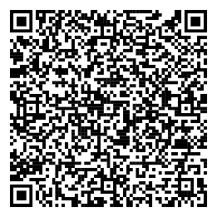
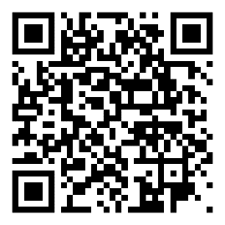

Reference
Taiwan Scholarship and
Huayu Enrichment Scholarship
Program Website
Bureau of Consular Affairs
Taiwan Fellowships
and Scholarships

Slide 23
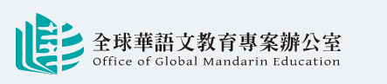
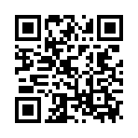

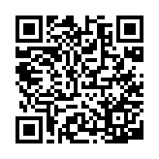

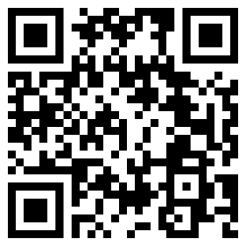
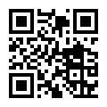

Reference
Mandarin Learning
TOCFL
Mock Test
Office of Global
Mandarin Education
Youth Mobility

Slide 24
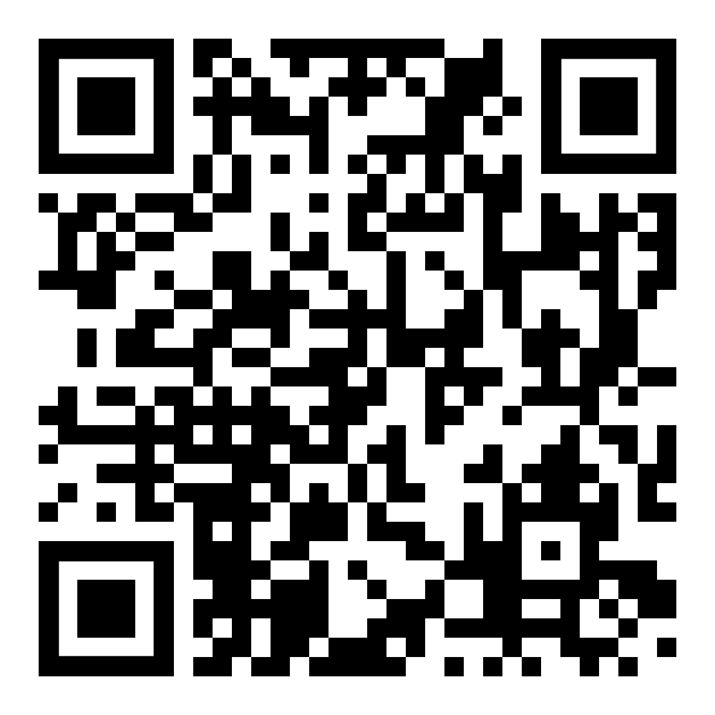

Contact Us!
More information on the TRO website:
Virginia 姜恬昕，Education Officer
Education Division, TRO London
020 7881 2650
london@mail.moe.gov.tw
virginia@mofa.gov.tw
Notes:
「與他國相關合作計畫」：合作開設華語課程-政府、非政府組織部份，舉例如下：
本部曾補助我國優質華語教師為外國單位（圖書館、政府單位）辦理短期華語進修課程
休士頓警用華語課程熱鬧啟動 警民互動和諧融洽：https://epaper.edu.tw/windows.aspx?windows_sn=21061
另本部也曾依據「促進華語文教育產業發展補助要點」，透過舊金山教育組補助國外圖書館聘請教師開設華語課程之鐘點費
或補助海外菁英（如駐外人員、政府機關）來臺接受密集華語訓練課程。
歐盟官員來臺樂學華語並說明歐盟獎學金最新訊息：https://www.edu.tw/news_Content.aspx?n=9E7AC85F1954DDA8&s=B7F6E129E003D53B

Slide 25

Q&A
Thank you!

