Slide 1
Disclaimer:
The information contained within this presentation is based upon the Dangerous Goods Regulations in force in 2012.
These will be updated in January 2013, so the information may not be accurate after this date.
This presentation remains the property of RoadSafe Europe Limited

Slide 2


The transportation
of Dangerous Goods

Slide 3
KEITH
HARRINGTON
Unit 006, Solent Business Centre, Millbrook Road West, Southampton, Hampshire, SO15 0HW
www.roadsafeeurope.com

Slide 4
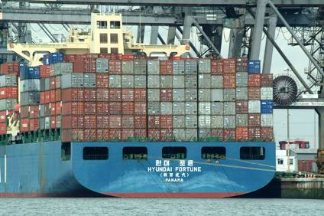
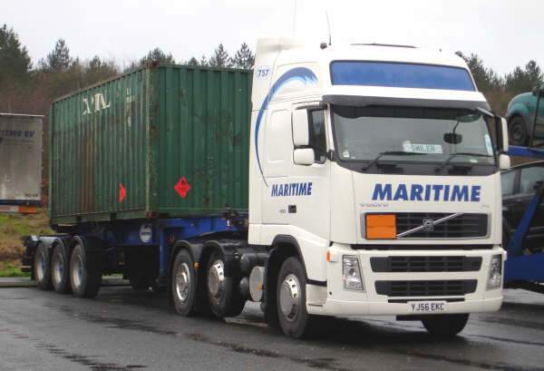
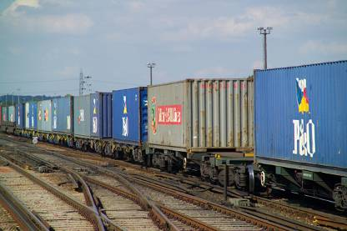

The Transport Chain

Slide 5
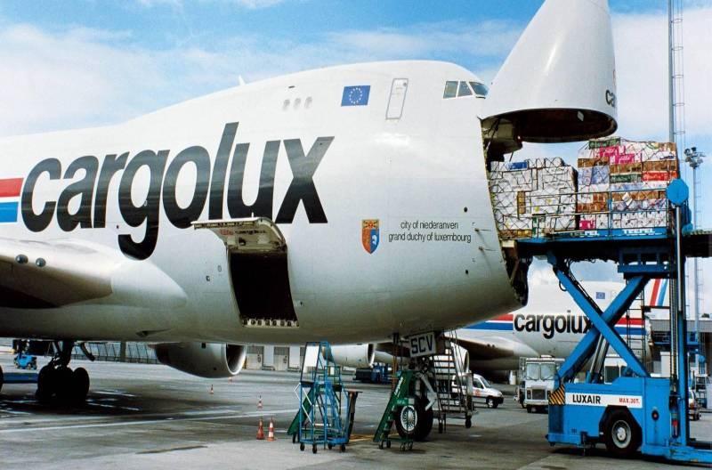

Dangerous Goods by Air
Dangerous Goods by air are governed by the IATA (International Air Transport Association) Regulations.

Slide 6

Dangerous Goods by Air
To package or consign Dangerous Goods by Air there is a legal obligation to hold a Vocational Training Certificate, obtained by receiving formal training on a two yearly cycle.
Today’s course will not be suitable.

Slide 7
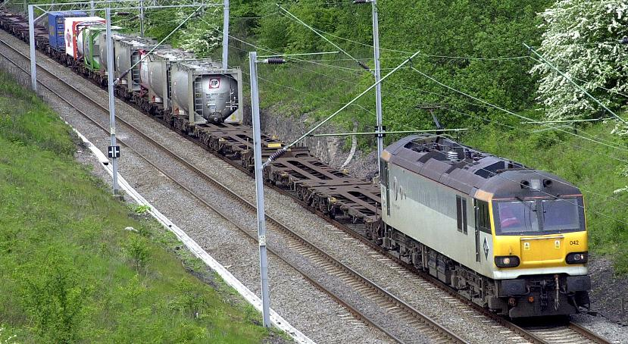

Dangerous Goods by Rail
International rail journeys are controlled by the RID (Reglement concernant le transport International ferroviare des merchandises Dangereuses) Regulations.

Slide 8
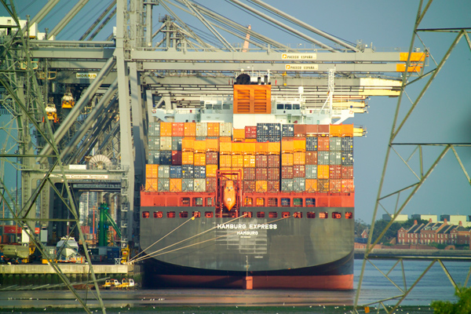
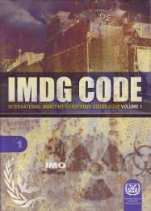
Dangerous Goods by Sea
Sea transport is subject to the IMDG Code. (International Maritime Dangerous goods)

Slide 9
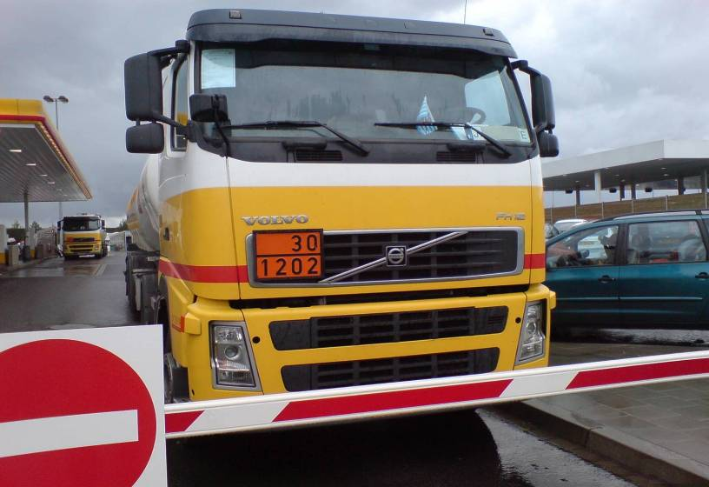
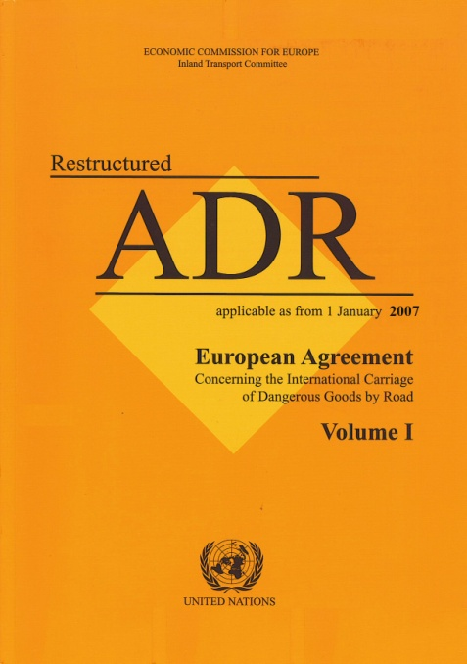
Dangerous Goods by Road
And, for International road journeys we have ADR (l'Accord européen relatif au transport international des marchandises Dangereuses par Route) – an agreement between 46 countries.

Slide 10
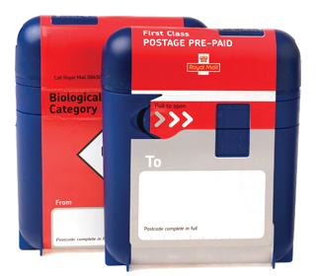

Dangerous Goods by Post
Essentially, the Royal Mail will not except categories of “Restricted” and “Prohibited” goods, which will include all forms of Dangerous Goods (full lists can be found on their website).
They will accept diagnostic specimens (UN 3373) in the general post, provided they are correctly packaged in their own SafeBox™ packs.

Slide 11
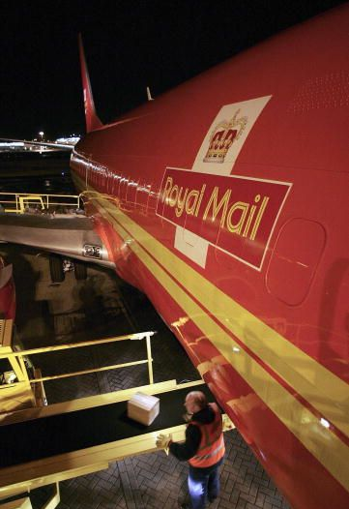
Air Mail
 Patient specimens, provided they are packed correctly.
Dangerous Goods are forbidden for carriage as Air Mail, except the following items that are allowed, subject to acceptance by national postal services and the IATA Regulations:
 Infectious Substances assigned to Category B……….… .….(UN 3373), again packaged correctly.
 Some low level radioactive materials …..(provided the activity does not.exceed one tenth of that permitted in Table 10.5.A, Page 635)

Slide 12

On-site movements
Movements wholly within an enclosed area are exempt from the main parts of the Regulations.
Also, between private premises and a vehicle in the immediate vicinity (for example loading a vehicle just outside the premises) - up to 100 metres according to the HSE.

Slide 13
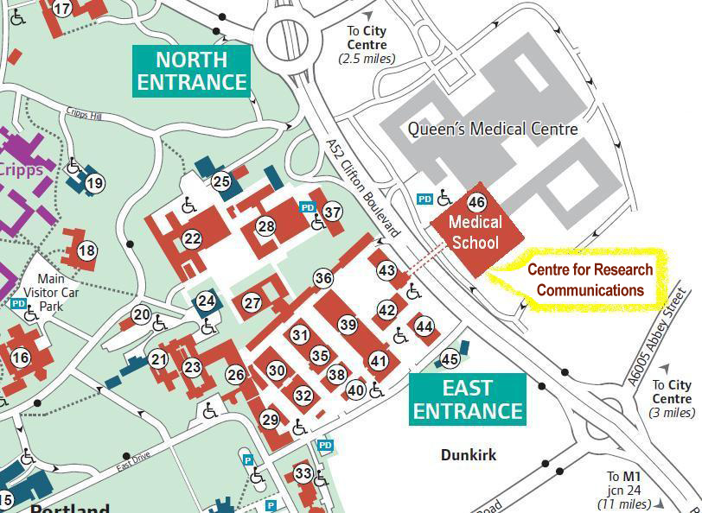

Site-to-site transfers
Transport between two private University premises within “the immediate vicinity” will be exempt from ADR, even if public roads are used.
Subject to any Court ruling, the HSE work on an arbitrary distance of 400 metres.

Slide 14



Public Transport
No actual guidance on the carriage of Dangerous Goods by individuals on public transport (other than for air) has been produced in the UK.
Therefore the decision to carry rests with the transport operator/driver. But, it will probably be refused on public safety or civil liability grounds.

Slide 15
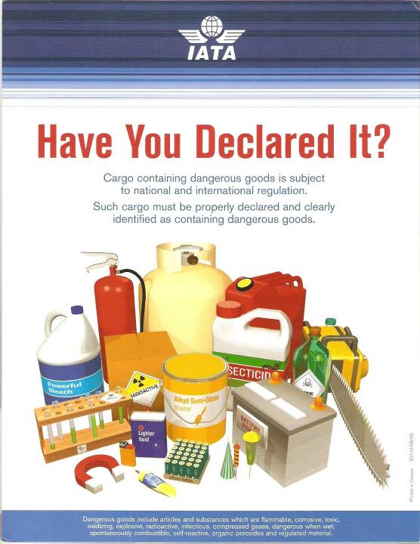
Public Transport
NEVER attempt to take Dangerous Goods on to commercial aircraft in either your checked, or carry-on baggage

Slide 16
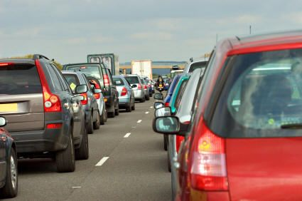
Private or Rental cars
The ADR Regulations are determined by the type and packaging of the Dangerous Goods, NOT the vehicle. So, cars may need to comply with the law.
A blanket exemption is in place for Dangerous Goods carried by private individuals, where the goods are packaged for retail sale, and are intended for their personal, domestic or sporting use.

Slide 17
Hazardous Wastes
Hazardous wastes are considered to be no different from other goods in ADR – the same limits, packaging and training requirements exist.
However, in the UK we have extra rules and regulations that will effect off-site waste movements.
But, not all Hazardous Wastes are Dangerous Goods.
The procedures for clinical wastes are changing. (stay tuned………….)

Slide 18

Hazardous Wastes
These two sets of UK Regulations impose greater restrictions on us in an attempt to stop some of the more “inventive” disposal methods.
STATUTORY INSTRUMENTS
STATUTORY INSTRUMENTS
2011 No. 894
2005 No. 895
ENVIRONMENTAL PROTECTION
ENVIRONMENTAL PROTECTION, ENGLAND
ENVIRONMENTAL PROTECTION, ENGLAND
The Hazardous Waste (England & Wales)
(amendment) Regulations 2011
The List of Wastes (England)
Regulations 2005

Slide 19
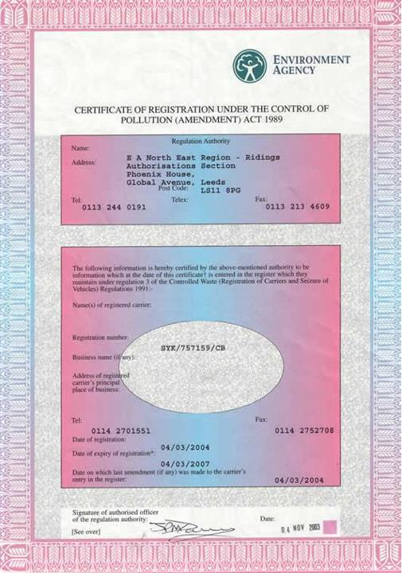
Wastes
The Controlled Waste (Registration of Carriers and Seizure of Vehicles) Regulations 1991 requires waste carriers to be registered and licensed by The Environment Agency.

Slide 20
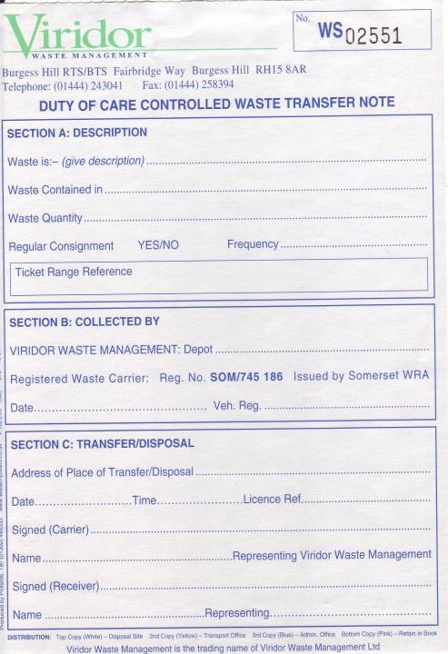

Wastes
Controlled Waste must be transported with a “Duty of Care” Waste Transfer Note, signed by the waste producer; the carrier and the disposal site.
All disposal sites must also be licensed.

Slide 21
Wastes
Hazardous Wastes loads must be accompanied by a special Transport Document called a Consignment Note.
The waste producer must now also be registered with the Environment Agency.
Waste paperwork must be retained for three years, and must be fully traceable.

Slide 22
International Waste Moves
Scotland is considered to be a different country from the rest of the UK, with their waste being regulated by the Scottish Environmental Protection Agency (SEPA).
The SEPA Consignment Note does not contain sufficient information to be used as an ADR Transport Document, so dangerous wastes will need extra documents.
Transporting waste to or from Scotland, and every other EU member State, is subject to stricter rules – The Transfrontier Shipment of Waste Regulations.
Page 22

Slide 23
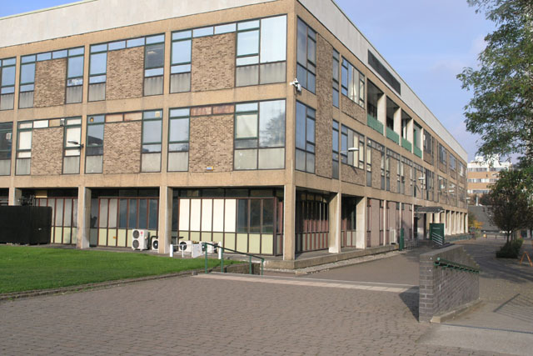
CHEMISTRY and PHYSICS departments

Slide 24
Chemical Transfers
Wherever possible, Dangerous Goods should be transported in their original packagings, as most packaging will need to be UN approved.
UN approval only indicates that the package will survive “normal transport conditions”.
The manufacturer will apply markings to the packagings to show that they have been tested. These markings always start with the UN packaging mark:
U
U

Slide 25
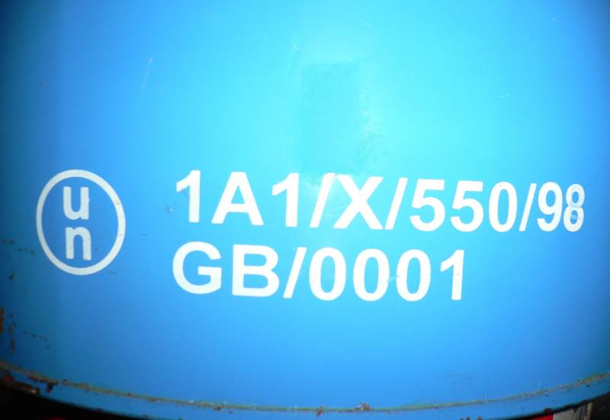

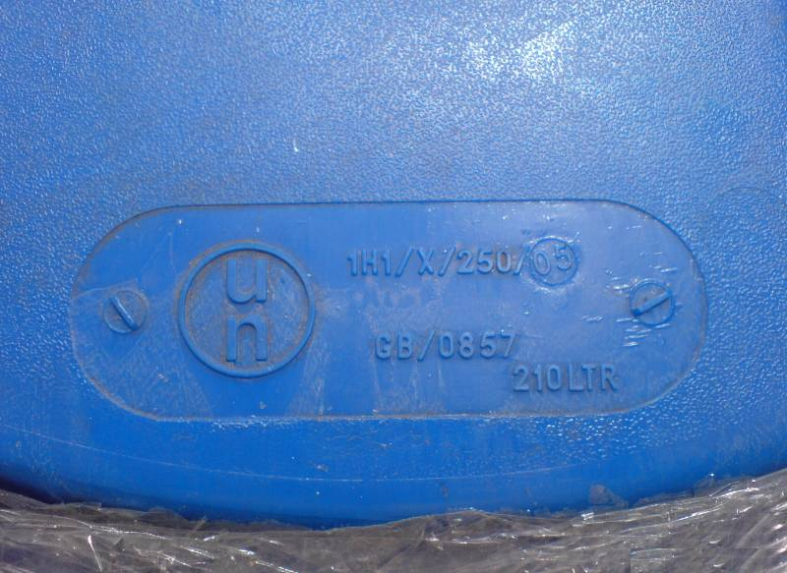
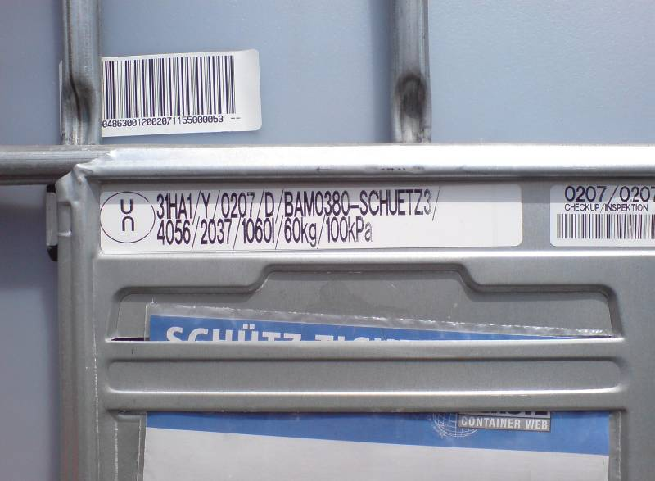
Steel drum
Cardboard box
Plastic drum
IBC

Slide 26
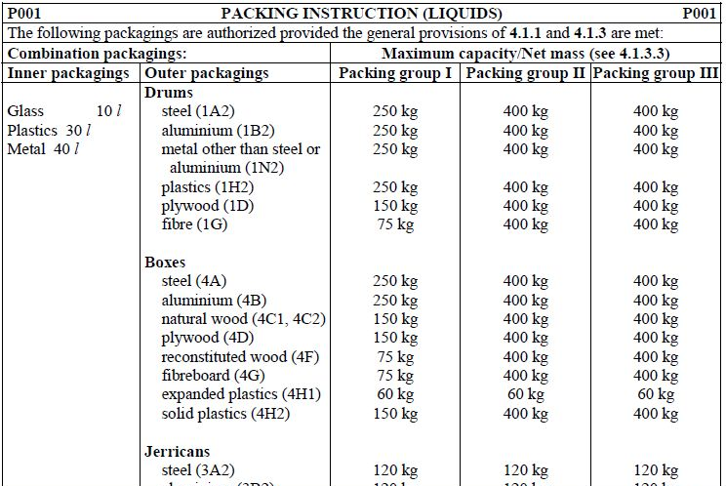
Chemical Transfers
All Dangerous Goods have a Packing Instruction

Slide 27
A
typical
Combination
Package
Inner packaging(s)
Inner divider for cushioning
Fibreboard Box (4G)

Slide 28
A
typical
Combination
Package
Inner packaging(s)
Styrofoamcushioning material
Fibreboard Box (4G)

Slide 29
ADR (Road) Regulations
Whilst carrying packaged Dangerous Goods, there are ways of effectively being able to ignore some of the Regulations. These conditions are subject to:
The size of the packages
How dangerous the goods are
How much is being carried
We will look at these ways out….

Slide 30
ADR (Road) Regulations
The size of the packages
These are exemptions present in all modes of transport that allow small items of packaged Dangerous Goods to be almost considered non-hazardous.
Each inner container must not exceed the maximum volume/mass indicated for that substance in the Regulations, and the gross mass of the entire package must not exceed 30kg.

Slide 31
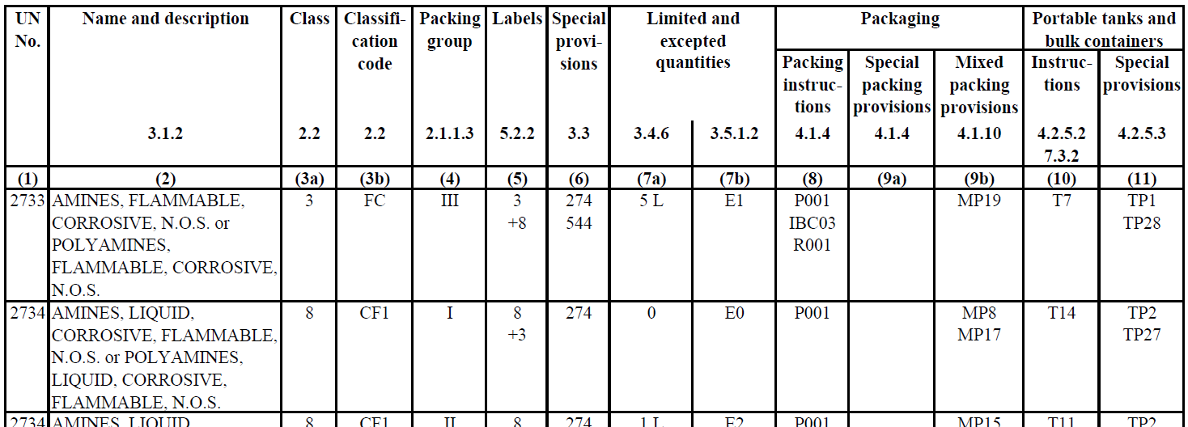
Limited Quantities
The Dangerous Goods list gives a “Limited Quantity” for each listed substance or article.
These figures tell us the suitable inner receptacle size.

Slide 32
Limited Quantities
However the figure “0” means that there is no Limited Quantity provision, as the material is considered to be too dangerous to exempt.

Slide 33
Limited Quantities
Any item of Dangerous Goods you buy in a supermarket, Pharmacy or DIY shop (e.g. paints, garden chemicals, cleaning materials etc), would have got there under the Limited Quantities provisions of the Carriage of Dangerous Goods by Road Regulations, as did many of your laboratory reagents.

Slide 34
Limited Quantities

Slide 35

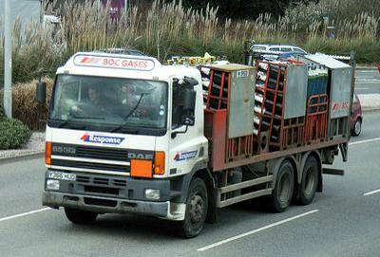



Gas Cylinders
Gas cylinders are best transported upright in racks or cradles, on open-backed vehicles.

Slide 36
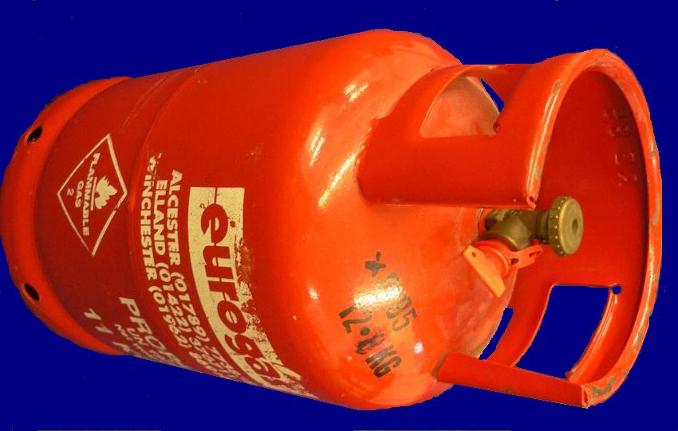
Gas Cylinders
Gas cylinders can be transported in closed, ventilated vehicles and containers.
Toxic gases must NEVER be transported in the same compartment as the vehicle crew or any passengers.
LPG and other liquefied gases MUST be stowed UPRIGHT.

Slide 37
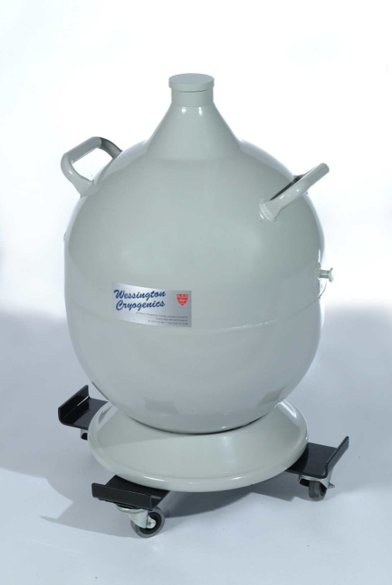
Cryostats
By design, cryostats and Dewar flasks cannot be hermetically sealed, and will constantly be venting large volumes of potentially asphyxiating or oxidizing gas.
As before, these must must be secured in the vehicle and kept UPRIGHT.

Slide 38
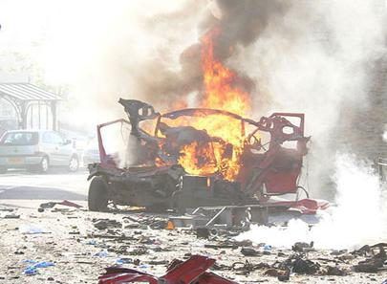
Gas Cylinders/Cryostats
Wolsingham, County Durham, May 2007 – one dead due to blast injuries.
WARNING:
NO VENTILATION
OPEN WITH CAUTION

Slide 39

Environmentally Hazardous
The Environmentally Hazardous marking is required on packages of polluting materials containing more than 5kg/L.
As the UN re-classifies other goods, this marking will become far more common.

Slide 40

MEDICAL and BIOLOGICAL departments

Slide 41
Infectious Substances
The heading of Class 6.2 covers infectious substances, which, for the purposes of ADR, are substances which are known or are reasonably expected to contain pathogens.
Pathogens are defined as micro-organisms (including bacteria, viruses, parasites, moulds, spores and fungi) and other agents such as prions, which can cause disease in humans or animals.

Slide 42
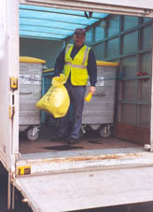
Infectious Substances
Class 6.2 is sub-divided as follows:
- Infectious substances affecting humans
- Infectious substances affecting animals only
- Clinical Wastes
- Biological Substances

Slide 43
Infectious Substances
And in turn, Infectious substances are divided into the following categories:
CATEGORY A
Are Infectious substances that are carried in a form that, when exposure to it occurs, is capable of causing permanent disability, life-threatening or fatal disease to either humans or animals.

Slide 44
Infectious Substances
These are assigned either one of these UN Numbers:
UN 2814
UN 2900

Slide 45
Infectious Substances
CATEGORY B
Are Infectious substances that do not meet the criteria for inclusion in Category A.

Slide 46
Infectious Substances
These are assigned to UN Number:
UN 3373

Slide 47

Infectious substances
Category A substances must be labelled with a Class 6.2 hazard diamond:
Category B substances must show the UN number in a diamond shaped area:
UN 3373

Slide 48
Infectious substances
Like all Dangerous Goods, infectious substances have explicit Packing Instructions (P620 for Category A, and P650 for Category B).
Category A (UN No.s 2814 and 2900) must also be in UN approved Packages:
U
4G/CLASS 6.2/10/GB/1234
U

Slide 49

Leakproof inner primary receptacles
Absorbent material
Leakproof secondary packaging
Itemised list of contents
UN 2814
Rigid UN approved outer packaging.
4G/CLASS 6.2/S/09/GB/3798
U
n

Slide 50
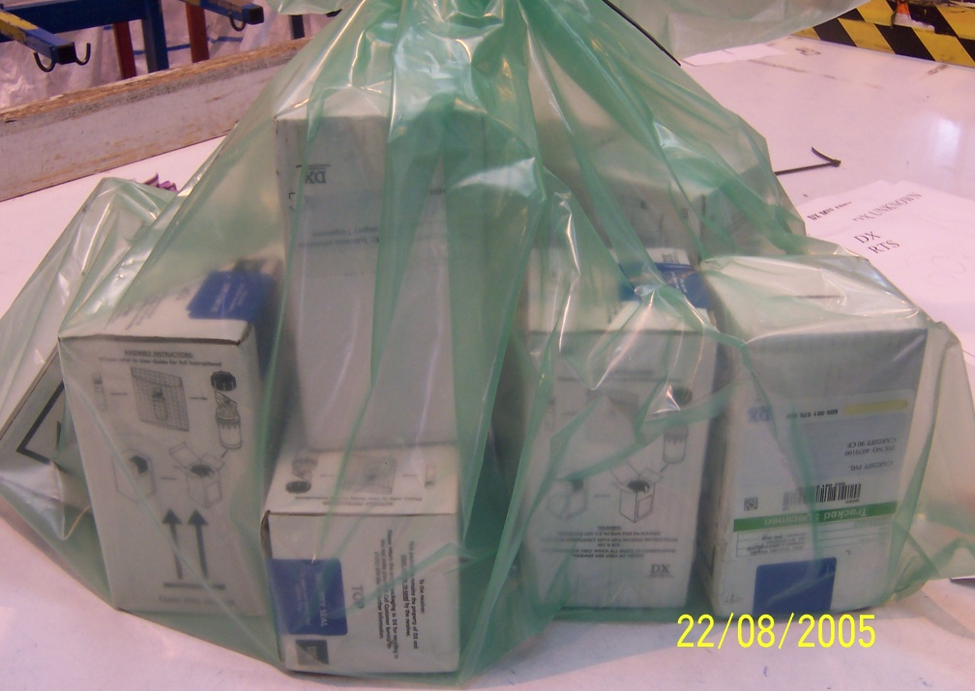
Infectious substances
Category B, Biological Substances (e.g. samples, vaccines, cultures etc) are exempt from the rest of ADR provided they are correctly packaged to the specifications in P650.
Remember these can even go in the post.

Slide 51
Leakproof inner primary receptacles
Absorbent material
Leakproof secondary packaging
BIOLOGICAL SUBSTANCE, CATEGORY B
Rigid outer packaging with cushioning material (e.g. styrofoam inserts)
UN3373

Slide 52
Clinical wastes (UN 3291)
Infectious for disposal by incineration:
The familiar yellow packages are being restricted to the most dangerous materials: Infectious materials (UN no.s 2814 and 2900), sharps, anatomical waste, carcasses, cytotoxic drugs etc.
If UN 2814 or 2900, then these items are ALWAYS subject to full ADR rules.

Slide 53
Clinical wastes (UN 3291)
Infectious for disposal by “other treatments”:
Orange bags are being introduced to replace most yellow bags. These are intended for materials such a used dressings, swabs, blood contaminated items.
They may be autoclaved/ heat treated prior to disposal by deep burial landfill.

Slide 54
Offensive wastes
Offensive wastes for disposal by landfill:
“Tiger Stripe” bags are being introduced for clinical waste where there is a minimal risk of infection. Examples may include incontinence waste, nappies, disposable bedpans etc
These will be routed for disposal to deep burial landfill.

Slide 55
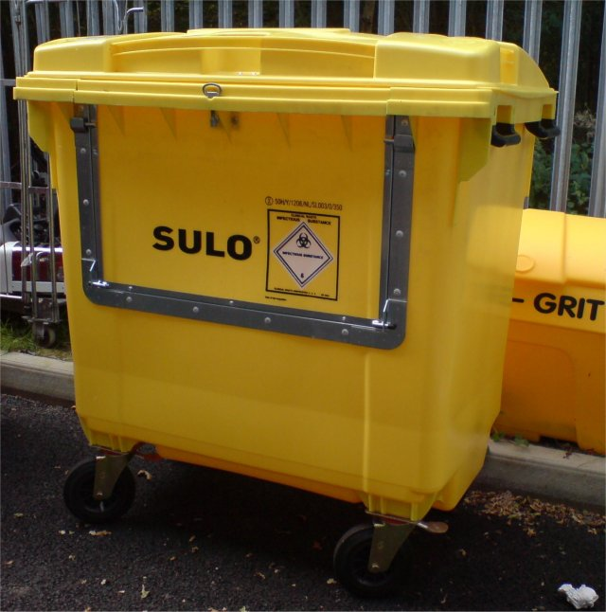
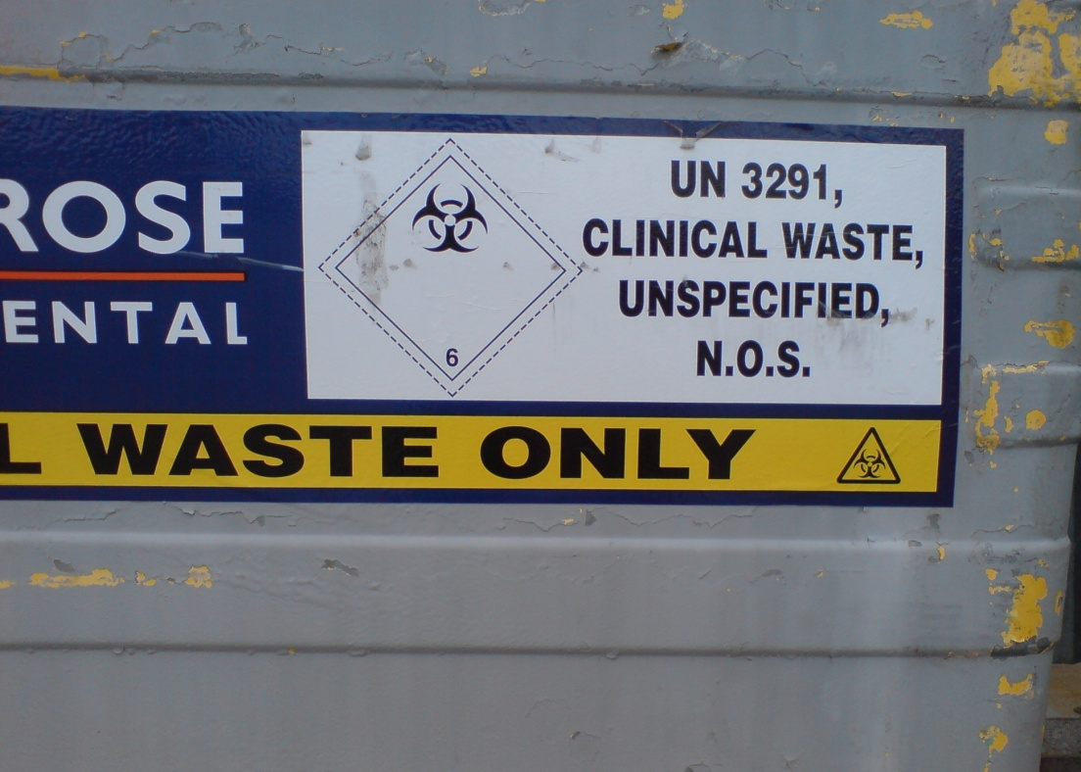
Clinical wastes (UN 3291)
Clinical Wastes have an ADR load limit of 333kg, provided the waste is contained in sealed, rigid, puncture resistant outer packages.

Slide 56

Exempt Specimens
Human or animal specimens for which there is a minimal likelihood that pathogens are present are not subject to the ADR Regulations provided they are packaged to prevent any leakage.
Such materials must be marked “exempt human specimen” or “exempt animal specimen”, as appropriate.
EXEMPT HUMAN SPECIMEN

Slide 57
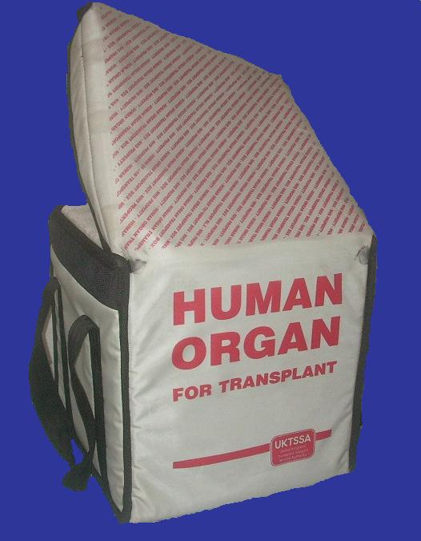

Exempt Materials
Blood and its components, which have been collected for transfusion, or the preparation of blood products, and also organs, harvested for transplantation, are exempt from the ADR Regulations.

Slide 58
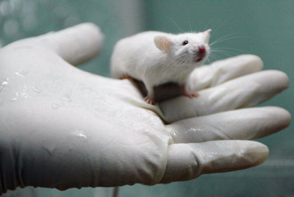
Laboratory Animals
Live animals are to be transported in accordance with Directive 91/628/EEC.
Unless an infectious substance cannot be consigned by any other means, live animals shall not be used to consign such a substance.
Should such carriage be necessary, approval must be sought from the Department for Transport.

Slide 59
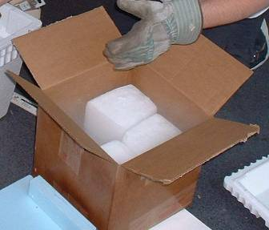
Dry Ice
Dry ice is not Dangerous Goods by road, but is dangerous by sea and air, due its possible asphyxiation hazard.
It is usually the Dangerous Goods cooled by the ice that take priority, but the presence of the ice is shown by the display of an additional Class 9 Label.
Packagings containing dry ice must be able to safely vent without the risk of rupture.

Slide 60





Dry Ice
Biological Substance, category B
Shipper:
BioGen Inc
2705 Pleasant Lake Shore
Cadillac, Michigan
USA, MI45556
Consignee:
Micro Works Limited
Blueprint 2000
Portfield Road, Portsmouth
Hampshire, UK
PO4 6TY
RESPONSIBLE PERSON:
Dr James Robertson
Tel: (0)2392 334 565
5

Slide 61
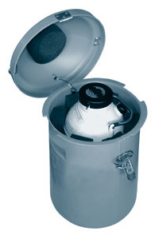
Dry Shippers
Dry Shippers are devices for holding materials at low temperatures by packing the samples in an absorbent that is impregnated with liquid nitrogen.
If filled correctly, they will not have any free liquid phase, so are not Dangerous Goods by road, but again, the samples may be.

Slide 62
Genetically Modified Micro-organisms
GMMO’s are assigned to Class 9 of Dangerous Goods (UN 3245), provided they do not meet the definition of infectious substances, but are capable of altering plants, animals microbiological substances or ecosystems in an unnatural way.
GMMO’s are not subject to ADR when authorised by the competent authorities of all nations involved in there carriage – origin, destination and transit.

Slide 63

Genetically Modified Micro-organisms
UN 3245
A “strong enough” outer packaging
Watertight primary receptacles
Watertight secondary packaging with absorbent

Slide 64
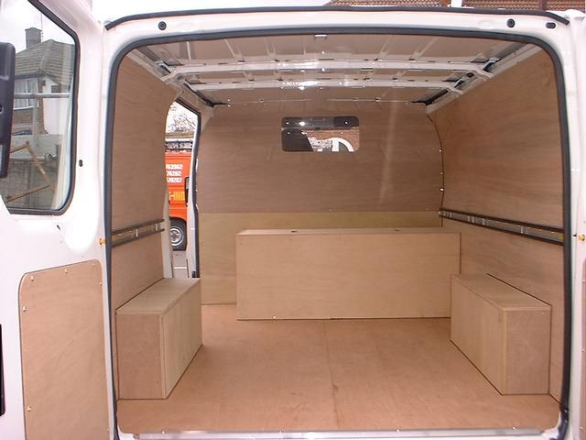
Cleaning after Unloading
If infectious, biological or GMMO substances are spilt in a vehicle, that vehicle cannot be reused until it has been cleaned and, if necessary, sterilized.
Any contaminated wooden parts must be removed and burnt !

Slide 65
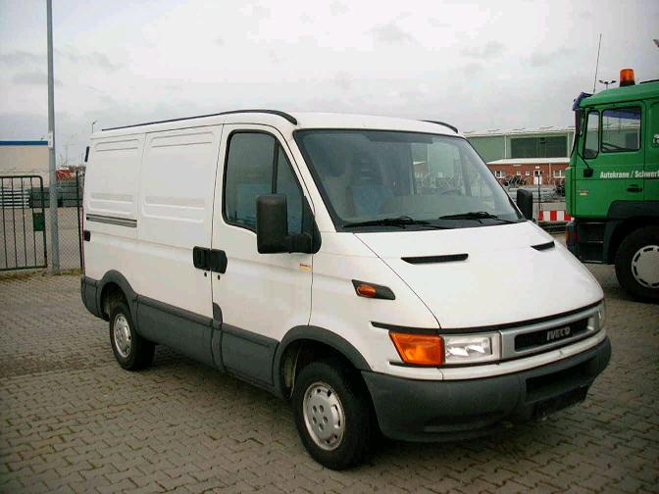
Vehicle Requirements

Slide 66

Bicycles/Motorbikes
The transport regulations do not apply where “carriage is not undertaken by a vehicle”.
The practical outcome is that the regulations do not apply to vehicles with:
Fewer than four wheels
A maximum design speed of 25 km/hour, or less

Slide 67
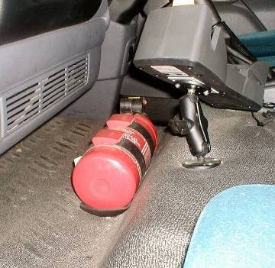
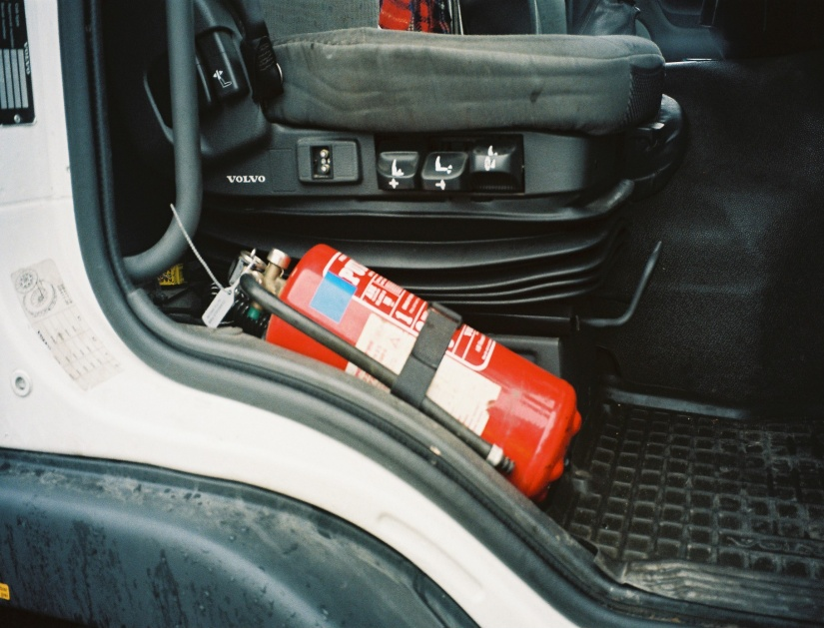
Fire Extinguishers
ALL vehicles transporting Dangerous Goods must have at least one 2kg size dry-powder extinguisher suitable for fighting a fire in the cab or engine compartment.

Slide 68
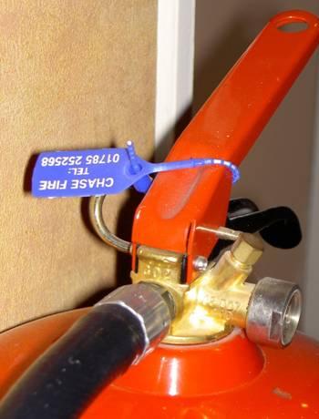
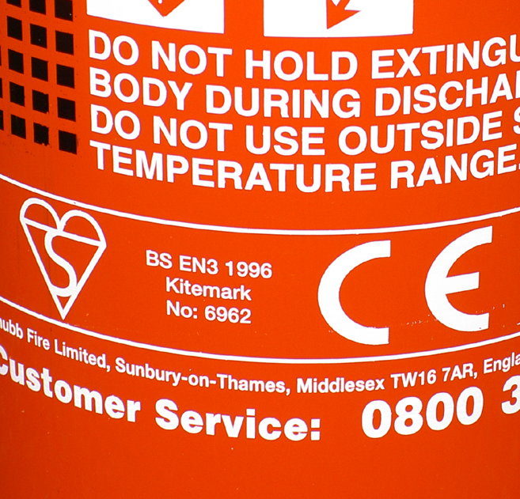
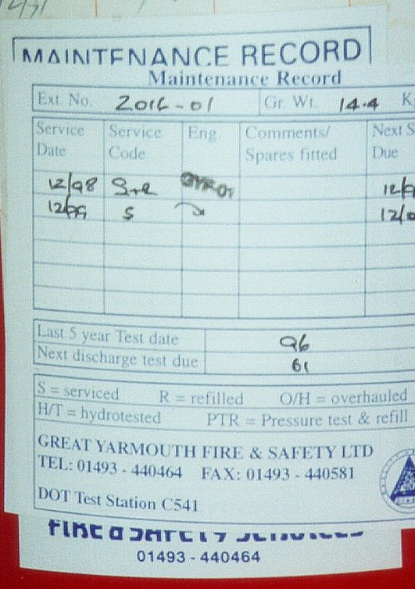
Fire Extinguishers
Seal
Mark of compliance
Date of next inspection

Slide 69
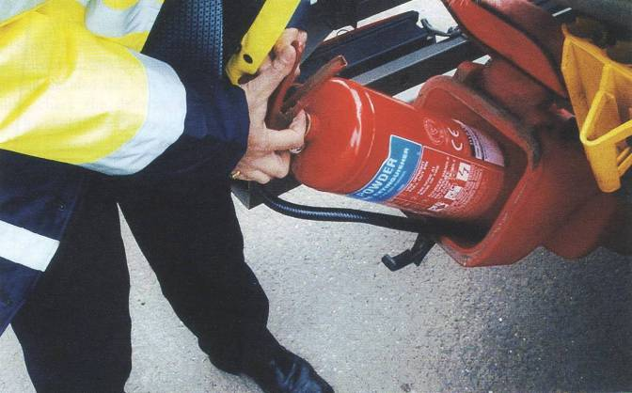
Fire Extinguishers
The driver has a duty to inspect (but not test !!!) the extinguishers daily.

Slide 70

Vehicle Markings
Unless you are a qualified ADR driver, carrying goods above the ADR limits, you must not display ANY warning diamonds or orange plates etc.
It is quite common to see work vans, etc, displaying hazard labels.
These are unnecessary, and can lead to an inappropriate response to accidents by the Emergency services.

Slide 71
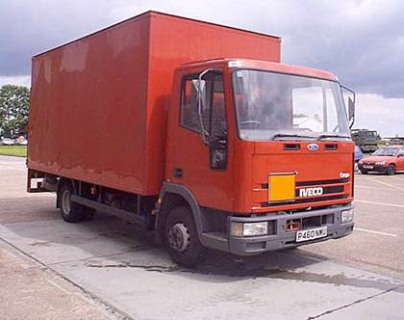
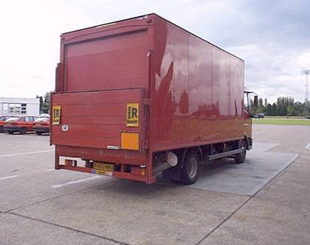
Vehicle Markings
A correctly marked vehicle for transporting packaged goods above the ADR load limits.

Slide 72
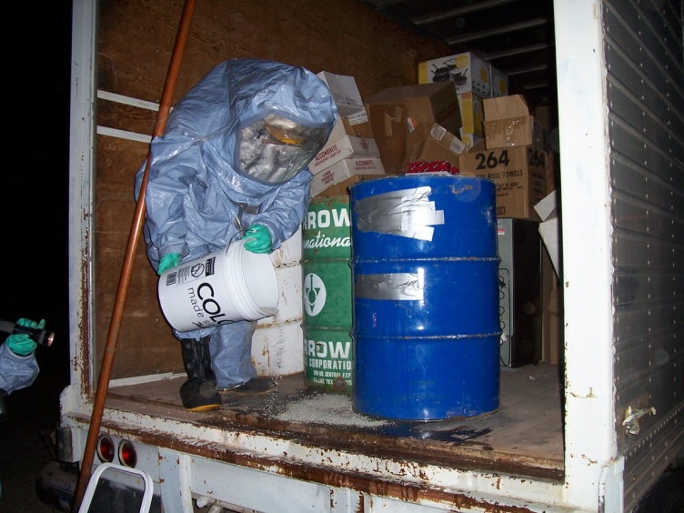
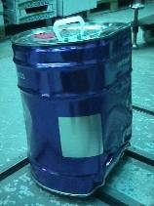
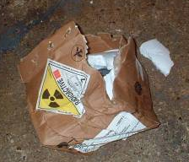
Vehicle Loading
The carriage rules apply from the point of loading until the vehicle is empty and risk free.
Check that the vehicle is fit to carry the goods. Ensure the bed is free of any previous spillages.
Do not accept anything that is leaking or appears damaged.

Slide 73
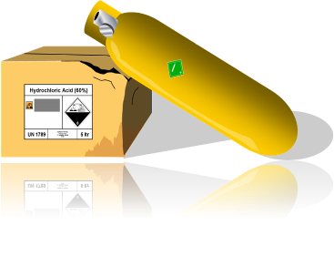

Vehicle Loading
Switch off the engine unless it is needed to power an item of loading equipment (Hi-Abs, pumps etc).
Protect fragile packages from damage.
Secure the load.

Slide 74
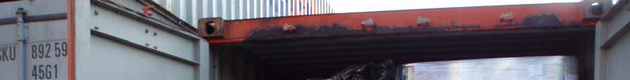

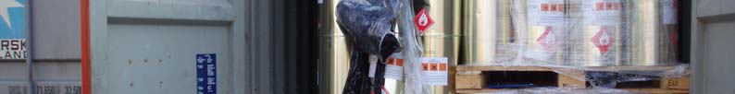




Slide 75






Slide 76



Slide 77





Slide 78

Vehicle Loading
NO SMOKING

Slide 79
Documentation
DANGEROUS GOODS TRANSPORT DOCUMENT
Consignor:
University of Nottingham, University Road, Nottingham, NG1 0XX
Consignee:
Biogen Laboratories, 5 Biogen Plaza, Oxford, OX4 3GD
UN 2814, Infectious substance affecting humans, 6.2, (E)
5 X Fibreboard boxes. Total weight = 1kg
In the event of an emergency, contact:
Dr Lancelot Spratt Tel: 0115 456789

Slide 80

Dangerous Goods Security

Slide 81

Security
Since the World Trade Centre attacks and the Madrid and London bombings, international anti-terrorist activity has increased considerably.
One potential risk identified is of the theft and misuse of Dangerous Goods during transport operations – 3500 HGV’s are stolen in the UK ever year.

Slide 82



Slide 83


Security
One of the University’s greatest vulnerabilities are goods being transported by pedestrians, or on public transport.

Slide 84


Security
Infectious Substance, affecting humans
UN 2814
Naturally, not all Dangerous Goods pose as great a risk of misuse, so a table of High Consequence Dangerous Goods has been drawn up of materials that could cause mass destruction or mass casualties.
IN THE EVENT OF AN EMERGENCY, CONTACT:
Dr Marvin Monroe
Southampton City Hospital
+44 (0)2380 702576
4G/CLASS 6.2/S/08
GB/Harrington-445

Slide 85
High Consequence Goods
Quantity
Class | Substances or articles | Tanks (L) | Bulk (kg) | Packages (kg)
2 | Flammable gases Toxic and corrosive gases | 3000 All | - - | - All
3 | Packing Groups I & II materials Desensitized explosives | 3000 - | - - | - All
4.1 | Desensitized explosives | - | - | All
4.2 | Packing Group I materials | 3000 | - | -
4.3 | Packing Group I materials | 3000 | - | -
5.1 | Packing Group I liquids Perchlorates and Ammonium Nitrates | 3000 3000 | - 3000 | - -
6.1 | Packing Group I materials | All | - | All
6.2 | Category A infectious substances | - | All | All
8 | Packing Group I materials | 3000 | - | -

Slide 86



High Consequence Goods
Transport companies involved with these High Consequence Dangerous Goods must implement extra security procedures as part of their Security Plan.

Slide 87


Slide 88


Slide 89
?
?
?
?
?
?
?
?
?
?
?
?
?
Any Questions
?
?
?
?
?
?
?
?
?
© 2012 RoadSafe Europe Limited

Slide 90

© 2012 RoadSafe Europe Limited
Unit 006, Solent Business Centre, Millbrook Road West, Southampton, Hampshire, SO15 0HW www.roadsafeeurope.com

