Slide 1
Leading and Managing Health and Safety The Risk from Unknown Knowns.
New guidance for creating a successful health and safety culture; and
Increased penalties for failing to provide a safe environment.
Notes:
New sentencing guidelines for health and safety offences and corporate manslaughter (applicable from February 2016) bring a fundamental change in the approach to enforcement and highlight the economic risk in failing to provide a safe environment. This coincided with the publishing of UCEA sector guidance on leading and managing health and safety which describes the broad principles and practices to be applied in order to demonstrate good safety management, in effect establishing a culture to secure a safe environment.
The risk arises from not knowing or doing what should have been known or done, hence falling short of the standard.

Slide 2
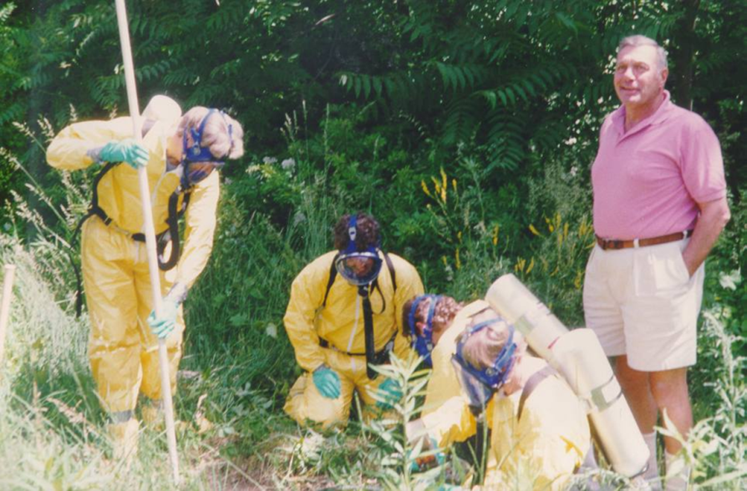
Outline
New Sentencing Guidelines
UCEA Code of Practice
Developing H&S Management
People Strategy
Health and safety performance indicators
Challenges and Incidents
Significant near miss examples
HSE review in a research facility
Notes:
These slides summarise:
some aspects of the new sentencing guidelines;
the HE Sector Code of Practice for Leading and Managing Health and Safety;
the University’s health and safety management arrangements;
work to further develop leadership and management of this in support of the People Strategy that supports University Strategy 2020, and
recent examples that highlight how a serious breach could arise and the evidence that could be required to demonstrate effective management arrangements.

Slide 3
New sentencing guidelines for health and safety offences
Sentencing Guidelines
Sentencing Council Website
1st February 2016
Determine Offence Category
Culpability
Harm
Size/Wealth of Organisation
Mitigating/Aggravating Factors
Notes:
New sentencing guidelines for corporate manslaughter, health and safety and food safety
From 1 February 2016 new sentencing guidelines for judges and magistrates on corporate manslaughter and food safety and hygiene offences come into effect. The new guidelines will apply to cases heard on or after that date, irrespective of when the offence was committed.
The offences covered range from a death of an employee by not providing the proper equipment for working at height to being misled about a food’s compliance with religious or personal beliefs.
Published by the Sentencing Council on 3 November 2015, the guidelines include key changes for organisations and individuals, as well as corporate manslaughter. This will mean that employers now face significant personal and financial implications if found to be in breach of Health and Safety regulations.
Organisations have been grouped into five categories: micro, small, medium, large and very large according to their annual turnover. A large organisation with a turnover of over £50m could face fines of up to £10m for serious health and safety offences. In addition to this individual managers/directors could face up to two years in prison in the most serious cases, if found to be personally liable.
In determining the level of fines to be imposed under the new guidelines courts would be required to assess ‘culpability’ and ‘harm’, cross-referencing this against the size and turnover of the organisation. For corporate manslaughter sentencing, the courts would not be required to consider ‘harm’ as all prosecutions would follow a fatality.
Details of the new guidelines can be found on the Sentencing Council’s website. https://www.sentencingcouncil.org.uk/news/item/sentencing-council-launches-new-definitive-guideline-for-health-and-safety-offences-corporate-manslaughter-and-food-safety-and-hygiene-offences/

Slide 4
Culpability
Sentencing Guidelines
Very High
Deliberate breach or flagrant disregard of the law
High
Far below appropriate standard
Not remedying recognised problems
Serious or systematic failings
Medium
Between high and low
Fell below appropriate standard,
Systems in place but not adequately implemented.
Low
Did not fall far short of appropriate standard
Notes:
There are descriptors for the 4 levels of culpability that form one of the considerations to be used by the courts in setting an appropriate penalty. Whilst the “Very High” level could be considered to relate to rogue operators that deliberately ignore health and safety standards for expedience or profit, the other three levels represent a spectrum of varying degrees of deficiencies in safety management systems that could arise in an organisation that otherwise does not deliberately intend to be non-compliant with legal requirements.

Slide 5
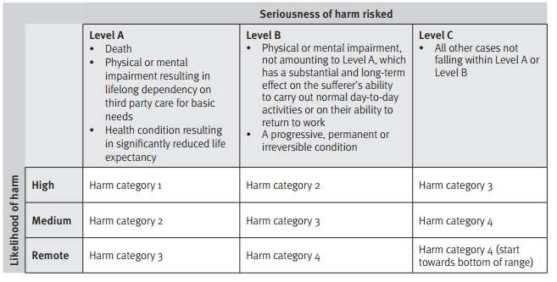
Harm Categorised according to severity and likelihood: - Death or life limiting (Level A) - Significant long term impact of life quality (Level B) - Other cases (Level C)
Sentencing Guidelines
Notes:
A matrix is used to assign a harm category based on the severity of the harm caused, or that could have been caused, and the likelihood of it arising.

Slide 6
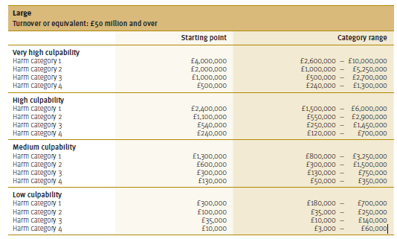
Penalties
Sentencing Guidelines
Large Organisation – Income >£50m
Very Large - proportionate adjustment possible
Culpability
Medium - systems not adequately implemented
Harm-
Significant long-term condition
Medium likelihood
Harm Category 3
Notes:
The final stage is to consider the culpability and harm in the context of the size and wealth of the organisation. The guidelines identify 4 levels of organisations. Large Organisations are at the upper specified threshold. Thresholds typically increases at factors of 5, consequently unspecified provision is made for further adjustments beyond this for very large organisations, which one might speculate could apply above £250m.
The example above represents a mid range type of incident. A scenario might be permanent debilitating respiratory damage arising from inhalation of hazardous substances arising from a failure to properly identify the hazard of the process, provide effective controls and/or maintain the controls.
Actions of senior managers which could lead to prosecution of University and/or individuals include:
running unacceptable safety risks to save money
sanctioning or promoting unsafe working practices
approving inadequate method statements or risk assessments
failure to perform individual and collective responsibilities diligently
failure to hold those with responsibility to account
failing to close out non-compliances

Slide 7
Individuals
Sentencing Guidelines
Culpability and Harm
Deliberate or fragrant disregard
Foresight of or wilful blindness of the risk
Scenario
Cavalier approach to risk assessment or controls that places others at risk
Act or omission short of reasonable care
Minimal fault
Significant efforts but controls inadequate
No warning/indication
Minor isolated failings
Fines or Imprisonment
Notes:
Individuals, as well as organisations, are included in the new sentencing guidelines. Again there are escalating levels depending on harm and culpability criteria. The two most serious categories would probably be considered as reckless actions or worse. The lesser two categories could probably be considered as careless or ill-thought out.
Legal H&S duties for individuals are:
Duty of employees: to take reasonable care of self and others affected by work (Health and Safety at Work etc Act 1974; s.7), and/or
Liability of directors and senior managers: Where an offence… has been committed with the consent, connivance, or…attributable to any neglect on the part of any director, manager … or a person who purports to act in that capacity, he/she as well as the company shall be guilty of that offence (HSWA s.37).
Courts have decided that:
Intention was to fix liability only on those in a position of real authority;
Decision makers who had power and responsibility to decide corporate policy and strategy;
Not meant to strike at “underlings”!
Prosecutors & investigators treat this as a flexible term

Slide 8
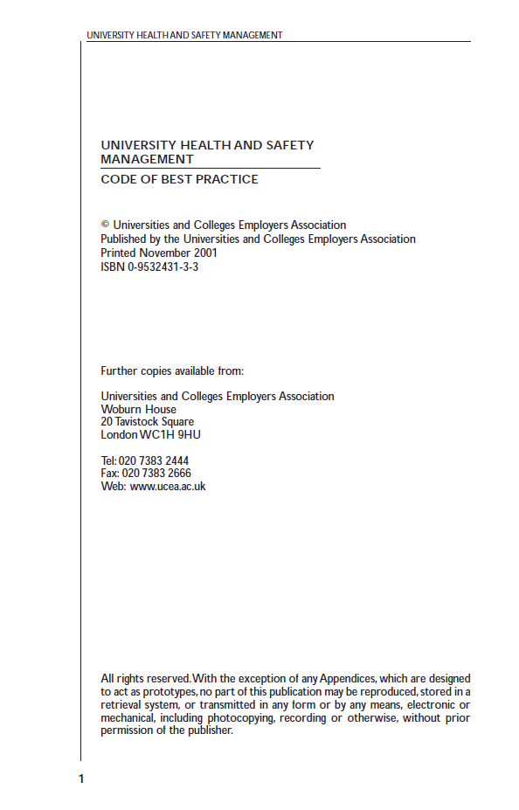
UCEA/USHA Code
LEADERSHIP & MANAGEMENT OF H&S in HEIs
Notes:
There have been a number of codes of practice relating to health and safety management for the sector. These have evolved over time as legislation and standards relating to corporate governance have evolved. The UCEA/USHA code is the latest version and was published in October 2015.

Slide 9
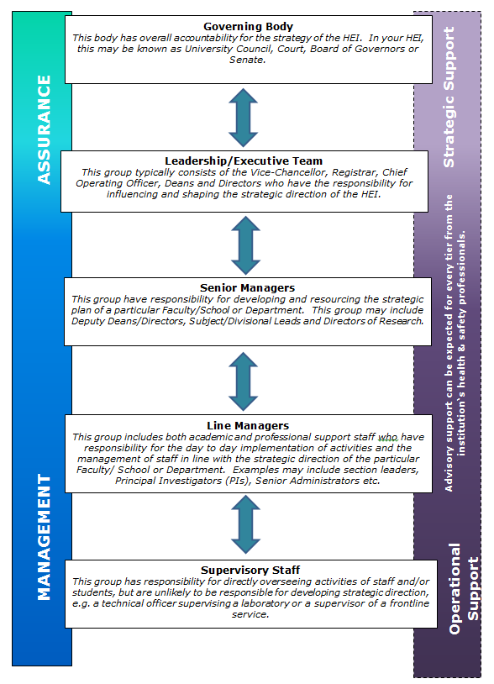
UCEA/USHA Code
Five tiers of management:
Council
University Executive Board
Senior Mangers:
Heads of School/Divisions
Directors of Professional Services[PS]
Senior Academics/ Principal Investigators/ PS Mangers
Laboratory/ Technical Supervisors/managers and
service supervisors
Notes:
The code outlines responsibilities and behaviours to 5 tiers of management, progressing from operational management to strategic oversight. There is a two page section devoted to each level covering indicative actions relating to the Plan, Do, Check and Review cycle. It includes links to further resources and the role of central H&S services in supporting this.
See next slide.

Slide 10
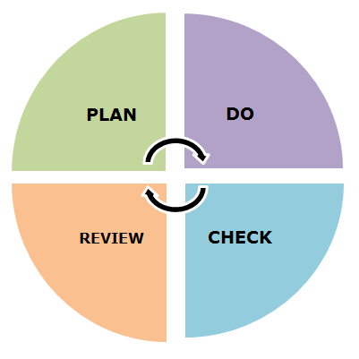
UCEA Code of Practice
H&S Management
Descriptors against each tier of
management for:
behaviours,
actions and
processes
Indicative features for advice and support from central H&S resource
Key Themes
Support and promote a positive H&S culture
Embed H&S as a core value and management process
Understanding the risk profile
H&S Risk Register
Performance Indicators
Notes:
The aim of the UCEA Code is to embed health and safety into the normal day to day routine of the way people work and the business operates. It will be used as a benchmark standard by regulators and the courts when assessing the effectiveness of health and safety risk management systems. Evidence to demonstrate how the principles are applied will be sought.

Slide 11
Core UoN Processes
Safety Policy and organisation
Commitment by HoS and SMT
Recognition in PDPR process for key H&S roles
Health and Safety Plan
Reflects risk profile
Routine and dynamic
New projects /equipment – H&S implications.
Risk assessment
Systems in place to ensure effective.
Training and competency
Induction training delivered
Training needs identified & delivered
Recording competence and robust storage of records
Appropriately supervised.
Monitoring Processes – proactive and reactive.
Notes:
These organisational arrangements and processes represent key management actions at University management unit level as defined in the University’s Effective Safety Management standard. Key indicators are as follows:
The local Safety Policy and arrangements are in place and up to date.
Organisation - Safety Committee (or agenda item at other forums such as staff meetings for small or low risk units)
Chaired by HoS or senior member of SMT
Terms of Reference & appropriately constituted
Includes staff/student/Trade Union reps (where available)/managers
Produce Annual Safety Plan
Routine and dynamic - template available from Safety Office;
Includes things that need to be done at regular intervals and the implications from changes, be they physical (new processes or facilities) or organisational.
Risk assessment – there are systems in place to ensure
All activities assessed and controls in place
Identification of key H&S risks, their control measures and how these can be regularly checked, in effect a risk register for key H&S risks with KPIs against them.
Findings communicated to workers and evidence for this.
Regular review – are the documents readily accessible, e.g. on a workspace or shared drive?
Workers trained & competent – systems in place to ensure
Induction training delivered
Training needs identified & delivered
Recording competence and robust and accessible storage of records, e.g. on a workspace or shared drive?
Appropriately supervised.
New projects /equipment – assess impact on H&S and H&S requirements
There are a number of local monitoring processes that management units are expected to implement. The mix and intensity will vary according to the size, complexity and risk profile of the unit.
Local Audits and Inspections -
Annual programme
Checks of critical control measures for higher risk processes. This creates a set of KPIs for key risks.
Check a representative sample of risk assessments and training records as part of audit
Report findings to H&S Committee
Local Housekeeping checks
Reviewed
Identify trends
Implement corrective actions
Accidents /incidents
Effectively investigated and closed out,
Reviewed,
Analysed to identify any trends,
Reported for review by H&S Committee
The Safety Office monitors performance through annual health and safety reports that have structured questions to confirm arrangements and compliance against organisational arrangements, control processes and monitoring arrangements. The Safety Office health and safety review programme is a light touch review of elements within this, for example risk assessment processes or demonstrating training and competency, or more generally a coherent safety management system.
The Safety Office also monitors performance and standards through specific risk review programmes, such as:
Fire safety
Radiation management
Biological safety
Laser safety
Statutory inspections – pressure systems and lifting equipment.
The Safety Office supports local health and safety committees, either routinely or by specific request. It also monitors and investigates incidents and provides advice to support new or changed processes, facilities or technologies.

Slide 12
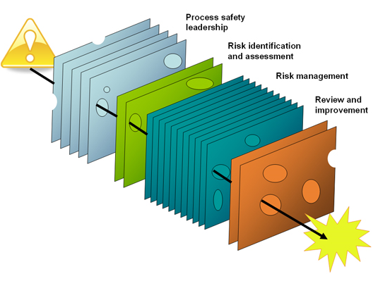
Multi-layered Defences
Organisation
Risk assessment
Physical safety
Procedural safety
Competence
Monitoring
Review and improvement process
Notes:
The health and safety management system can be compared to Swiss cheese. There are many layers of control and processes that should ensure that if one or two layers have gaps then there are other systems that will capture the failure before it results in harm and feedback will then try to close of the gaps.

Slide 13
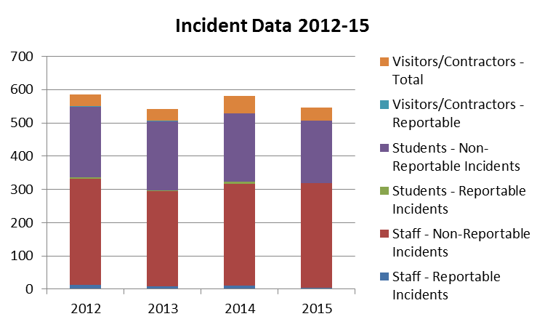
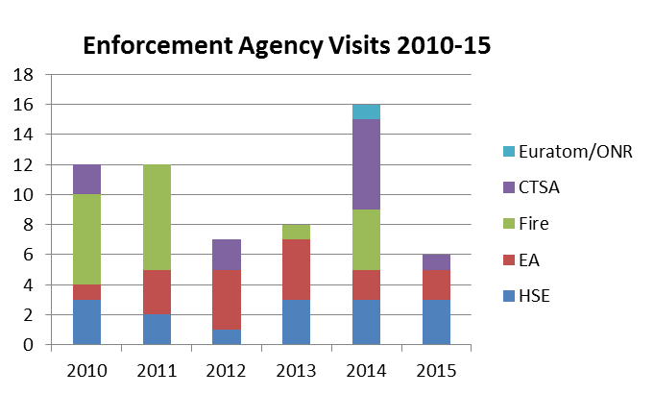
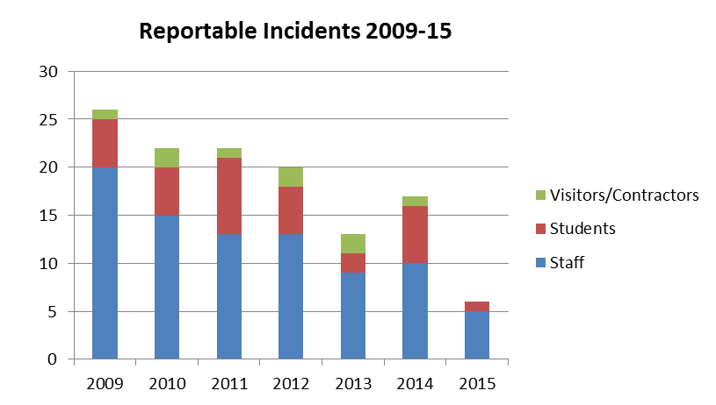
Performance Indicators
Notes:
Incident data for staff and student, adjusted for the number of incidents per 1000 staff/students, shows progressive reduction over time such that the incidence is approximately 1/3rd of that recorded in 2000. This mirrors a general improving trend across the HE sector.
The University is also regularly audited by a range of regulatory agencies. These can be as part of their own routine compliance monitoring programme or in response to an incident. The agencies include:
Health and Safety Executive
Environment Agency
Fire Brigade
Police Counter-terrorism Security Advisor (high risk chemicals, biological agents and radiation sources)
Euratom
Office for Nuclear Regulation
Non-regulatory reviews are also carried out by the University’s insurers and some commercial third parties such as courier companies handing hazardous packages consigned by the University. Suppliers and funding bodies can also seek assurance on health and safety management systems.

Slide 14
HSE Investigation Risk Assessment, SOPs, Training and Supervision
HSE Investigation
Adequacy of risk assessments etc
Demonstration of competence
Induction
Building
Labs
Equipment/Processes
Awareness of risk assessments & SOPs
Records made and available
Supervision
H&S included? Records of meetings
Risk Assessment
Safe Operating Procedure
Training
(Recorded)
Actions
Robust process to cover absence of key trainer.
Accessibility of records
shared resource – shared drive or workspace
personal training records also held in locally.
Notes:
A critical control process is the cycle of risk assessment for the work, operation instructions or method statement for safe working and training of those doing the work against these. Can this be evidenced by a document trail? It is one of the main things a regulator will check.
The University provides facilities, equipment and substances that will be used in a variety of ways, often changing as the work evolves. A key control therefore is the knowledge, skill and diligence of the researcher in understanding the inter-relationship of the components that are being used and the impact of changes to the process or equipment, e.g.
varying the reaction mixture, conditions or scaling up.; or
altering the configuration or operation conditions of an experimental rig.

Slide 15
Challenges
Change
Step or drift
Project evolution
Process/equipment change
Personnel changes
Restructuring
Unallocated responsibility for core process
Familiarity/Training
Authority
Consistency
Approach across different sections/research groups
Closing of actions
Notes:
Consistent standards would include approach to risk assessment, operating procedures, training and monitoring standards. Develop the best practice examples from within the management unit.
The following two slides illustrate circumstances that could give rise to unsafe conditions.

Slide 16
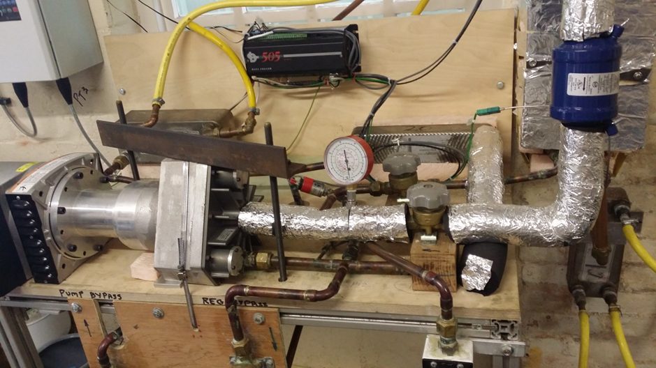
Component failure - no injury near miss.
System using heat and pressure.
Following a system modification a component failed and disintegrated.
Metal pieces energetically ejected, missing the research student.
Adequate:
Risk assessment?
Operating procedures?
Training?
Supervisor aware of the changes?
Notes:
An experimental rig that uses heat and pressure to drive a number of components to generate data on the effect of varying the conditions. The researcher, for example a mid-term PhD student, alters the configuration by introducing an extra component into the system. This changes the behaviour of the system causing one of the components to be driven beyond its service specification resulting in an energetic disintegration and metals casing fragments to be propelled around the laboratory. Should anyone be hit by one of these then serious injury might occur. Safety management considerations would include:
The adequacy of the risk assessment. Was there one; is it current; did it cover changes to the rig; was the student knowledgeable of it?
What training did the student receive? General safety rules and procedures, operation of the rig and any processes to go through to alter it?
What supervision was in place? Was the supervisor aware of how the work was progressing, the competency of the student, and of any proposals to change the rig configuration?
What evidence is available to confirm the above processes were in place? The records should be readily accessible and up to date – a shared drive or works[ace could be used for this. Can the supervisor evidence that regular progress reviews were being carried out and the safety was discussed where relevant?

Slide 17
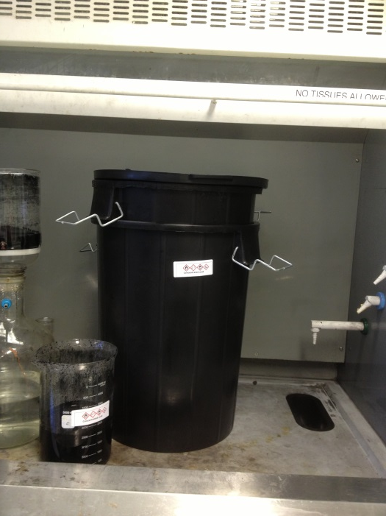
Exposure to acid fumes
Acid treatment of powders
Concentrated sulphuric acid and hydrogen peroxide
Process scale up to 20 litres.
Exothermic reaction liberating copious acid fumes.
Fume cupboard overwhelmed
Laboratory and adjacent areas evacuated.
Several people exposed.
Relied on original small scale process and risk assessment.
Notes:
The project involves chemical treatment of powder to alter the surface properties. The process has been developed using small quantities of the reagents – a few hundred ml. Having proven the process the researcher then decides to do a larger production batch scaling by a factor of 20+.
The reaction is exothermic but at low volumes heat generation and dissipation was not significant. However when scaled up the process became very hot and liberated a large quantity of acid fumes that the fume cupboard could not contain and caused the lab to be evacuated with minor exposure to some occupants. The release of fumes might have the potential for causing ill-health effects, particularly if anyone exposed had a respiratory sensitivity.
Safety management considerations would be similar to the previous example and include:
The adequacy of the risk assessment. Was there one; is it current; did it cover consider the scaling up of the process; was the researcher familiar with it?
What training did the researcher receive? General safety rules and procedures, including the need to consult on scaling up of the process?
What supervision was in place? Was the supervisor aware of how the work was progressing, the competency of the researcher, and of any proposals to increase the scale of the work?
What evidence is available to confirm the above processes were in place? The records should be readily accessible and up to date – a shared drive or works[ace could be used for this. Can the supervisor evidence that regular progress reviews were being carried out and the safety was discussed where relevant?

Slide 18
Next Steps
People Strategy - Leadership Strand
Integrate UCEA/USHA Code into a leadership and competency framework being developed .
Develop training and development strategy to support this.
Working with Faculty PVCs and Strategy Boards
Supporting the new faculty structures via FPVCs and Strategy Boards.
Provision of H&S KPIs and development of Faculty H&S strategies.
H&S Performance Indicators for the Faculties - summary information:
Annual H&S Reports
Significant themes from H&S Reviews
Significant themes Fire Risk Assessments
Regulatory visits to the schools within the faculty
Incident and fire statistics across the faculty.
Statutory Inspection Registers
Notes:
The People Strategy supports Strategy 2020. The Leadership strand within this is enables incorporation of aspects of the UCEA/USHA code into general leadership behaviours and competencies.
Effective Safety Management will require review to ensure alignment with the code and will incorporate the outputs from the leadership strand of the People Strategy.
There is also work commencing to support FPVCS with meaningful H&S KPI data and identify local risk registers and relevant KPIs. This will be an evolving programme.

Slide 19
“Rumsfeld Matrix”
Prudent Measures | Compliant
Reasonable assumptions - first principles | Unknown Known
Is:
what should be known known,
what should be done done?
What was known
What should have been known
Notes:
The greater weight of the new sentencing guidelines is likely to fall where the knowledge and actions brought to a set of circumstances fell short of what is widely known and accepted to be applicable for that situation, i.e. what should have been known was not known (or done).
With apologies to Donald Rumsfeld. The Risk from Known Unknowns. United States Secretary of Defense, Donald Rumsfeld, responded to a question at a U.S. Department of Defense news briefing on 12 February 2002 about the lack of evidence linking the government of Iraq with the supply of weapons of mass destruction to terrorist groups.
Rumsfeld stated:
Reports that say that something hasn't happened are always interesting to me, because as we know, there are known knowns; there are things we know we know. We also know there are known unknowns; that is to say we know there are some things we do not know. But there are also unknown unknowns – the ones we don't know we don't know. And if one looks throughout the history of our country and other free countries, it is the latter category that tend to be the difficult ones.
These terms were used in evidence given to the British Columbia Royal Commission of Inquiry into Uranium Mining in 1979:
Site conditions always pose unknowns, or uncertainties, which may become known during construction or operation to the detriment of the facility and possibly lead to damage of the environment or endanger public health and safety. The risk posed by unknowns is somewhat dependent on the nature of the unknown relative to past experience. This has led me classify unknowns into one of the following two types: 1. known unknowns (expected or foreseeable conditions), which can be reasonably anticipated but not quantified based on past experience as exemplified by case histories (in Appendix A and 2). Unknown unknowns (unexpected or unforeseeable conditions), which pose a potentially greater risk simply because they cannot be anticipated based on past experience or investigation. Known unknowns result from phenomena which are recognized, but poorly understood. On the other hand, unknown unknowns are phenomena which cannot be expected because there has been no prior experience or theoretical basis for expecting the phenomena. Known unknowns are the concern for risk management and compliance/reputation.

